Slide 1



Guide to Student Registration
LAS Links Online

Slide 2
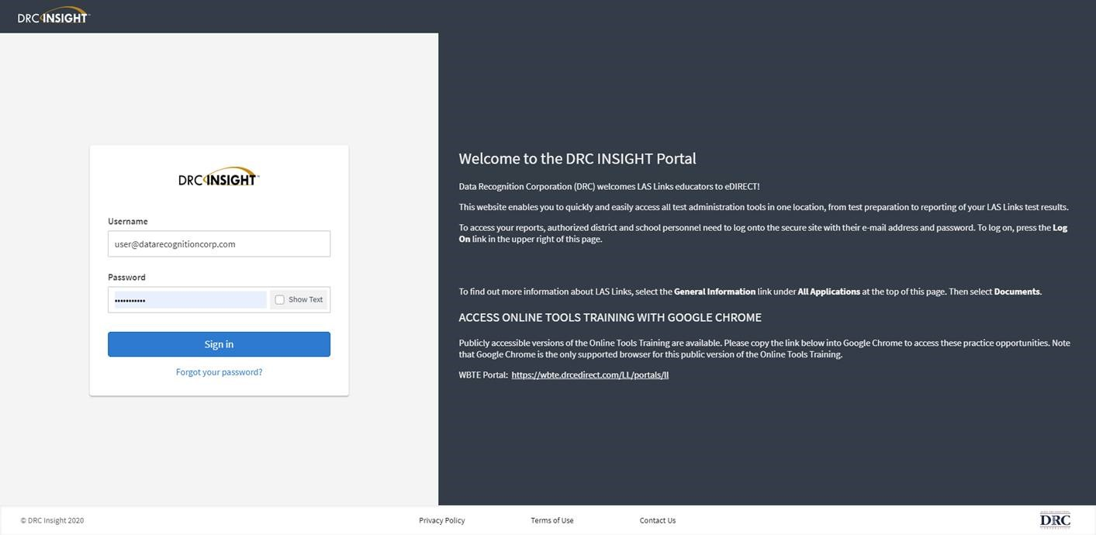
Access the DRC INSIGHT Portal
www.drcedirect.com
Notes:
Use the INSIGHT portal for Test Administrative functions such as rostering students, creating test sessions, scoring student responses and for On-Demand reporting.

Slide 3
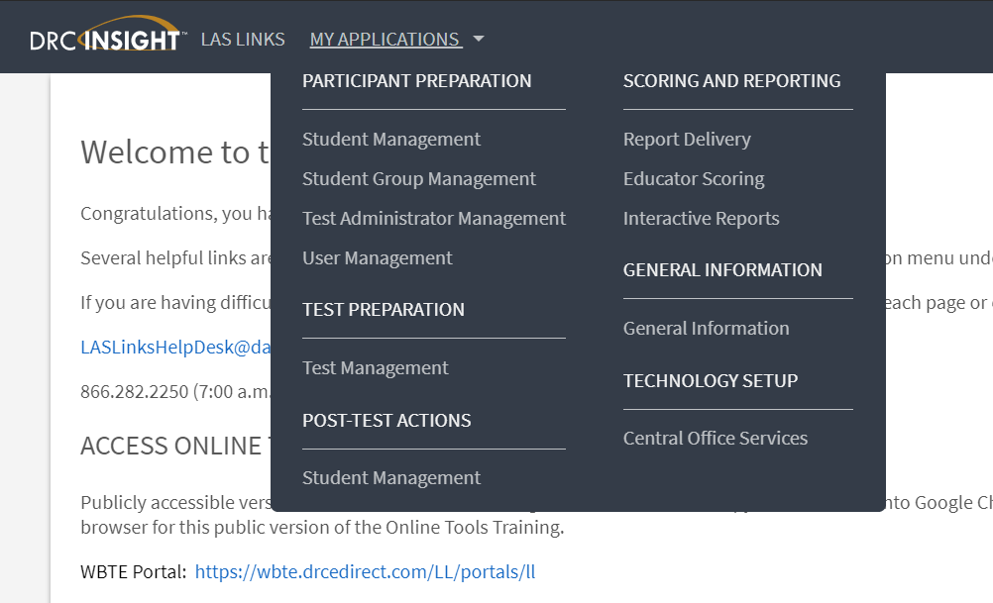
Student Management
Adding Students
Notes:
From the My Applications Menu, choose the “Student Management” application. This will redirect the page to the Student Management page.

Slide 4
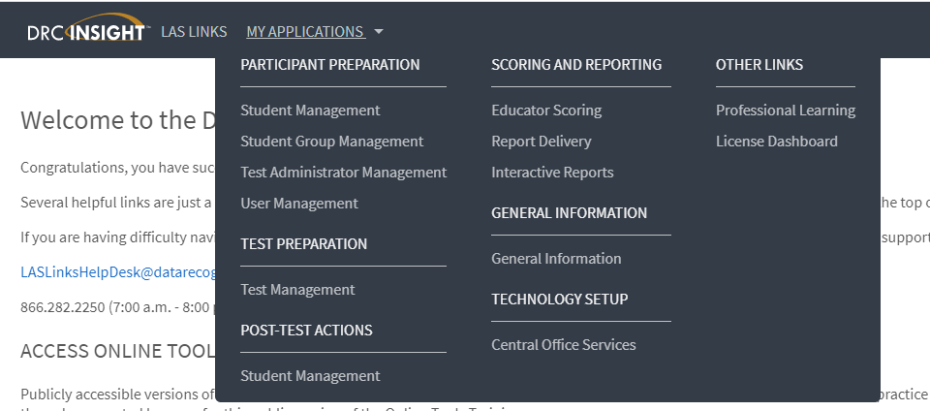
Student Management
Adding Students
Notes:
From the My Applications Menu, choose the “Student Management” application. This will redirect the page to the Student Management page.

Slide 5
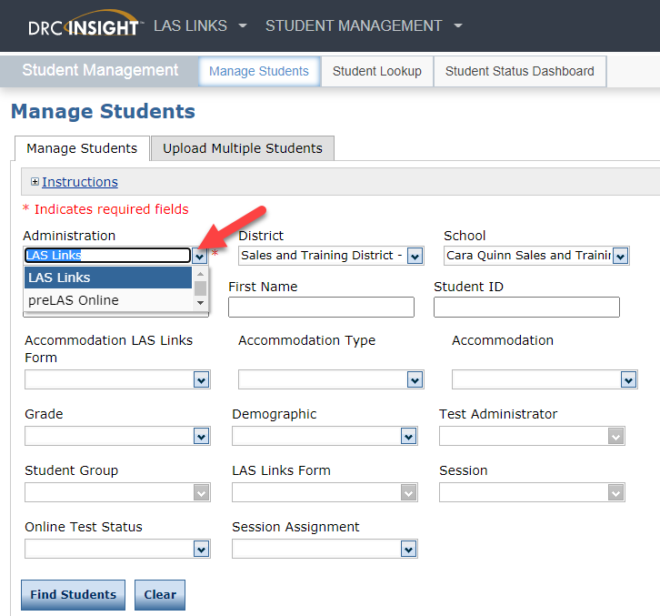
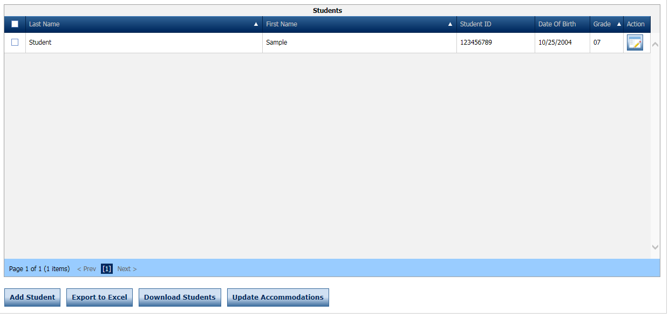
Add a Student
Choose the administration – will default to LAS Links if you have not purchased preLAS Online
Choose the District and School
Click Add Student at the bottom of the screen
Notes:
To add a single student, from the Manage Students page, once you have picked the District and School to add the student to, click on the Add Student button at the bottom of the page. A new window will then appear.

Slide 6
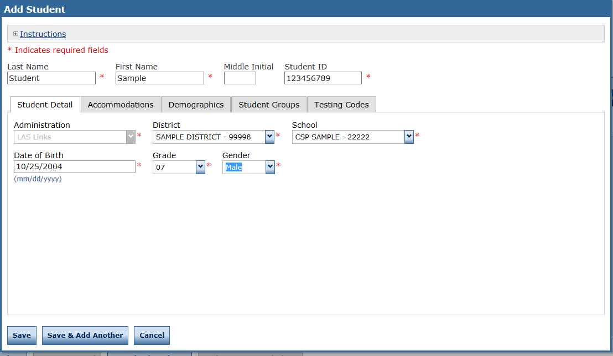
Add a Student
Any cell with an asterisk* next to it is required student information.
If you do not have a student ID number established by the time you are testing the student, one recommendation is to enter a temporary ID number and once the student ID is available, find the student, click edit and update the student ID. Student IDs must be unique throughout your district therefore a suggested temporary ID would be “temp01[schoolname]”
Notes:
Enter the student’s Last Name, First Name, Middle Initial (if known) and the Student ID#, Date of Birth, Grade and Gender. Please note that the required fields are marked by a red asterisk *. Click Save to go back to the manage students page or click save and add another to add another student right away.

Slide 7
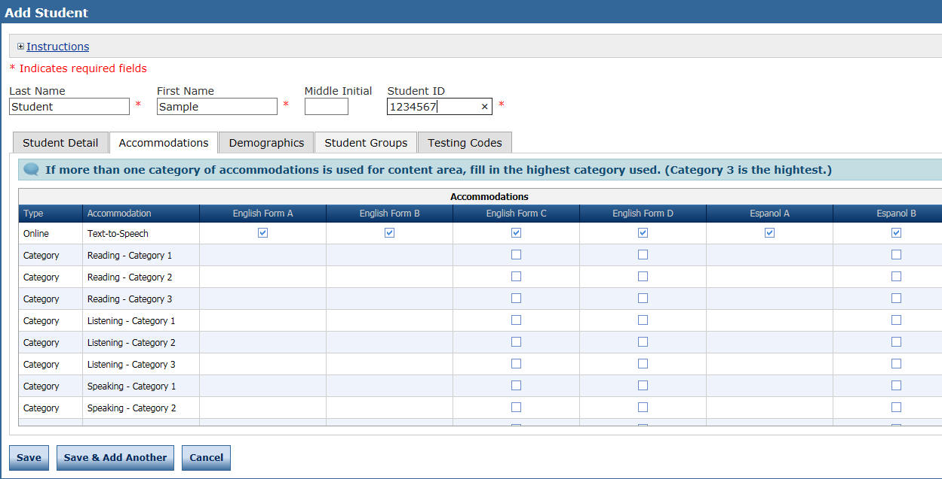
Add a Student
Accommodations
Notes:
There are additional tabs that the additional optional tabs available to capture “Accommodations”, “Demographics”, “Student Groups” and “Testing Codes”. Testing Codes, while showing, is not active for LAS Links. Let’s start with the Accommodations Tab.
Accommodations – Please consult your LAS Links Examiner’s Guide for Accommodation Definitions. This area is available for you to track the accommodations you provide your student. The Text to Speech (TTS) accommodation is the only accommodation that will change the way the assessment is presented to the student in the online test. TTS provides all written prompts and answer choices in the Reading and Writing assessments in a verbal/audio format.
Demographics – Demographic data can be stored for each student in this area of the application. Best use of this area is to capture demographics across all of your students or none. If you do capture this data in this area, you will be able to sort your data by demo in the Reporting Tool after testing is complete.
Once you have completed entering the data on the student, click SAVE or SAVE and ADD if you’d like to enter another student.
Accommodations – A feature included in LAS Links Online as an accommodation is Text to Speech. If you would like to activate this accommodation, click on the corresponding Form(s) of LAS Links that you will be using and Text-to-Speech will then be delivered to this particular student.

Slide 8
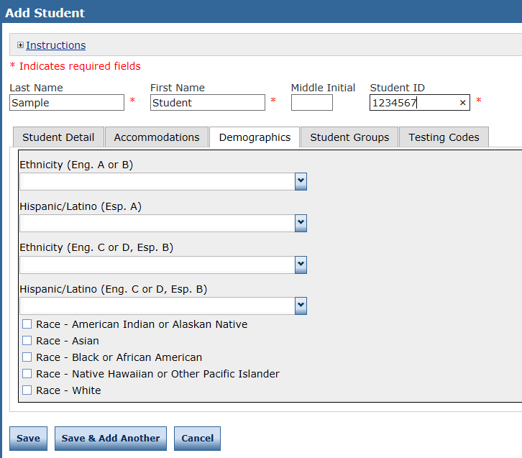
Student Management
Adding Demographics
Notes:
Indicate the student demographics by clicking on the Demographics tab. Please note the LAS Links form(s) listed with the particular demographic field. If you are using Eng C or D or Esp B and you choose Ethnicity for Eng A or B, the data will not be reported with that test administration.
Please note, student demographic data will only be included in reporting when you add this information to the INSIGHT portal.

Slide 9
Student Management
Adding Demographics
Please note, student demographic data will only be included in Interactive Reporting (an additional purchase), not the OnDemand report, when you add this information to the INSIGHT portal.
Notes:
Indicate the student demographics by clicking on the Demographics tab. Please note the LAS Links form(s) listed with the particular demographic field. If you are using Eng C or D or Esp B and you choose Ethnicity for Eng A or B, the data will not be reported with that test administration.
Please note, student demographic data will only be included in Interactive Reporting (an additional purchase), not the OnDemand report, when you add this information to the INSIGHT portal.

Slide 10
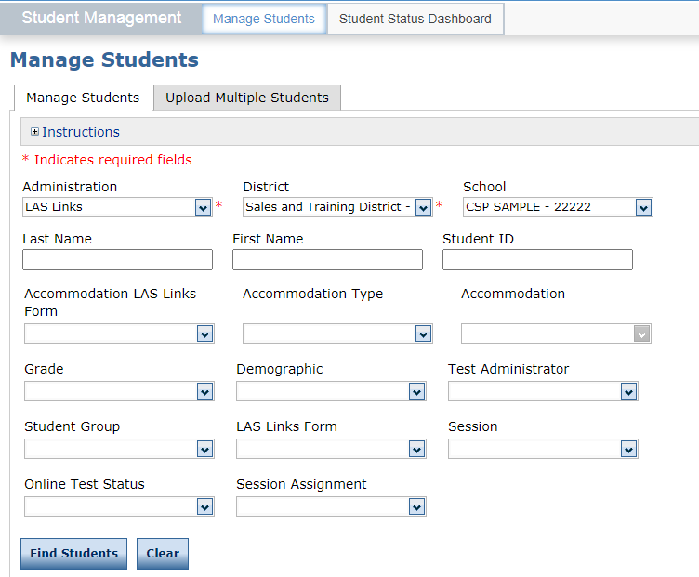
Student Management:
Uploading Multiple Students
Click My Applications >> Manage Students.
Click the Upload Multiple Students tab.
Download the File Layout PDF and the Sample File (CSV Text File).
Notes:
Users may load multiple students using an upload file. The file has a specific lay-out, and the upload data file must be in CSV format. Notice that the File Lay-out is accessed here, and the Sample File, which is already in CSV format can be opened here. After opening it, you can add your students after deleting the sample student—but be sure to keep the headings in place.—and save your file on your desktop so you can browse for it from this window. Once you see the file title in the File Field, you will click on Upload.

Slide 11
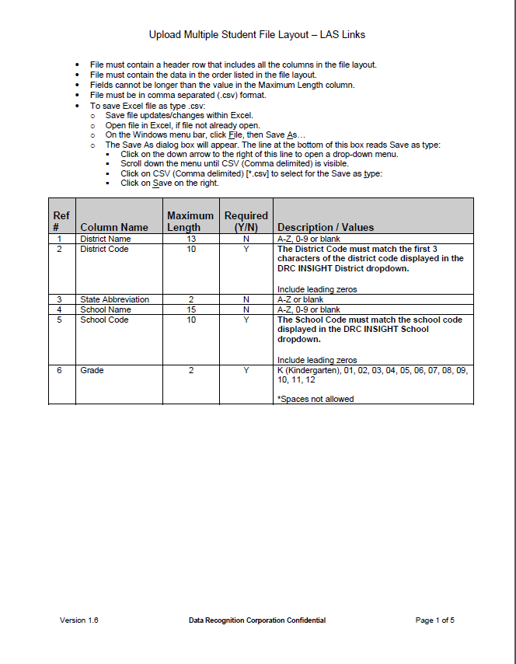
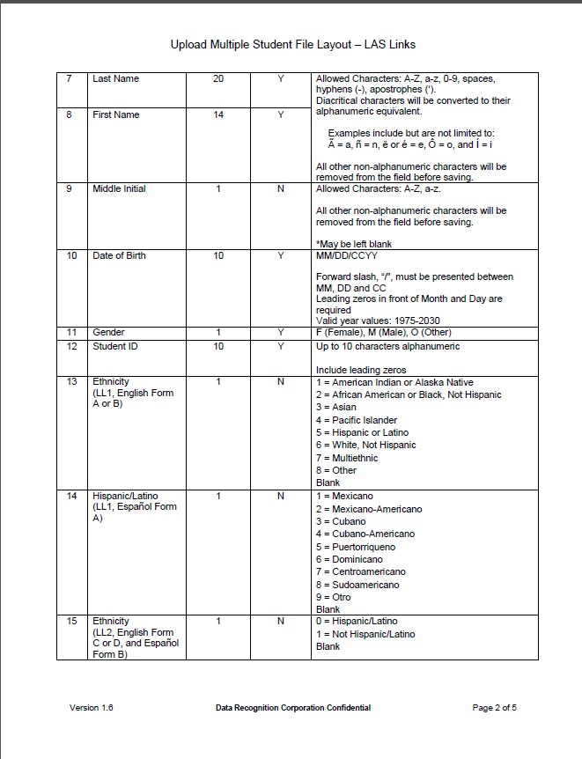
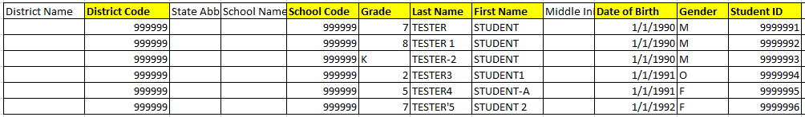
Student Management:
Multiple Student Upload (MSU)
Use the File Layout PDF to guide you on file requirements.
Delete the sample data in the first 6 rows;
Required cells are highlighted in screenshot below;
DO NOT change the header row – INSIGHT will not accept your file if you change the header row
Once data is inserted, save as a .CSV file – INSIGHT will not accept your file if it is not a .CSV file.

Slide 12
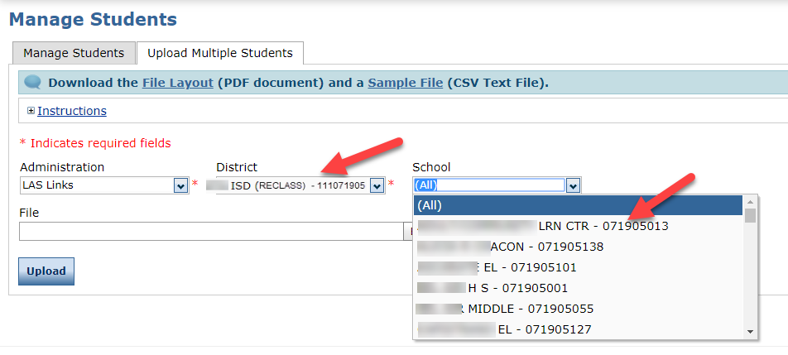
Student Management:
Multiple Student Upload (MSU)
Insert your District Code and School Codes in the corresponding columns. District and School codes can be found by clicking on the District and School drop down buttons in INSIGHT
District and School codes are found in the drop down menu(s)

Slide 13
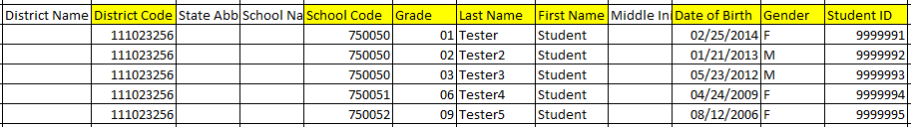
Student Management:
Multiple Student Upload (MSU)
Highlighted cells (below) indicate required fields;
District Code and School Codes are found in the drop down menu(s) in INSIGHT;
Grade must be two digits: 01, 02, 03….;
Date of Birth must be in the mm/dd/yyyy format (see next slide to see how to format the cells correctly)
Student ID must be unique to your LEA/District.

Slide 14
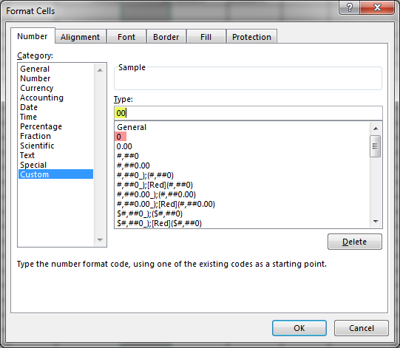
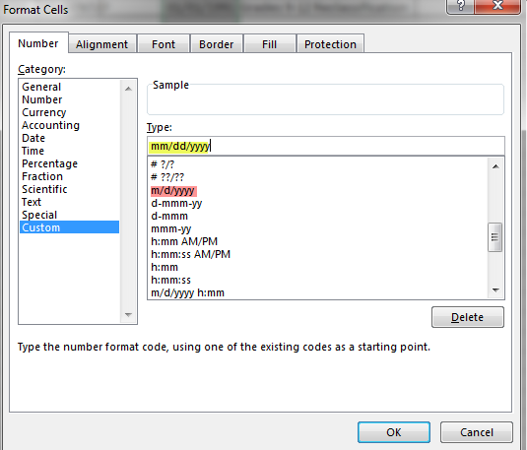
Student Management:
Multiple Student Upload (MSU)
To format the Grade and DOB:
For grade, often the cells will default to a single digit;
To change and save the format, highlight the grade column, then right click and choose “format cells”. Choose “custom” at the bottom of the list. Click on “0” then change the open “type” box to read “00”, click OK.
Often, the date cells will default to m/d/yyyy format.
To change and save the format, highlight the DOB column, right click and choose “format cells” then choose “custom” at the bottom of the list. Scroll down and choose m/d/yyyy. Change the open “type” line to mm/dd/yyyy, click OK.

Slide 15
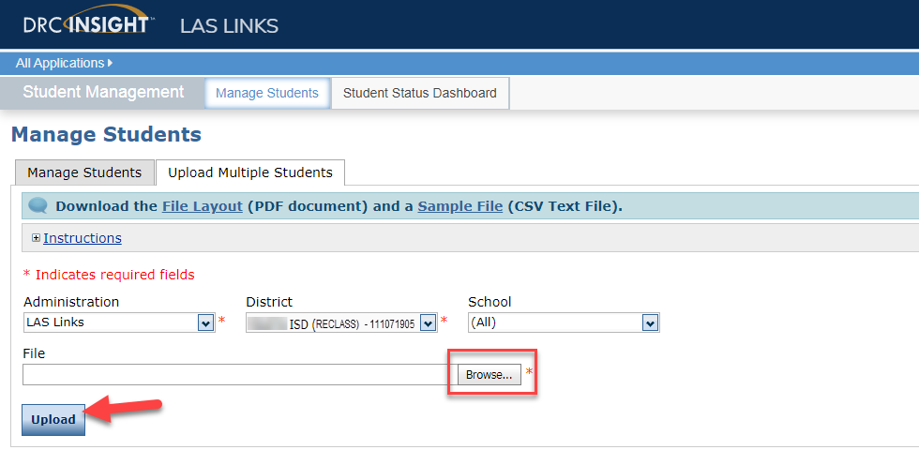
Uploading the MSU file
Once your .CSV is complete, Click on Browse to find the file;
Click Upload;
Refresh occasionally to see if your file uploaded correctly;
You will receive an error report if there are any issues with your file;
Correct the issues indicated in the error file, save, browse and upload the file again.

Slide 16
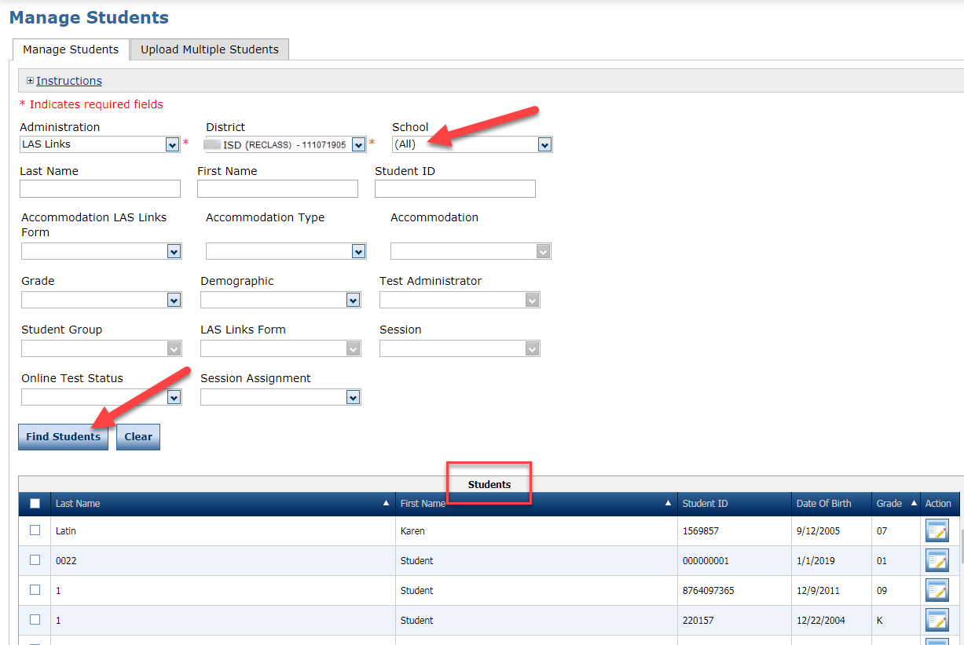

Student Management
View and Edit Students
To see a roster of all students rostered in INSIGHT:
  Choose “all” from the School drop down menu.
To find a particular student:
  Fill one or more of the search fields (ie Name and/or Student ID).
Click Find Students;
Roster will appear below;
Click the View/Edit action button to edit a student’s information;
Caution: DO NOT utilize the MSU to edit students’ first and last names, IDs, nor DOB. If you change any of these via the MSU, you will create a duplicate student. Only use “edit student” to change these elements.
View/Edit
Notes:
To edit a student, first find that student. You can do this by utilizing the fields provided on the top of the page or by generating a list by that student’s District and School and then scrolling through the generated list once you’ve pressed the “Find Student” button. Please note that the list of Students provided is dependent upon which District and School they were assigned to upon set up in the system.
Your students will be listed alphabetically in a continuous list with 100 students viewable at a time — to narrow your list, you can search by School or any of the fields listed on the screen such as last name, first name, student ID, grade etc.
When you click on the action button for View/Edit, the Student profile for the student appears. Edit or Add any additional data prior to clicking the SAVE button.

Slide 17
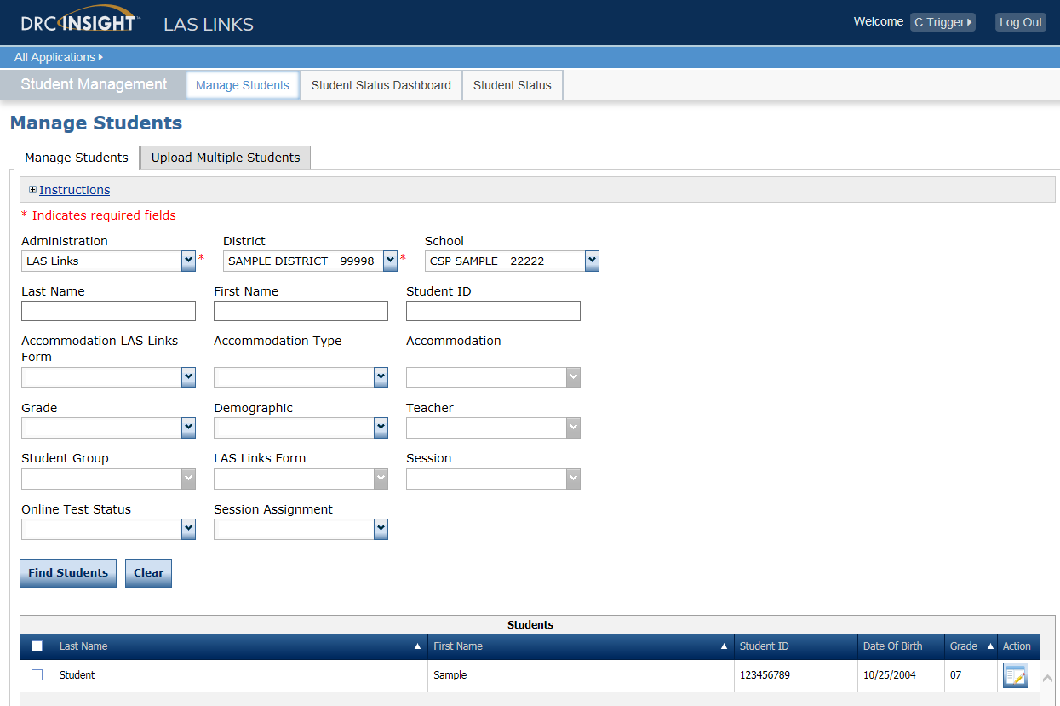
Student Management
Editing Student Information
View/Edit
Notes:
To edit a student, first find that student. You can do this by utilizing the fields provided on the top of the page or by generating a list by that student’s District and School and then scrolling through the generated list once you’ve pressed the “Find Student” button. Please note that the list of Students provided is dependent upon which District and School they were assigned to upon set up in the system.
Your students will be listed alphabetically in a continuous list with 100 students viewable at a time — to narrow your list, you can search by School or any of the fields listed on the screen such as last name, first name, student ID, grade etc.
When you click on the action button for View/Edit, the Student profile for the student appears. Edit or Add any additional data prior to clicking the SAVE button.

Slide 18
Creating Student Groups
LAS Links Online

Slide 19
Why Use Student Groups?
Use student groups in order to designate a “Class” within your organization’s testing hierarchy.
  If Student Groups are NOT created, when you receive your Interactive reports, all students will be visible to all Users at that site. Example: Second Grade ESL Test Administrator will see all other grade levels reports at that school unless they are associated to a specific Student Group only.
  Student groups allow users at the Test Administrator level (and above) who are associated with a student group to be the only users that are able to view the testing results for students who are associated to that group in the ORS system.
  Student groups allow you to associate students to Test Administrators in the Portal.
  Students may only be associated to one student group only.
  Students and Test Administrators must be added to the Portal before Student Groups can be created.

Slide 20
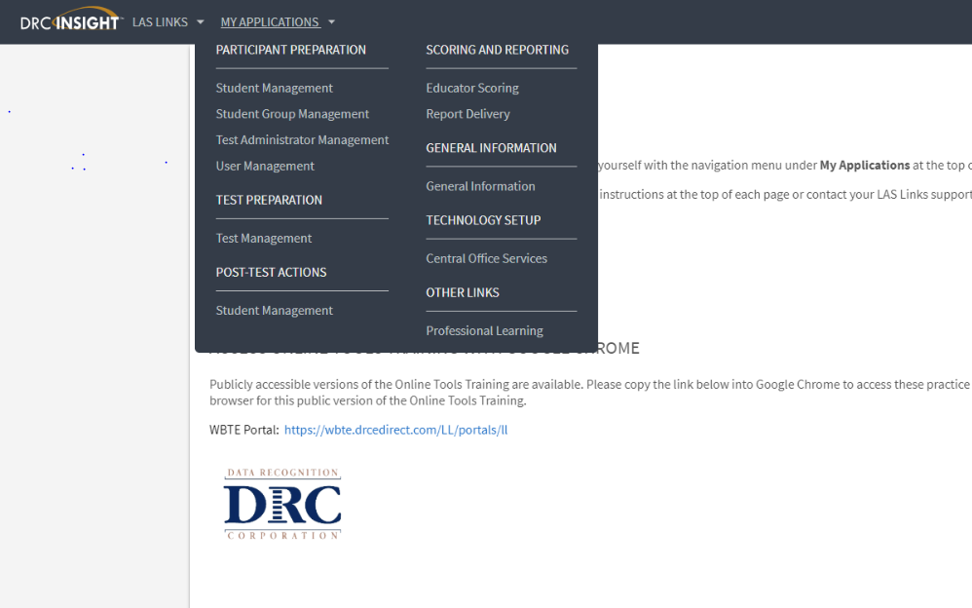
Creating Student Groups
Add/View/Edit
Notes:
From the My Applications Menu, choose the “Student Group Management” application. This will redirect the page to the Student Management page.

Slide 21
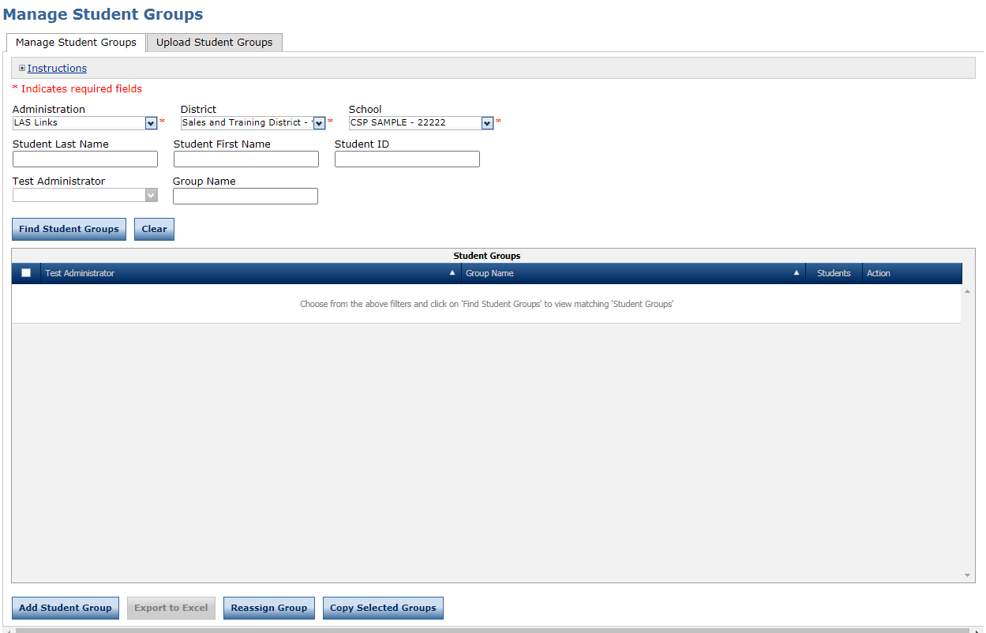
Creating Student Groups
Add/View/Edit
Notes:
To add a student group, click Add Student Group at the bottom of the page.

Slide 22
Creating Student Groups
Add/View/Edit
Be sure that your “Group Name” is unique and exactly how you’d like it displayed in IR (i.e 2nd Grade ESL)
Notes:
First, enter a Group Name for the student group. Be sure that your Group Name is exactly how you’d like it displayed in ORS.
Then, select a Teacher or Test Administrator from the dropdown menu or click Add to add a Teacher/Test Administrator to the Portal, then select the teacher for the student group. Please note that a Teacher/Test Administrator added here does not give that Teacher/Test Administrator Portal User credentials. If you want to add this Teacher/Test Administrator as a Portal User too, you must go to the User Management application and add the Teacher/Test Administrator there as a User.
Finally, click Find students if the have already been rostered in the Portal or click New Student to be able to add a student to the portal.

Slide 23

Support
LAS Links Help Desk:
  866.282.2250
  7:00 a.m. - 8:00 p.m. EDT
LASLinksHelpDesk@datarecognitioncorp.com
  If you already called in and have a case, provide your case number for expedited service

