Slide 1
LAS Links Online Navigating the INSIGHT Portal – Educator Scoring
Notes:
Welcome to the LAS Links Online Administration Training of Trainers.

Slide 2
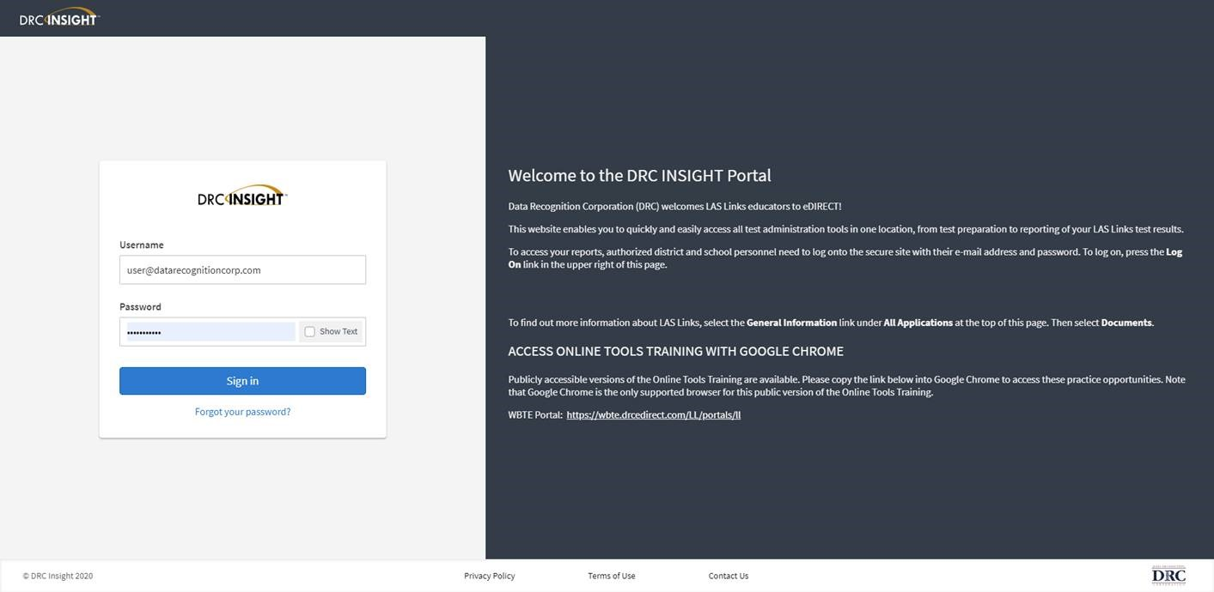
Access the DRC INSIGHT Portal
www.drcedirect.com
Use the INSIGHT portal for Test Administrative functions such as professional learning, rostering students, creating test sessions, scoring student responses and for On-Demand reporting.
Notes:
Look for an email from no-reply@datarecognitioncorp.com which provides your access.
Use the INSIGHT portal for Test Administrative functions such as rostering students, creating test sessions, scoring student responses and for On-Demand reporting.

Slide 3
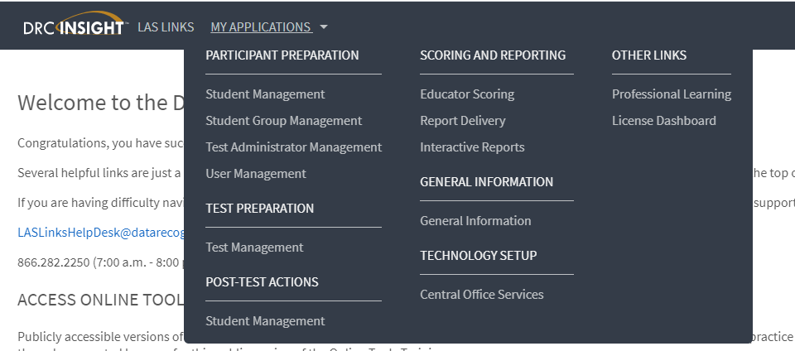
Educator Scoring
Notes:
To Score Student Data, choose the “Educator Scoring” application.

Slide 4
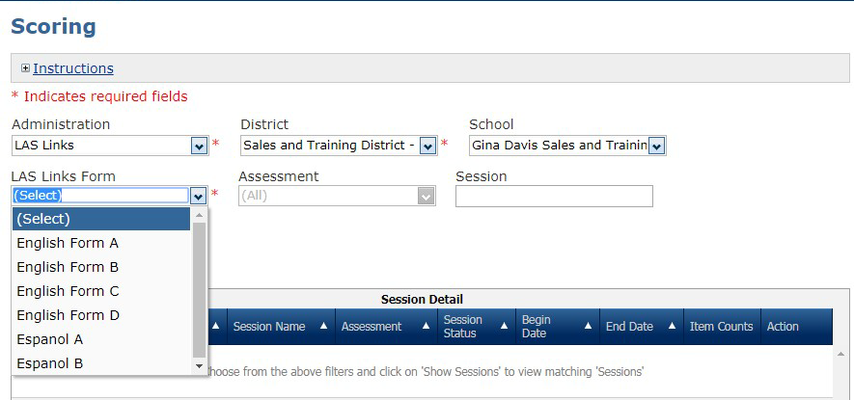
Educator Scoring
Choose the form you need to score
Filter by grade span by clicking on the Assessment dropdown
Filter by session by typing in the session name in the Session search field
Notes:
Notice there are expandable Instructions.
Then notice the required fields to search for students to score (for example, Administration, District and School will most likely be pre-filled based upon your sign-in)
Then we have the Search fields – Form and Assessment
Once you have chosen your search criteria, click on Show Session.
If you do not fill in any search criteria, all of the Sessions at your testing site will be displayed.
A grid with Sessions will appear below the search fields.

Slide 5
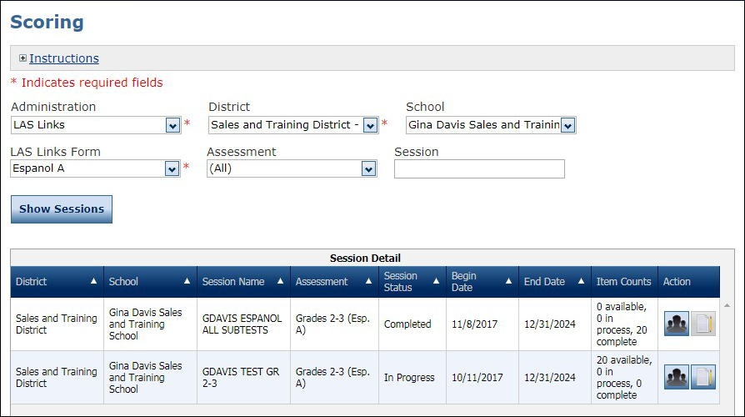
Educator Scoring
Click the Show Sessions button
Available = items that need to be scored
In Process = items that have been scored and are processing through the scoring system
Complete = items that processed correctly through the scoring system and are moving towards reporting
Notes:
You will see under item counts the following:
Available = items that need to be scored
In Process = items that have been scored and are processing through the scoring system
Complete = items that processed correctly through the scoring system and are moving towards reporting

Slide 6
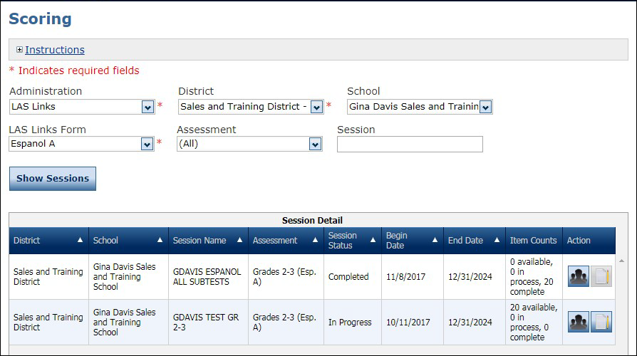
Educator Scoring
Score by Student
Score by Session
Notes:
You may either score by student or score by session.

Slide 7
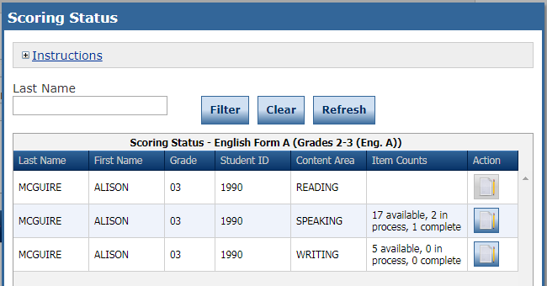
Educator Scoring
Choose from the roster of students and content areas that have items available for scoring
Click the “Score Student” icon in the Action column
Notes:
When you choose to score by student, you will choose from the roster of students and content areas that have items available for scoring. Click on the score student in the action column.

Slide 8
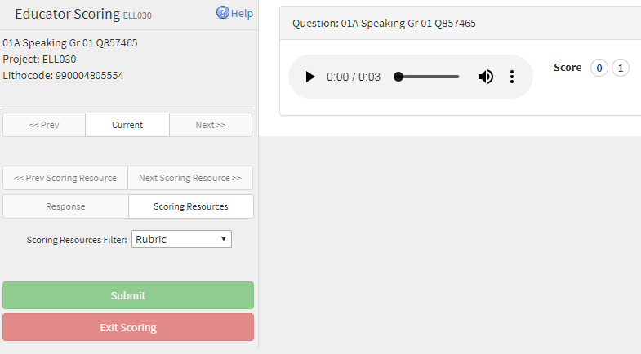
Educator Scoring
IMPORTANT:
Be sure to enable popups from scoring.drcedirect.com
so that you are able to complete scoring
When you clicked on the Action button (as shown in the previous slide) a new page will pop up taking you to a new URL.
Notes:
When you clicked on the Action button (as shown in the previous slide) a new page will pop up taking you to a new URL. Be sure to enable popups from scoring.drecedirect.com so that you are able to complete scoring.

Slide 9
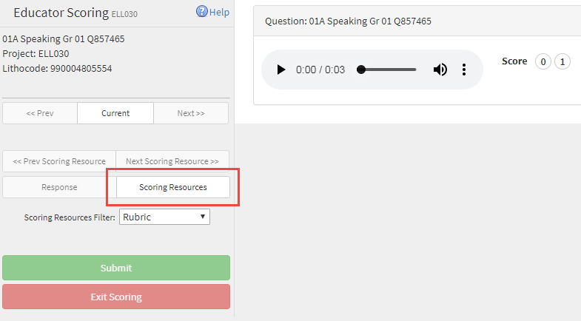
Educator Scoring
Utilize this naming convention to determine the item you are scoring. For this item, we are on: Item #1, Form A, Speaking, Grade 01
If scoring Español forms, “Speaking” will read as “Hablando”
Click here to download and save the student verbal response to your computer. This can only be done BEFORE you submit your score.
Click the play button to hear the student response.
Click here to choose the score you are giving the student response.
Click Scoring Resources to access the item and rubric information.
Click submit when you are done giving this item a score.
Notes:
For Speaking, click the play button to hear the student response.
You have the option to download and save each of the students’ audio file with their verbal responses. Please note that this can only be done BEFORE you submit your score.
Click on the radio button indicating the score you are giving each of the students’ responses. These scores should be applied according to the rubrics provided by LAS Links.
Once you have chosen the score, click submit.

Slide 10
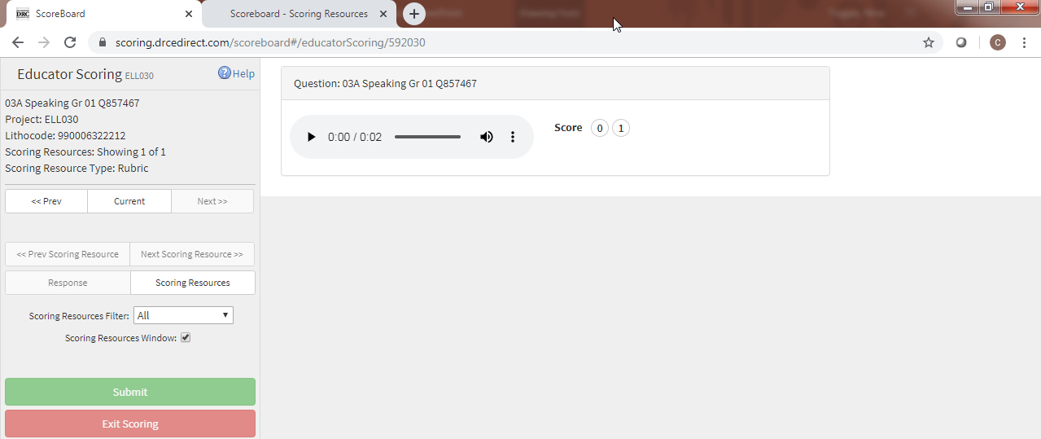
Educator Scoring
Once you have clicked on Scoring Resources, to have the resources open on a separate page (for easy toggling), check the radio button next to “Scoring Resources Window”.
Scoring resources include the item presented to the student, the rubric and exemplars.
Notes:
Click on the Scoring Resources Window button and a separate page will open allowing access the rubric and the prompt (the Scoring Resources) separately from the student response.
Once you have scored the item and have clicked submit, when you get to the next item, simply click on the Scoring Resources button and the “Scoreboard – Scoring Resources” page will automatically update with the applicable rubric and student response.

Slide 11
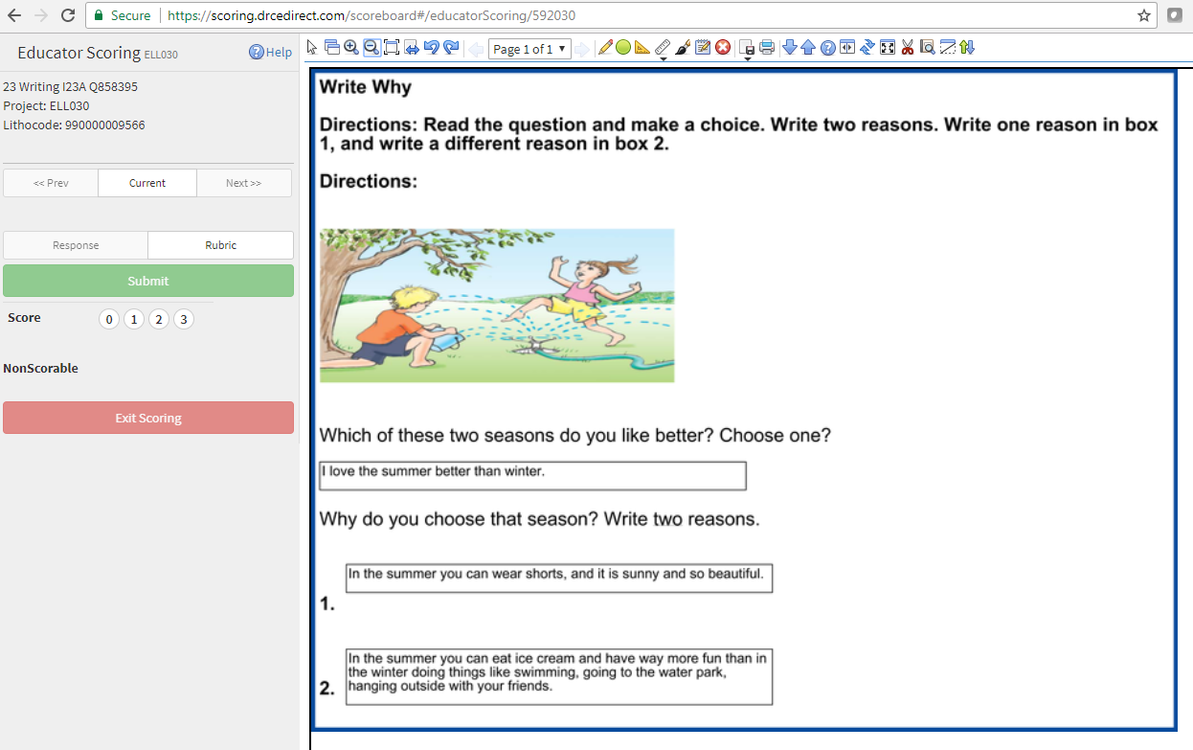
Educator Scoring
Click submit when you are done giving this item a score.
Click here to choose the score you are giving the student response.
The student responses are found in the boxes.
Notes:
For Writing, score the student responses according to the LAS Links rubrics, apply the score by clicking on the appropriate radio button then click submit.

Slide 12
Support
LAS Links Help Desk:
866.282.2250
7:00 a.m. - 8:00 p.m. EDT
LASLinksHelpDesk@datarecognitioncorp.com
If you already called in and have a case, provide your case number for expedited service

