Slide 1
preLAS and LAS Links Online Administration Training
Notes:
Welcome to the preLAS and LAS Links Online Administration Training

Slide 2
Training Agenda
Preparing for training
Training Readiness Checklist
Gathering materials/resources needed for presenter and trainees
Delivering training on:
Pretest activities (preparing to test)
Proctoring the test (student experience)
Post test activities (scoring and reporting)
Remote testing
Q and A

Slide 3
Pre-Training Activities
Notes:
Let’s start with the pre-training activities DRC recommends to take place prior to training others.

Slide 4
Online Testing Training: Readiness Checklist
Pre-Training Prep Activities
Be sure all trainees have been added as Users to the INSIGHT portal prior to training (this will save you a lot of training time if this is done prior to training)
Access the LAS Links Online National Digital Library found at LASLinks.com
Print and distribute or email the training ppt to all trainees - titled "LAS Links ONLINE ADMINISTRATION - Trainee PPT” – found in the LAS Links Online National Digital Library
Notes:
Utilize the Online Testing Training Readiness Checklist to help you prepare for your training.

Slide 5
Online Testing Training: Readiness Checklist
Pre-Training Prep Activities
Run through a practice test, found at https://wbte.drcedirect.com/LL/portals/ll to experience the student testing experience for yourself. Be sure to use a headset with a microphone and use Google Chrome to launch the practice test (it will not work with any other browser).
Recommended: assign training pre-work to trainees such as providing links to training videos found in the Digital Library. This will allow trainees to have preliminary knowledge when they arrive at your training.

Slide 6
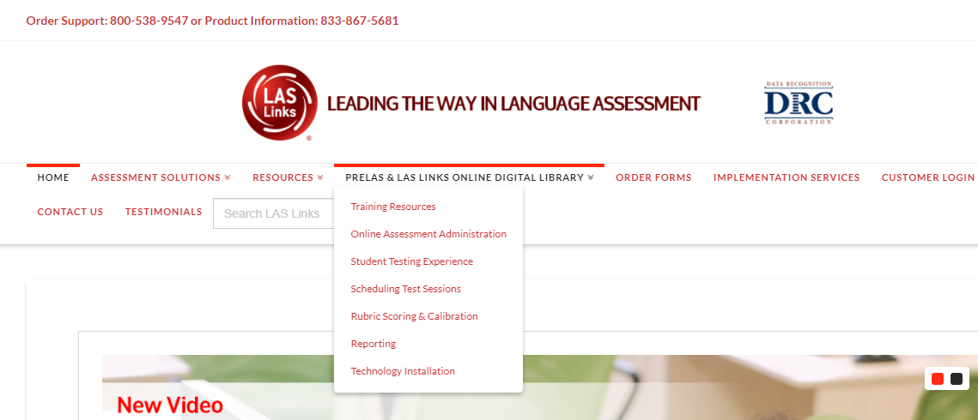
Accessing the National Digital Library
LASLinks.com
Notes:
To access the audio files, log into INSIGHT, Log into INSIGHT, click General Information under My Applications
Click Documents
Choose Digital Libraries

Slide 7
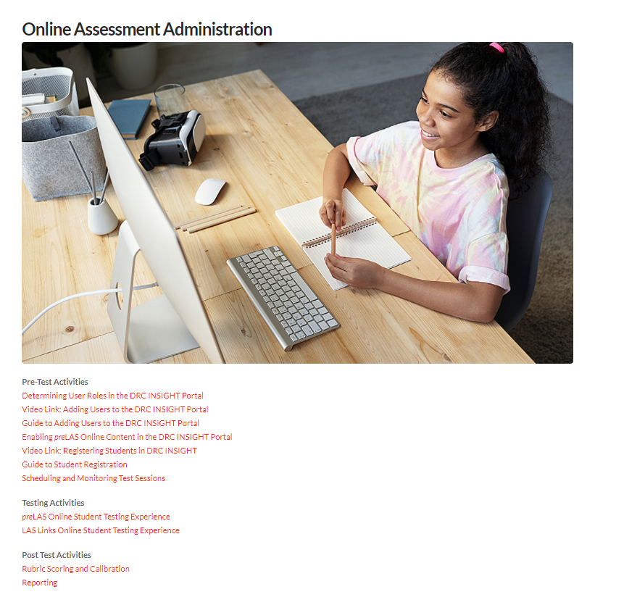
National Digital Library
Training Resources are found in the National Digital Library
provides administration, scoring and reporting guidance documents and videos
Notes:
Download important training documents from the LAS Links Online Digital Library. Key documents for training are found throughout the digital library which provides portal navigation resources regarding administration, scoring and reporting.

Slide 8
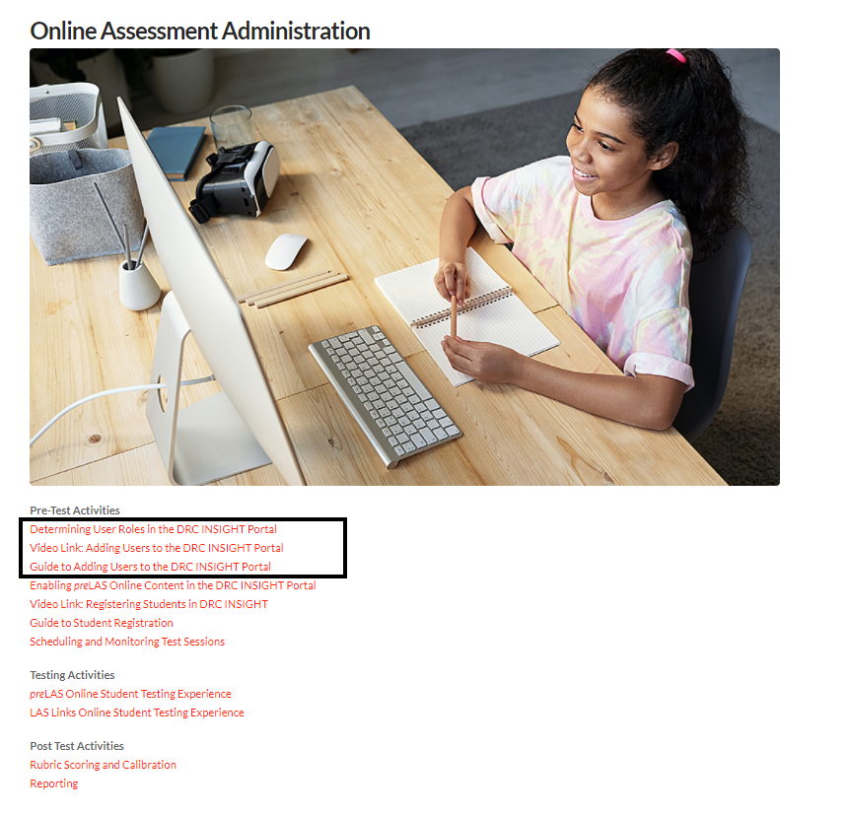
Adding Users to the Portal

Slide 9
Coordinator and Proctor Training Agenda
Training Part 1: Pretest activities (preparing to test)
Training Part 2: Proctoring the test (student experience)
Training Part 3: Post test activities (scoring and reporting)
Notes:
The trainee training power point can be found at www.laslinks.com/Texas and provided to you prior to this onsite training). The trainee ppt follows the following agenda:
Training Part 1: Pretest activities (preparing to test)
Training Part 2: Proctoring the test (student experience)
Training Part 3: Post test activities (scoring and reporting)
This agenda slide is also where the “trainee” powerpoint starts (with the exception of the Title slide).

Slide 10
Training Part 1: Pre-Test Activities
Activity 1:
Accessing the INSIGHT portal
Notes:
Let’s start with Training Part 1: Pre Test Activities (for trainees) – Activity 1: Accessing the INSIGHT portal and DRC’s Professional Learning courses

Slide 11
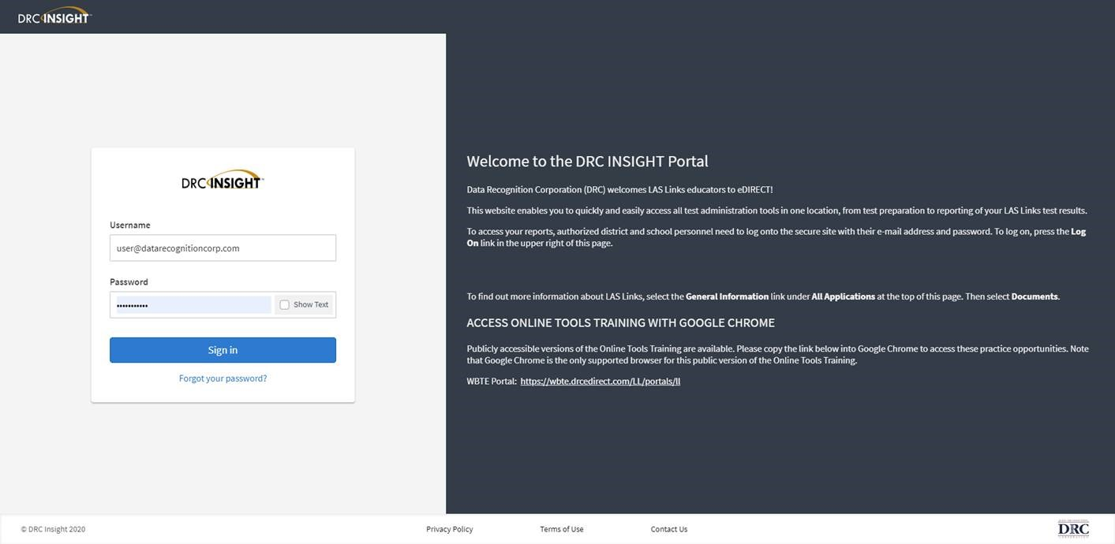
Access the DRC INSIGHT Portal
www.drcedirect.com
Use the INSIGHT portal for Test Administrative functions such as professional learning, rostering students, creating test sessions, scoring student responses and for On-Demand reporting.
Notes:
Look for an email from no-reply@datarecognitioncorp.com which provides your access.
Use the INSIGHT portal for Test Administrative functions such as rostering students, creating test sessions, scoring student responses and for On-Demand reporting.

Slide 12
Portal Activation Email
Sent from: no-reply@datarecognitioncorp.com
Check your clutter/spam if you do not find the email in your inbox
Notes:
As a Point of Contact for your testing site, you will be set up in the DRC INSIGHT Portal. Once this occurs, you will receive an Activation Email that looks like this. Notice that the greeting says “Welcome to the DRC Portal, “ and you are informed that your user name is your email address. Then you click on the link provided, or you can copy/paste the longer link, and follow the steps to activate your account.

Slide 13
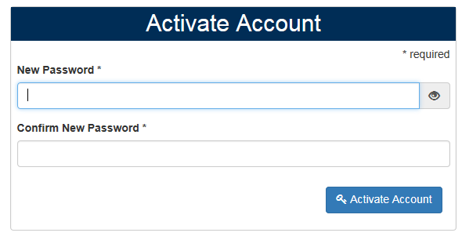
Activating your INSIGHT account
Notes:
Once you click the link, you will create & confirm a new password for your account. Your password must be at least be at least 8 characters long. Once entered and confirmed, you will click on Activate Account.
Must have:
at least 1 numeric character
at least 1 upper case character
at least 1 lower case character
at least 1 of the following special characters: !#$%&()*+,-./:;<=>?@[\]^_`{|}~
NOTE: ONLY these special characters are allowed currently
Password is rejected if longer than 127 characters.
Password is rejected if it contains the user's username.
Password is rejected if it contains the user's first name or their last name.
Password is rejected if same as last 5 previously used passwords.

Slide 14
Logging into the Portal
Notes:
And now you are ready to log into the Portal, by inputting your Username and Password. Click the Show Text button if desired.

Slide 15
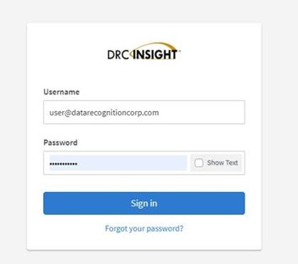
Logging into the INSIGHT portal
Click on “Forgot your password?” if unable to locate your welcome email
Your Username is your email address
If the system does recognize you as a User, please check with your LEA’s director who will need to add you as a User to the portal.

Slide 16
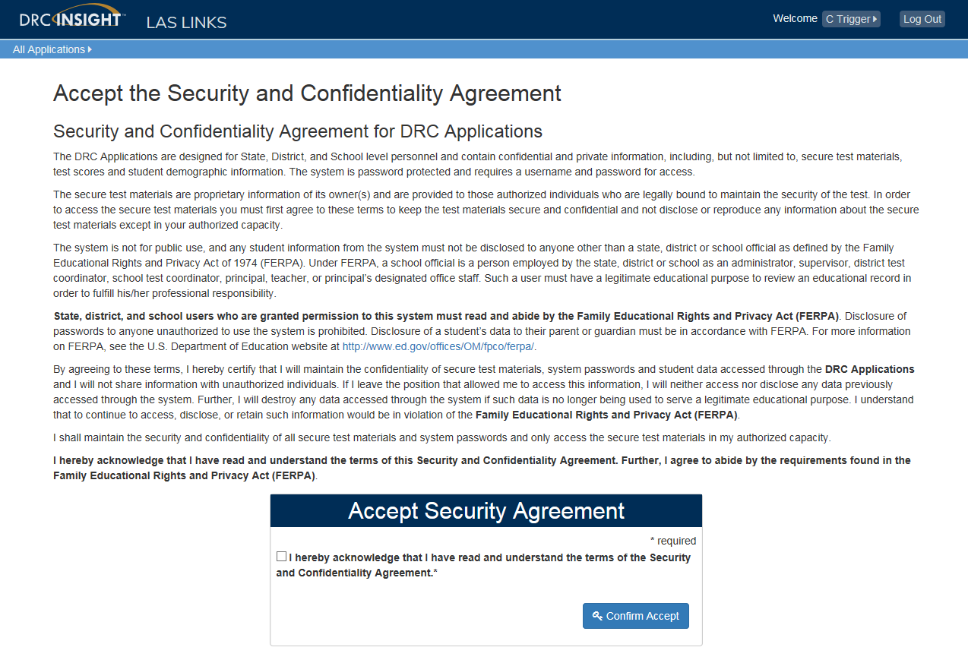
Security Agreement
Notes:
Next, you will see the Security & Confidentiality Agreement. You must accept the Security Agreement the first time you access your account in order to enter the portal.

Slide 17
Training Part 1: Pre-Test Activities
Activity 2:
Adding (registering) Students in the INSIGHT portal
Notes:
Training Part 1: Pre Test Activities (for trainees) – Activity 2: Adding (registering) Students in the INSIGHT portal

Slide 18
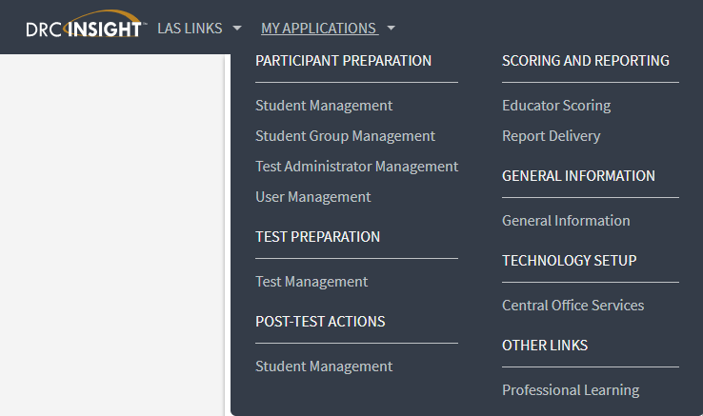
Student Management Add/View/Edit
Notes:
From the My Applications Menu, choose the “Student Management” application. This will redirect the page to the Student Management page.

Slide 19
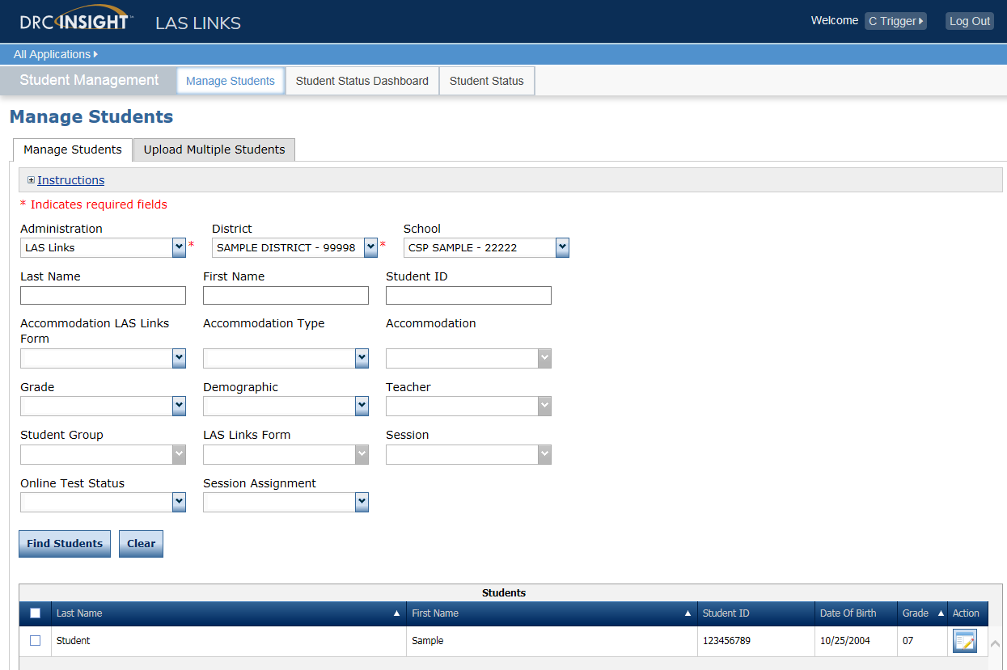
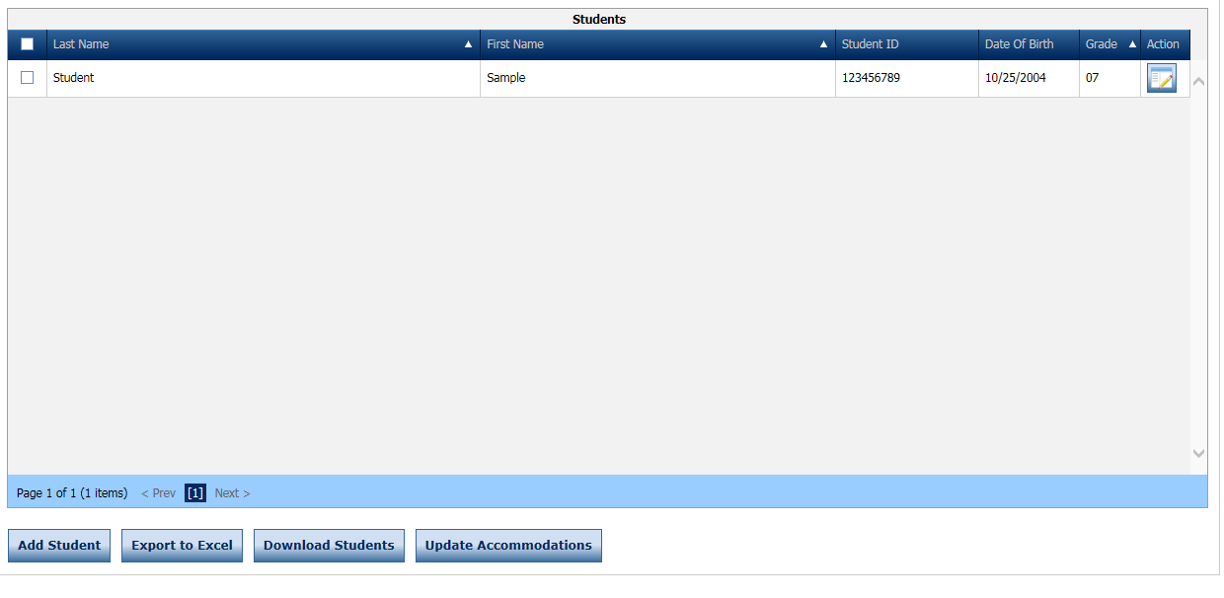
Adding Students One-by-One
Click Manage Students
Choose a School from the drop down menu
Click Add Student at the bottom of the screen
Notes:
To add a single student, from the Manage Students page, once you have picked the School to add the student to, click on the Add Student button at the bottom of the page. A new window will then appear.

Slide 20
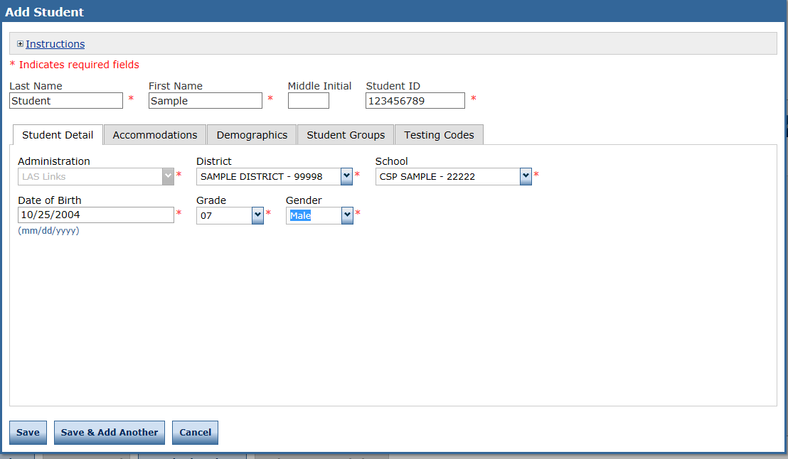
Adding Students One-by-One
Any cell with an asterisk* next to it is required student information.
If you do not have a student ID number established by the time you are testing the student, one recommendation is to enter a temporary ID number and once the student ID is available, find the student, click edit and update the student ID. Student IDs must be unique throughout your district therefore a suggested temporary ID would be “temp01[schoolname]”
Notes:
Enter the student’s Last Name, First Name, Middle Initial (if known) and the Student ID#, Date of Birth, Grade and Gender. Please note that the required fields are marked by a red asterisk *. Click Save to go back to the manage students page or click save and add another to add another student right away.
If you do not have a student ID number established by the time you are testing the student, one recommendation is to enter a temporary ID number and once the student ID is available, find the student, click edit and update the student ID. Student IDs must be unique throughout your district therefore a suggested temporary ID would be “temp01[schoolname]”
There are additional OPTIONAL tabs available to capture “Accommodations”, “Demographics”, “Student Groups” and “Testing Codes”. Testing Codes, while showing, is not active for LAS Links. Let’s start with the Accommodations Tab.

Slide 21
Student Management Find and Edit Students
To see a roster of all students rostered in INSIGHT
Choose “all” from the drop down menu
To see a roster of all students at a School
Choose the School from the dropdown menu
To find a particular student:
Fill the one or more of the search fields (ie Name and/or Student ID)
Click Find Students
Roster will appear below
View/Edit
Notes:
To edit a student, first find that student. You can do this by utilizing the fields provided on the top of the page or by generating a list by that student’s District and School and then scrolling through the generated list once you’ve pressed the “Find Student” button. Please note that the list of Students provided is dependent upon which District and School they were assigned to upon set up in the system.
Your students will be listed alphabetically in a continuous list with 100 students viewable at a time — to narrow your list, you can search by School or any of the fields listed on the screen such as last name, first name, student ID, grade etc.
When you click on the action button for View/Edit, the Student profile for the student appears. Edit or Add any additional data prior to clicking the SAVE button.

Slide 22
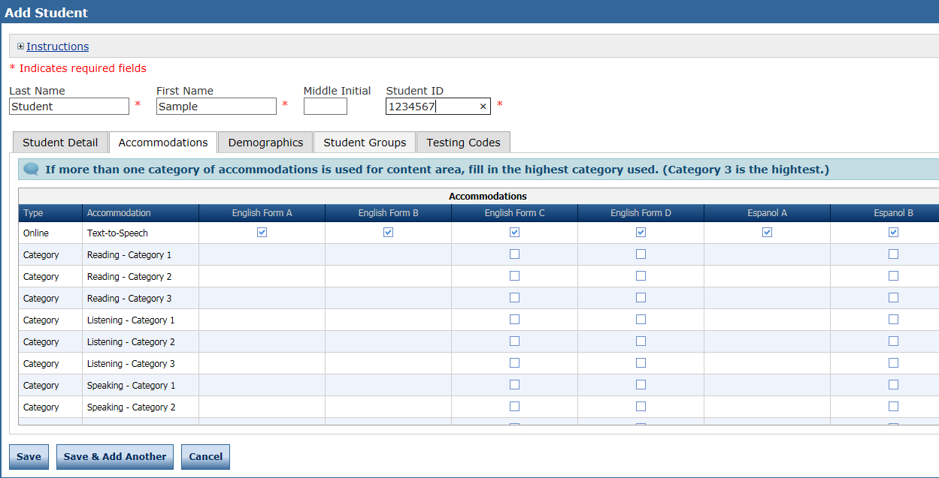
Student Management Accommodations
Accommodations – A feature included in LAS Links Online as an accommodation is Text to Speech. If you would like to activate this accommodation, click on the corresponding Form(s) of LAS Links that you will be using and Text-to-Speech will then be delivered to this particular student.
To track in reporting the accommodations provided to your student(s) click on the corresponding Accommodation Type listed on the screen.
You will find definitions for the Accommodation Type Definitions when you click Instructions at the top of the page or please consult your LAS Links Examiner’s Guide(s) for Accommodation Type Definitions.
Except for with Text-to-Speech, selecting any of the listed Accommodations does not modify how the LAS Links test is delivered to the student.
Notes:
Accommodations – A feature included in LAS Links Online as an accommodation is Text to Speech. If you would like to activate this accommodation, click on the corresponding Form(s) of LAS Links that you will be using and Text-to-Speech will then be delivered to this particular student.
To track in reporting the accommodations provided to your student(s) click on the corresponding Accommodation Type listed on the screen.
You will find definitions for the Accommodation Type Definitions when you click Instructions at the top of the page or please consult your LAS Links Examiner’s Guide(s) for Accommodation Type Definitions.
Except for with Text-to-Speech, selecting any of the listed Accommodations does not modify how the LAS Links test is delivered to the student.

Slide 23
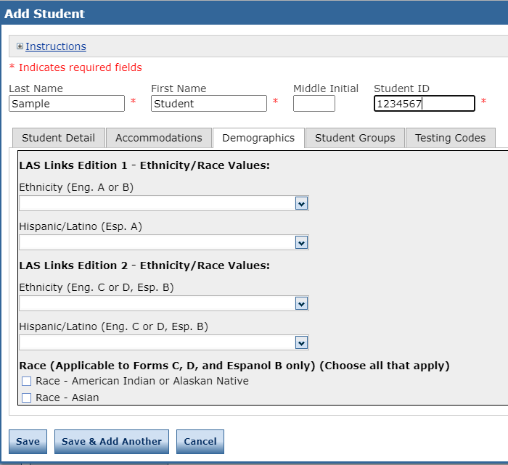
Student Management Adding Demographics
Please note, student demographic data will only be included in Interactive Reporting, not the On-Demand report, when you add this information to the INSIGHT portal.
Notes:
Indicate the student demographics by clicking on the Demographics tab. Please note the LAS Links form(s) listed with the particular demographic field. If you are using Eng C or D or Esp B and you choose Ethnicity for Eng A or B, the data will not be reported with that test administration.
Please note, student demographic data will only be included in Interactive Reporting, not the On-Demand report, when you add this information to the INSIGHT portal.

Slide 24
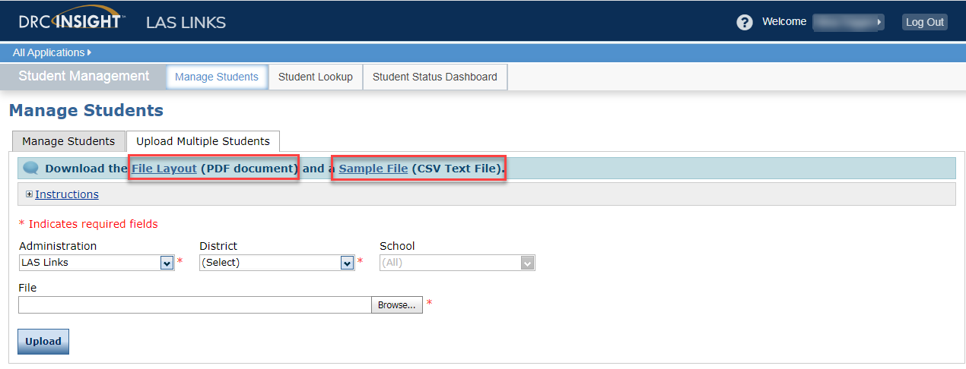
Student Management: Multiple Student Upload (MSU)
Caution: DO NOT utilize the MSU to edit students’ first and last names, IDs, nor DOB. If you change any of these via the MSU, you will create a duplicate student. Only use “edit student” to change these elements.
Require cells are highlighted.
District Code and School Code can be found by clicking on the District and School tabs above.
If you are a large district and need a list of your school codes (as opposed to using the drop down school list), please contact Tech Support.
Notes:
Users may load multiple students using an upload file. The file has a specific lay-out, and the upload data file must be in CSV format. Notice that the File Lay-out is accessed here, and the Sample File, which is already in CSV format can be opened here. After opening it, you can add your students after deleting the sample student—but be sure to keep the headings in place.—and save your file on your desktop so you can browse for it from this window. Once you see the file title in the File Field, you will click on Upload.
Caution: DO NOT utilize the MSU to edit students’ first and last names, IDs, nor DOB. If you change any of these via the MSU, you will create a duplicate student. Only use “edit student” to change these elements.

Slide 25
Training Part 1: Pre-Test Activities
Activity 3:
Creating Test Sessions and Monitoring Student Progress
Notes:
Training Part 1: Pre Test Activities (for trainees) – Activity 3: Creating Test Sessions and Monitoring Student Progress

Slide 26
Test Management – Creating a Session
Notes:
To Schedule a Test Session, choose the “Test Management” application. This will redirect the page to the Test Management page. Here you can manage your test sessions, specifically you can create a single test session or upload multiple sessions. You can also edit existing test sessions.

Slide 27
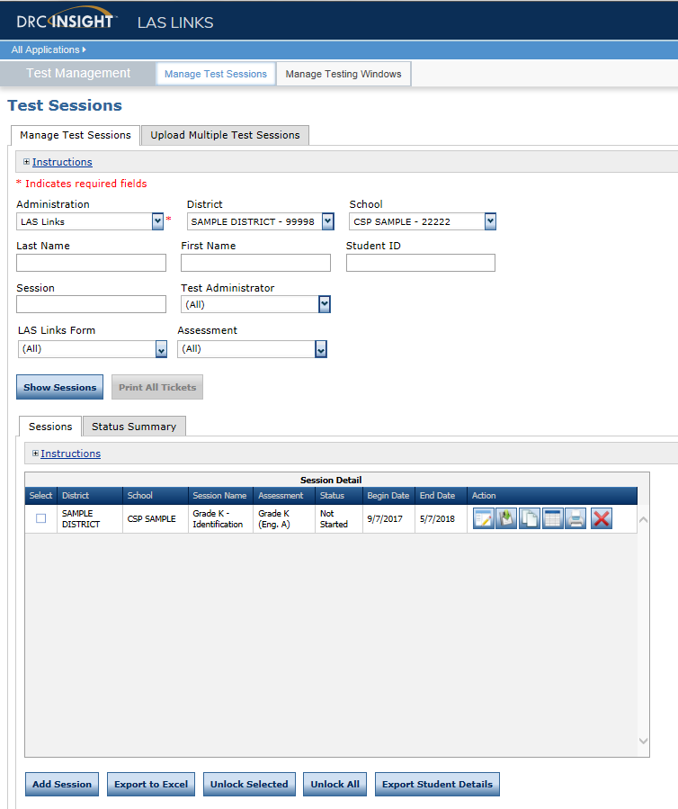
Creating a Session
To add a session, choose the School (as applicable) from the drop down menu, then click Add Session, found at the bottom of the page.

Slide 28
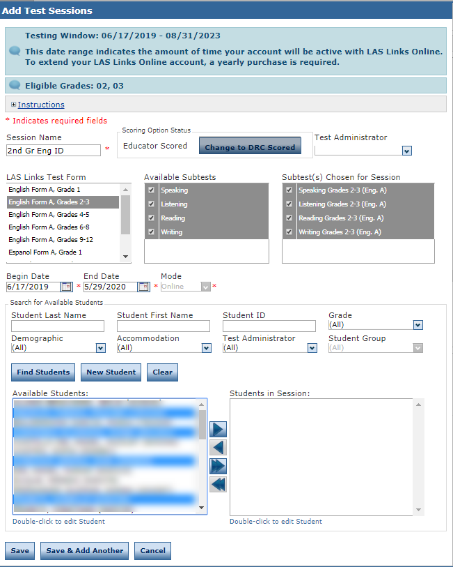
Creating a Session
Uniquely name your session so you can easily search for it later
Choose the desired Level and Form
Choose from the available subtest
Note: subtests MUST be contained in the same session in order to generate composite scores
Students can only be added to assessments corresponding to their grade level
Highlight the students to be added to the session and click the blue right arrow to assign them to the session.
Notes:
Once in Test Management, click on the Manage Test Sessions Tab.
To Schedule a test session within your account Testing Window you will need to follow these steps:
Uniquely name your session so you can easily find it later
Choose the desired Form
Choose from the available subtest- For Texas English Form A and Espanol Form A are used for Identificaton grades 1-12 and 1-6 respectively
Note: subtests MUST be contained in the same session in order to generate composite scores
Note: you must create separate test sessions for each language of the test and each grade span of the test.
Students can only be added to assessments corresponding to their grade level – you can also search for available Student to assign to this Test Session by clicking the “Find Students” button. You can be more specific in your search by populating the optional fields of Student Last Name,.
Grade, Demographics, Accommodations or Test Administrator.
Highlight the students to be added to the session and click the blue right arrow to assign them to the session.
Finally, click SAVE or SAVE & ADD Another to complete the process

Slide 29
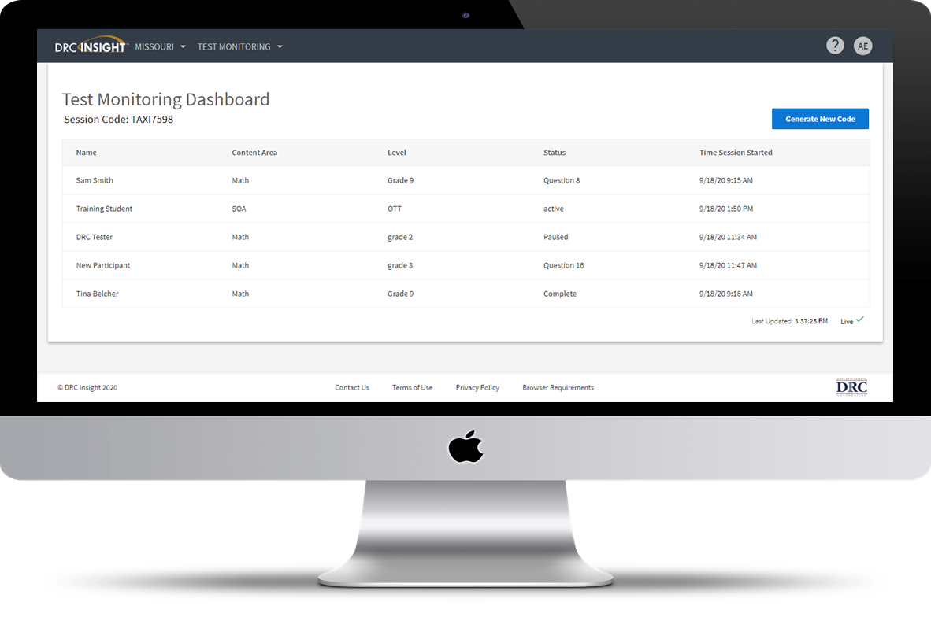
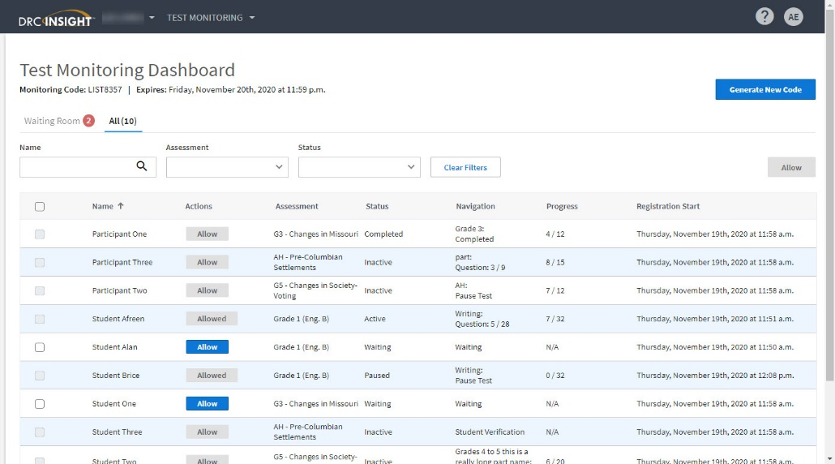
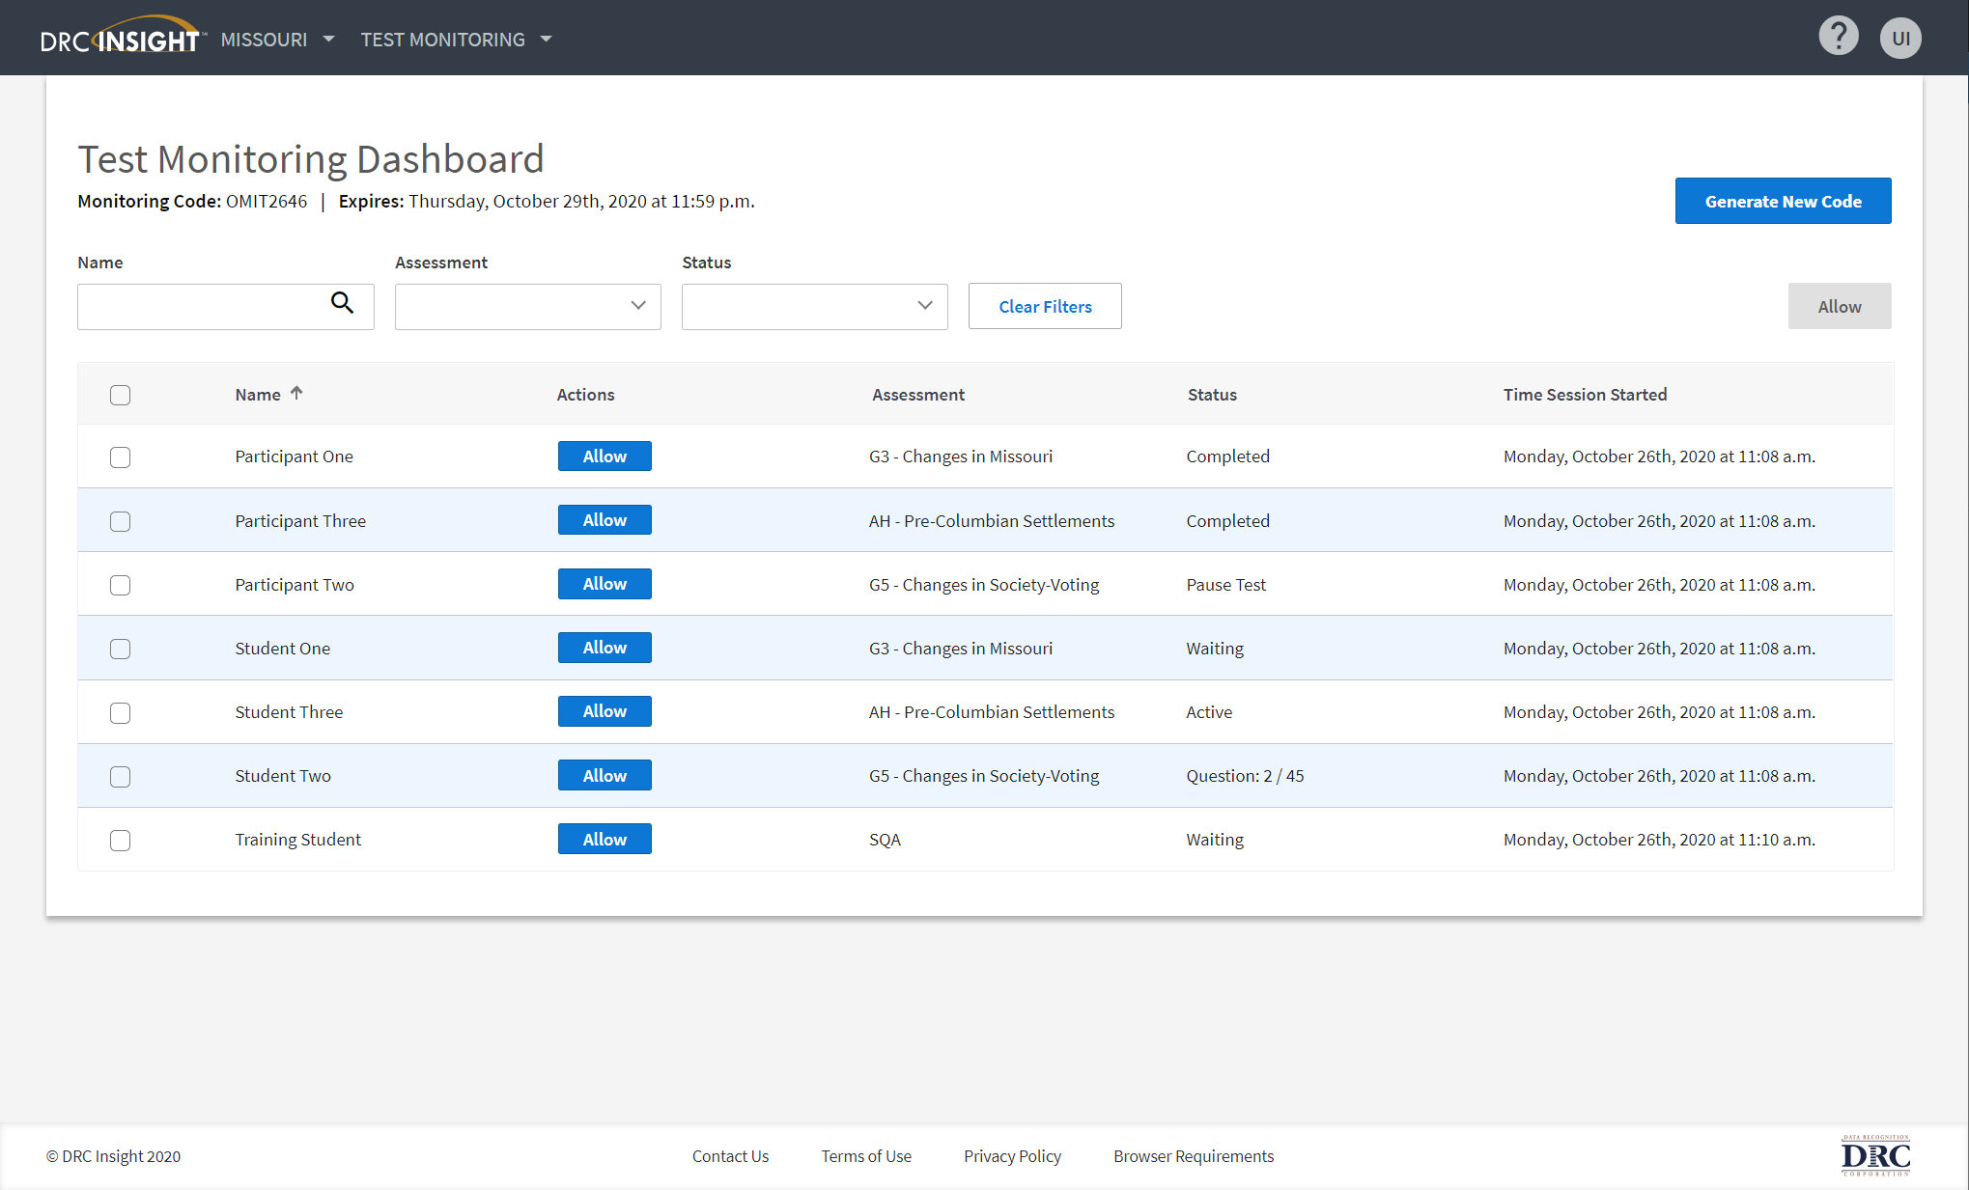
Optional - Test Monitoring Application (TMA)
New Test Monitoring Application for Test Administrators to securely monitor participants’ testing status in real-time
Addresses Test Administrators’ common questions and actions
Which students have logged in to the test?
Which students have started the test?
Are students progressing through the test?
What question are they on?
Which students have completed the test?
Have any students Paused their test?
Are any students seeing an error message?
NOTE: Test Administrators must have TMA
user permissions. See Test Monitoring Application
Notes:
These slides describe how to use the Test Monitoring application in the DRC INSIGHT Portal to monitor participant testing activity throughout the duration of their test using Monitoring Codes.
Test Administrators/Teachers will be able to see participants who have logged into a test and registered to a Test Monitoring Dashboard. The Test Monitoring application provides visibility to the participant’s status throughout the testing session, including the screen or question on which the participant is currently working and progress towards completion within the test.
Information displayed on the Test Monitoring Dashboard updates in near real time. including the Waiting Room tab, which displays participants who are placed in a waiting room where the Test Administrator controls when testing begins if your testing administration is configured to Restricted Access.
The Test Monitoring Application within the DRC INSIGHT Portal uses a Monitoring Code to assign a participant’s testing session to a Test Administrator’s Test Monitoring Dashboard. To do this, a Test Administrator will open the Test Monitoring application where a random unique Monitoring Code will be assigned.

Slide 30
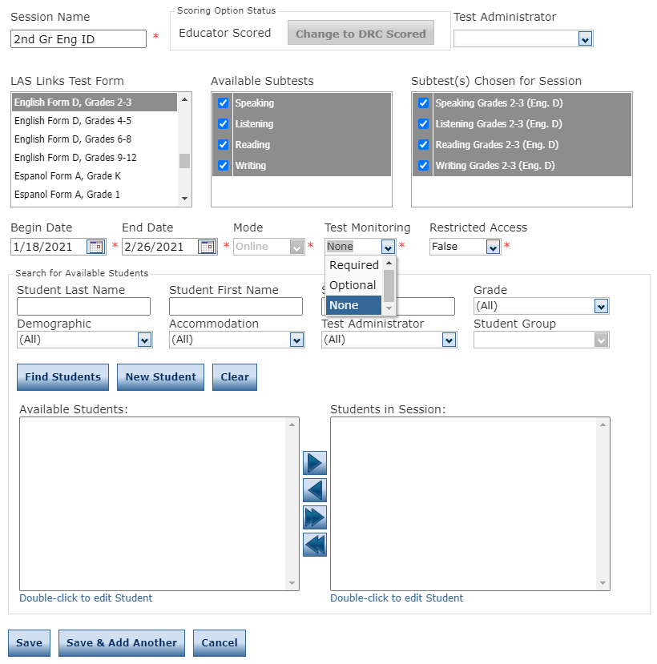
Scheduling a Session with TMA (Optional)
NEW! The Test Monitoring drop down will default to None. Choose Required or Optional if you would like to use TMA
Required: Student must have a code to enter the test
Optional: Student, although prompted for a code, will not be required to enter one
The Restricted Access drop down
will default to False . Change this to True so the student(s) may not
access the test until the TA has
granted access during testing.
Notes:
Once in Test Management, click on the Manage Test Sessions Tab.
To Schedule a test session within your account Testing Window you will need to follow these steps:
Uniquely name your session so you can easily find it later
Choose the desired Form
Choose from the available subtest- For Texas English Form A and Espanol Form A are used for Identificaton grades 1-12 and 1-6 respectively
Note: subtests MUST be contained in the same session in order to generate composite scores
Note: you must create separate test sessions for each language of the test and each grade span of the test.
Students can only be added to assessments corresponding to their grade level – you can also search for available Student to assign to this Test Session by clicking the “Find Students” button. You can be more specific in your search by populating the optional fields of Student Last Name,.
Grade, Demographics, Accommodations or Test Administrator.
Highlight the students to be added to the session and click the blue right arrow to assign them to the session.
Finally, click SAVE or SAVE & ADD Another to complete the process

Slide 31
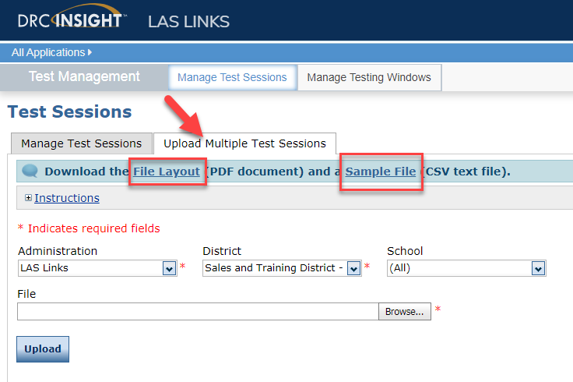
Creating Multiple Sessions
Click on Upload Multiple Test Sessions
Download the File Layout (for guidance)
Download the Sample File to add your sessions to be uploaded
Fill in the file according to the File Layout
Save the file then click browse to find the file
Click upload
Note: students must pre-exist at every grade band (1, 2-3, 4-5, 6-8, 9-12) to be able to utilize the Multiple Test Sessions upload file.

Slide 32
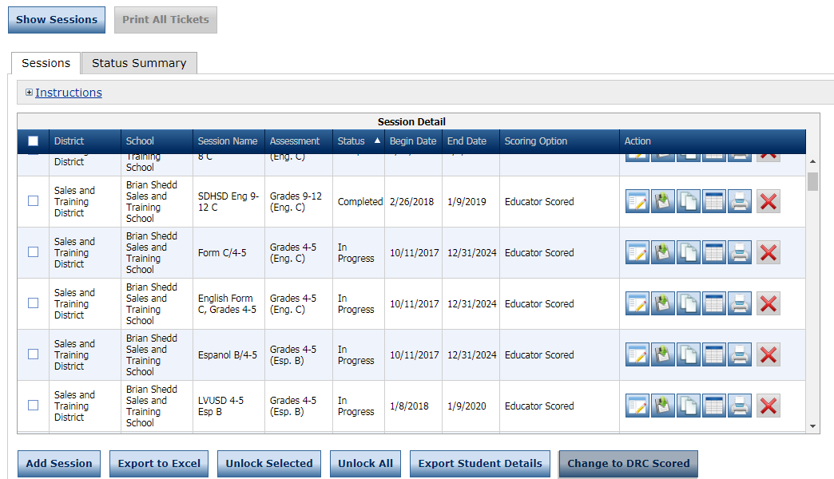
Generating Test Tickets Print All / Print Selected
To print all of the test tickets for the students in a test session, click the Print All Tickets icon ( ) in the Action column of the Sessions Detail window for the test session.
Notes:
Once a test session has been created, you can create and print Test Tickets.
Do this by clicking the box next to the listed Test Session, then clicking one of these Action Keys: “Print All” or “Print Selected”. Print all will generate test tickets containing log in credentials for all of the students assigned to that session. Print Selected provides you first with a list of the students assigned to the test and allows you to select only those students you would like test tickets printed for.

Slide 33
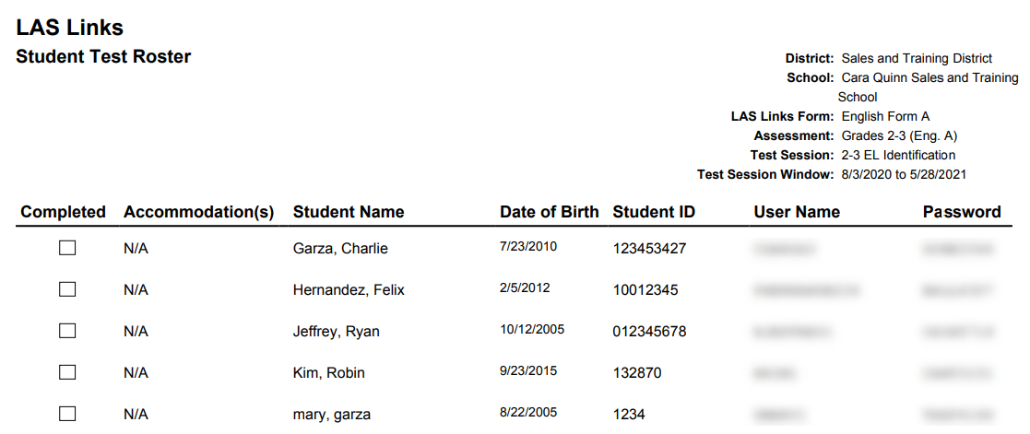
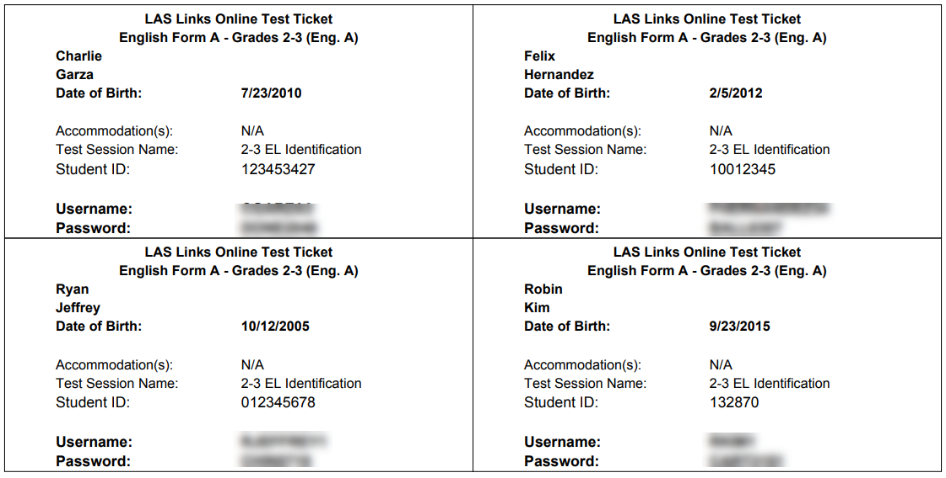
Test Tickets
Student Roster is for the administrator
Test Ticket is for the student
Notes:
The Administrator will generate a Test Ticket containing the entire Roster of students taking that Test Session. It includes the Student’s Name, Date of Birth, Student ID, User Name and Password credentials.
Each individual student Test Ticket contains the Test Form, Accommodations, Student ID, plus their user Name and Password credentials.

Slide 34
Editing a Test Session
To edit a test session, click the View/Edit icon ( ) in the Action column. Once one student has started testing in that particular test session, the only edits you can make to a test session is to change the test session end date, add additional students to the session, or to remove students (who have not started testing) from the test session.
Notes:
You can always edit a Test Session. Specifically you have the ability to edit all aspects of the session up until testing has begun, meaning a student has logged into their test. After this point, a Test Session can be edited in 2 ways. 1) elongating the testing window timeframe. 2) Adding students to the Test Session.
To edit a Test Session, first find the Test Session. You can do this utilizing the fields provided on the top of the page or by generating a list by a District and School and then scrolling through the generated list once you’ve pressed the “Show Sessions” button.
You can then select the Session from the list by clicking the box just to the left of the user’s information. From there click on the icon to the right of the page in the “Action” column that is the “Edit” button.
Edit or Add any additional data prior to clicking the SAVE button.

Slide 35
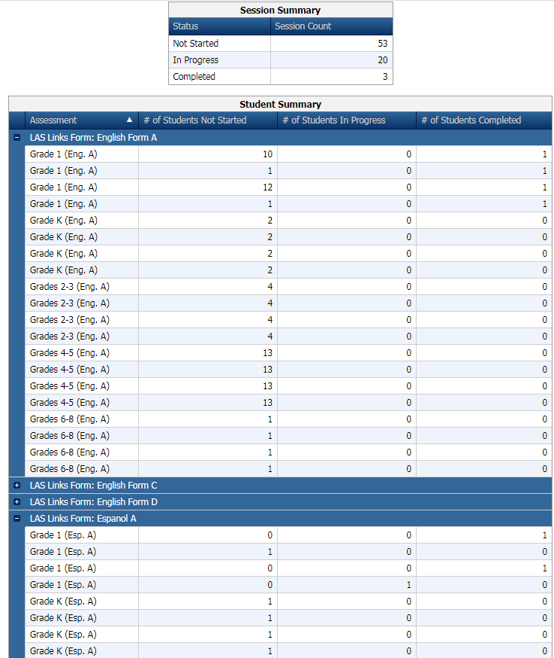
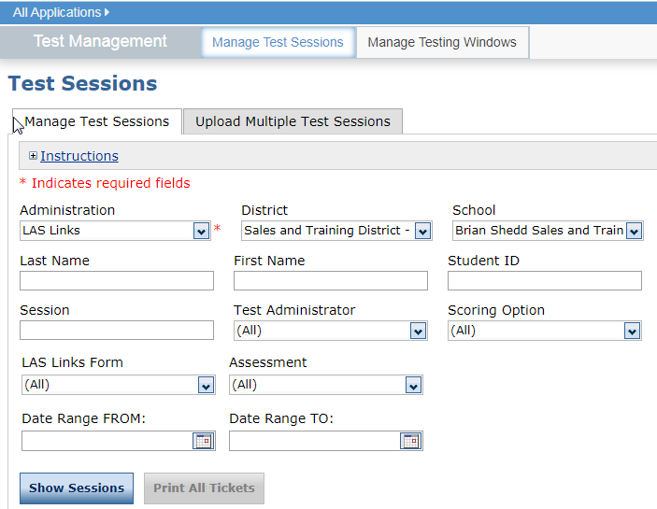
Check the Status of a Test Session
Click on Test Management
Click on Manage Test Sessions
Click on Show Sessions
Click on Status Summary to see the over test session summary
Notes:
Within the tab “Manage Test Sessions”, you may check the status of a Test Session to see the number of students that have not started, those in progress and the number of students that have Completed the Test Session using the “Status Summary” tab.

Slide 36
Student Status Dashboard
Click on MY APPLICATIONS >> Student Management:
Choose Student Management from the My Applications Dropdown Menu

Slide 37
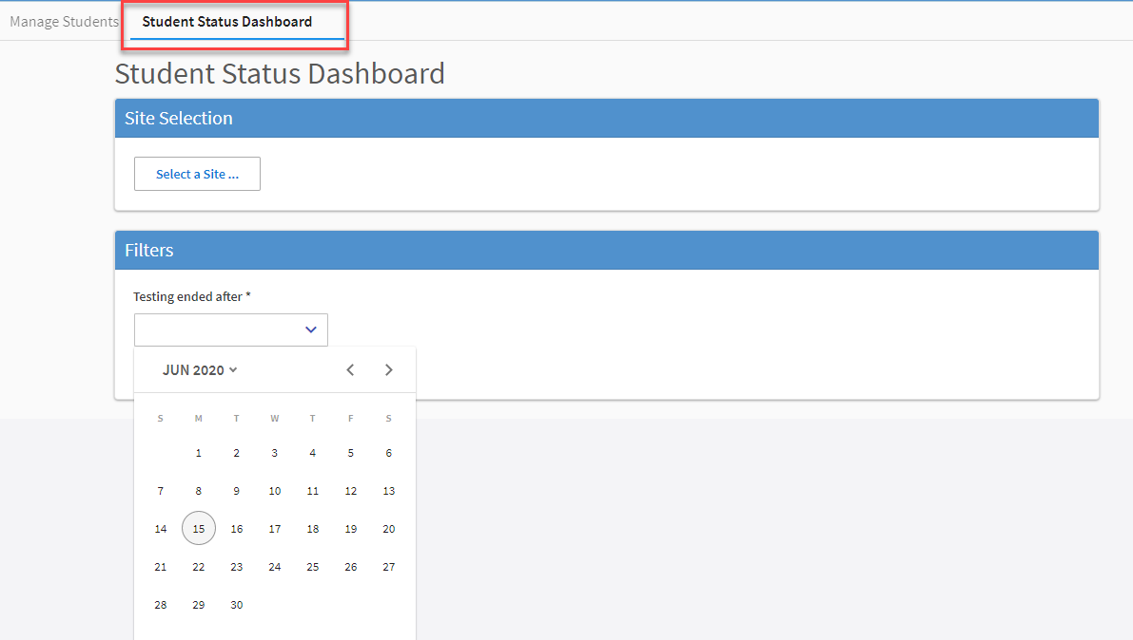
Student Status Dashboard
Under Student Management, click “select a site” and type in the school name.
Once the site is chosen, pick the “Testing ended after” date.

Slide 38
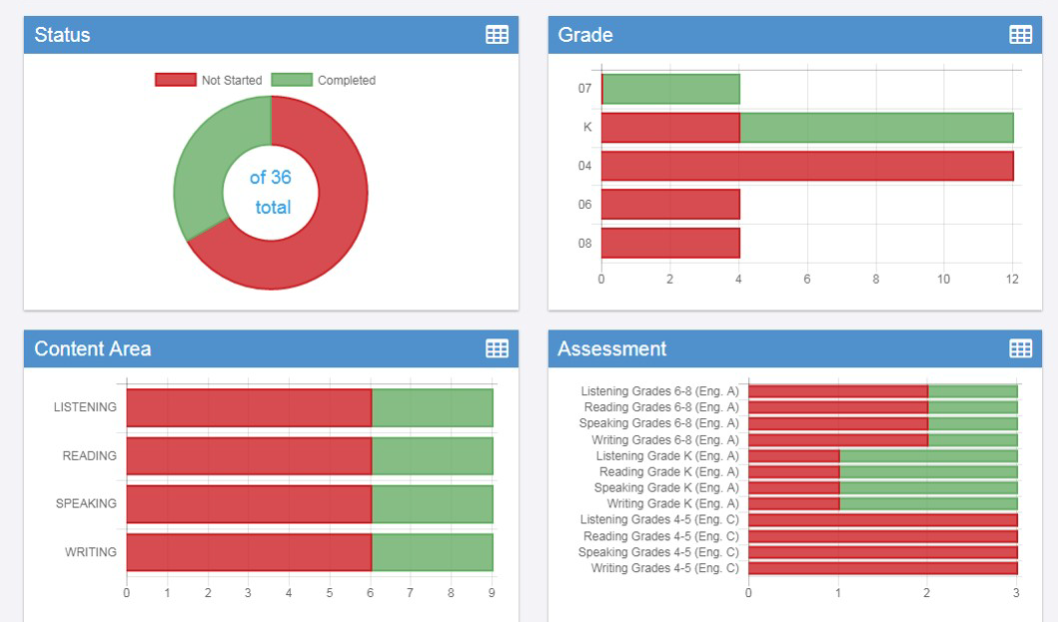
Student Status Dashboard
The student status dashboard will provide you in a graphical presentation, status by School overall, by grade, by content area and by assessment.
When you hover over any color, it will give you students counts.
Click on the icon in the right hand corner of each chart to make it a list as opposed to a chart.

Slide 39
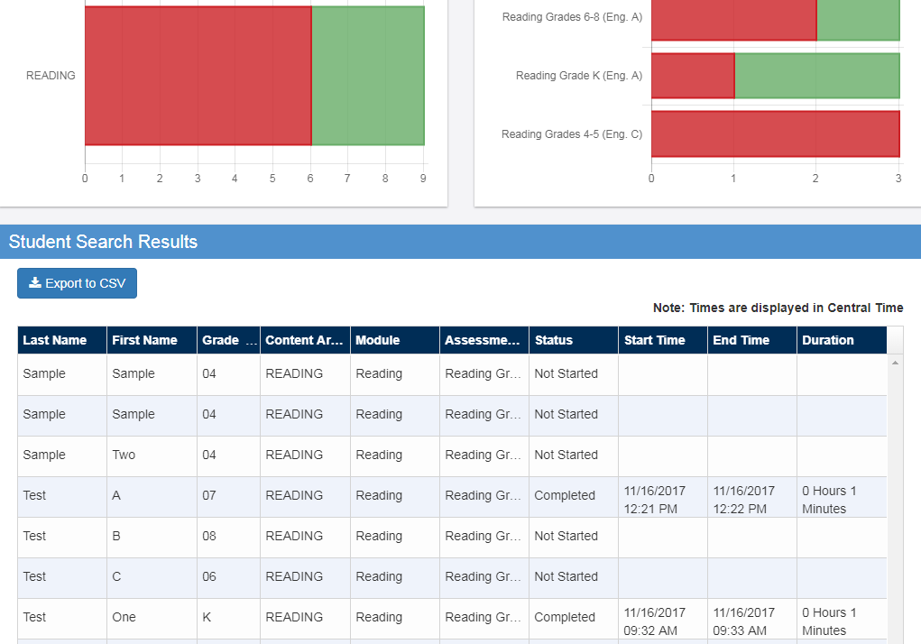
When you click on one of bars (or circle), it will provide you with a student roster with time stamps, at the bottom of the page. This is a report that can be exported.

Slide 40
Training Part 2: Administering the Test
Activity 1: preLAS Online
Test Administrator Testing Experience
Notes:
Training Part 2: Student Readiness and Proctoring the Test
Activity 1: preLAS Online – Test Administrator testing experience

Slide 41
preLAS Online Testing
When you, the Test Administrator, are ready to administer the test, click on the DRC INSIGHT App installed on your device
–OR- for Remote Testing, go to the Public URL.
Notes:
When you, the Test Administrator, are ready to administer the test, click on the DRC INSIGHT App installed on your device
–OR- for Remote Testing, go to the Public URL.
Installation of the Test Delivery Client is done by your District’s IT. DRC has provided technology resources on our website at www.laslinks.com.

Slide 42
Sign In
Type in the Username and Password provided to you on the Test Ticket

Slide 43
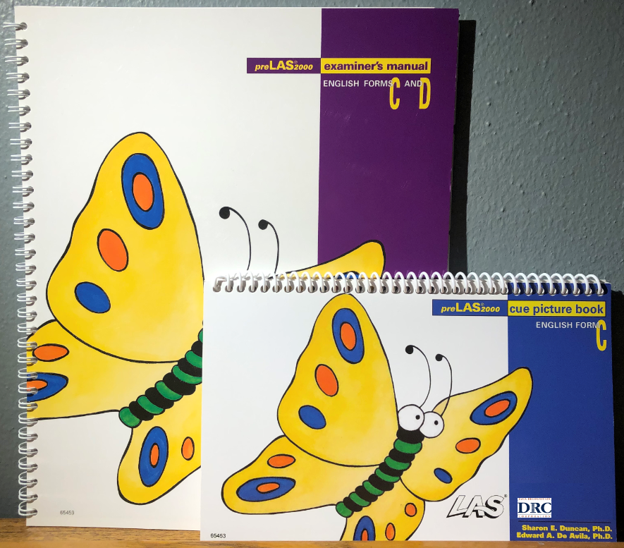
preLAS Test Materials Needed for Online Testing
Student licenses in DRC’s INSIGHT Portal
Examiner’s Manual: provides in-depth test directions, rubrics and scoring
Cue Picture Book: provides picture prompts to use while testing
Audio CD and/or Audio Files found in INSIGHT
Notes:
To administer the preLAS you will need: Test Administration Kits at a rate of one kit for every 50 students or less.
Each kit includes a cue picture book, examiner’s manual and a quick reference guide.
DRC also provides the audio files in an MP3 format. These are accessible via the INSIGHT portal.

Slide 44
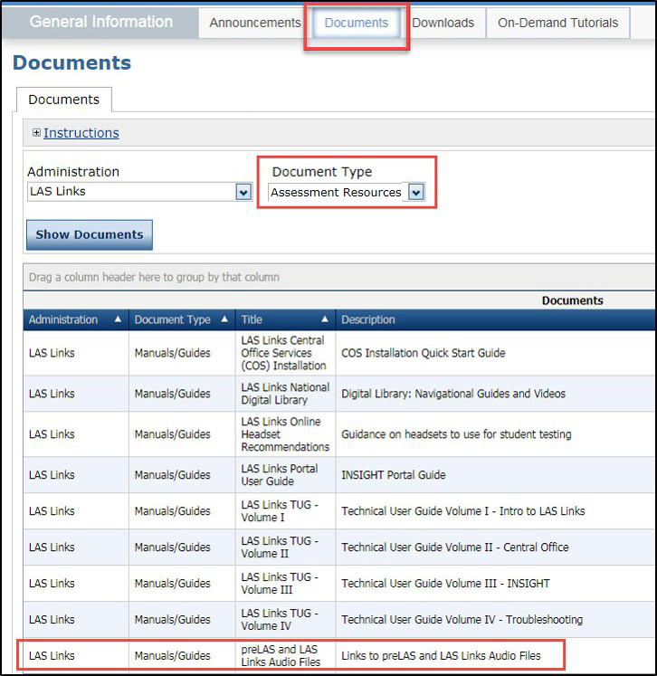
Accessing the Audio Files
Log into INSIGHT, click General Information under All Applications
Click Documents
Choose Assessment Resources
Notes:
To access the audio files, log into INSIGHT, Log into INSIGHT, click General Information under My Applications
Click Documents
Choose Assessment Resources

Slide 45
What is the preLAS?
The preLAS is language proficiency assessment consisting of an Oral Language component in English and Spanish for preK3-, preK4-, and Kindergarten students. Test results are used to:
Identify and place English Language Learners (EL’s) in appropriate classroom settings
Measure the developing language of first-language learners of Spanish
Individually administered assessment
Takes approximately 15 minutes to administer
Notes:
The preLAS is a language proficiency assessment consisting of an Oral Language component in English and Spanish for three-, four-, and five-year olds. Test results are used to: Identify and place English Language Learners (EL’s) in appropriate classroom settings and to measure the developing language of first-language learners of Spanish. The preLAS assessment is individually administered and takes approximately 15 minutes to administer.

Slide 46
Test Response Time
Refer to page 14 of the Examiner’s Manual
PreLAS is not a timed test.
Test can be administered in several sessions.
Test can be administered in any order.
Allow 3 - 5 seconds for each response. If there is no response, prompt a second time. If there is still no response, continue to the next item.
Prompts may be said no more than twice.
Notes:
For the test response time, please turn to page 14 of your Examiner’s manual if available.
For the preLAS response time, please note the following:
PreLAS is not a timed test
Test can be administered in several sessions
Test can be administered in any order
Two most key things to note……
- Allow 3 - 5 seconds for each response. If there is no response, prompt a second time. If there is still no response, continue to the next item
- Prompts may be said no more than twice

Slide 47
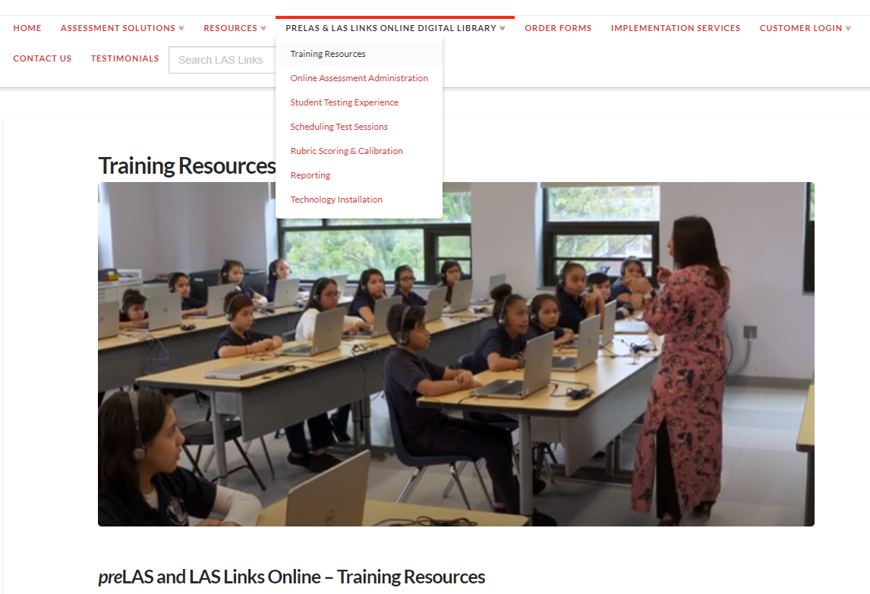
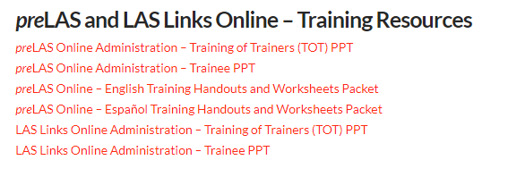
preLAS Online Training Resources

Slide 48
Training Part 2: Administering the Test
Activity 2: LAS Links Online
Student Practice Test
Notes:
Training Part 2: Student Readiness and Proctoring the Test - Activity 2: The Student Practice Test

Slide 49
LAS Links Online: Student Practice Test
Practice Test: Highly recommended prior to live testing. Student technology readiness should be determined during the practice test.
Students may access the practice test two ways: click on the DRC INSIGHT app or using CHROME go to: https://wbte.drcedirect.com/LL/portals/ll
Note: do NOT give the student live test credentials (their test ticket) until they are ready to actually take the real test.
Student Access:
PC/MAC/iPAD/Chromebook
Notes:
The Practice Test is highly recommended prior to live testing. Student technology readiness should be determined during the practice test.
Students may access the practice test two ways: click on the DRC INSIGHT app or using CHROME go to: https://wbte.drcedirect.com/LL/portals/ll
Note: do NOT give the student live test credentials (their test ticket) until they are ready to actually take the real test.
Installation of the Test Delivery Client is done by your District’s IT. DRC has provided technology resources on our website at www.laslinks.com.

Slide 50
Training Tip(s) for the Practice Test
Have the link to the Practice Test open on another tab on your computer:
https://wbte.drcedirect.com/LL/portals/ll and show it as a whole group –or- have each participant go to this URL, put their headsets on and take the practice test.
If you take the trainees through the practice test(s) as a whole group, if you show the speaking domain, you will need a head set that you will plug in when you are prompted to record an answer.
The embedded videos regarding the tools provided in each of the 4 domains are the same videos. Once the student has watched those videos and practiced with the tools during the first domain, they may skip the videos and the tools practice in the remaining domains and go straight to the specific domain practice items.

Slide 51
Training Part 2: Administering the Test
Activity 3: LAS Links Online
Proctoring Student Testing
Notes:
Training Part 2: Student Readiness and Proctoring the Test - Activity 2: Proctoring Student Testing

Slide 52
Estimated Total Time to Complete Administration of each Subtest (Forms C&D)
Subtest Area | Estimated Time
Speaking | 15 minutes – all Grades
Listening | 35 minutes – Grades K-1 30 minutes – Grades 2-3, 4-5, 6-8 and 9-12
Reading | 35 minutes – Grades K-1, 2-3 and 4-5 45 minutes – Grades 6-8 and 9-12
Writing | 30-35 minutes – Grades K-1 35 minutes – Grades 2-12
NOTE: For scheduling purposes these times are recommended to complete administration of each subtest and include setup, logins, etc. in addition to testing

Slide 53
LAS Links Online: Student Experience
When the student is ready to take the live test, he/she should be given the test ticket and should click on the DRC INSIGHT App installed on the student device.
Notes:
Students will access the live test by utilizing the LAS Links INSIGHT app installed on a PC, MAC, iPAD and/or Chromebook. Once the app is clicked, the student will utilize their credentials provided on their test ticket to login to their assigned test.
Installation of the Test Delivery Client is done by your District’s IT. DRC has provided technology resources on our website at www.laslinks.com/Texas and continues to provide live technology webinars.

Slide 54
Ending Incomplete Tests

Slide 55
Ending Incomplete Tests
Notes:
If you determine that a student Speaking and/or Listening test should be stopped based on the guidelines of the previous slide, those tests will remain “in limbo” until you “push” the tests to complete status. To do this, under Manage Test Sessions, click the Edit/Print Ticket Status Icon.

Slide 56
Ending Incomplete Tests
Notes:
The Testing Status pop up will appear. Note the Status by Module dropdown. You must End Incomplete Tests by Module (or subtest). Click on the green action button which, when hovered over says “End Incomplete Tests”.

Slide 57
Ending Incomplete Tests
Notes:
A pop up will appear confirming that you would like to end this incomplete test. When clicked, all Speaking items that were completed will then become available for scoring. Once this process is applied to the Listening test, the score will auto-generate (based on scoring items as correct or incorrect on completed items and auto applying a number correct of 0 on any items not attempted) on the On Demand report.

Slide 58
Training Part 3: Post Test Activities
Activity 1:
Scoring
Notes:
Training Part 3: Post Test Activities- Activity 1: Navigating Educator Scoring

Slide 59
Speaking (Forms C&D)
Speaking Skill Areas | Scoring
Make Conversation | Correct, Incorrect, No Response
Use Academic Words | Correct, Incorrect, No Response
Describe and Request Information | Constructed Response
Present and Explain Information | Constructed Response
Tell a Story | Constructed Response

Slide 60
Listening (Forms C&D)
Listening Skill Areas | Scoring
Listen for Information | Multiple-Choice
Listen for Academic Instruction | Multiple-Choice

Slide 61
Reading (Forms C&D)
Reading Skill Areas | Scoring
Read Words (K-3 only) | Multiple-Choice
Read School Texts | Multiple-Choice
Read Academic Texts | Multiple-Choice and Constructed Response (items 23, 24, 29, 30)

Slide 62
Writing (Forms C&D)
Writing Skill Areas | Scoring
Start Writing (K-1 only) | Constructed Response
Write to Express Ideas (all grades) | Constructed Response
Write Academic Texts (1-12 only) | Constructed Response
Use Grammar and Conventions (all grades) | Multiple-Choice

Slide 63
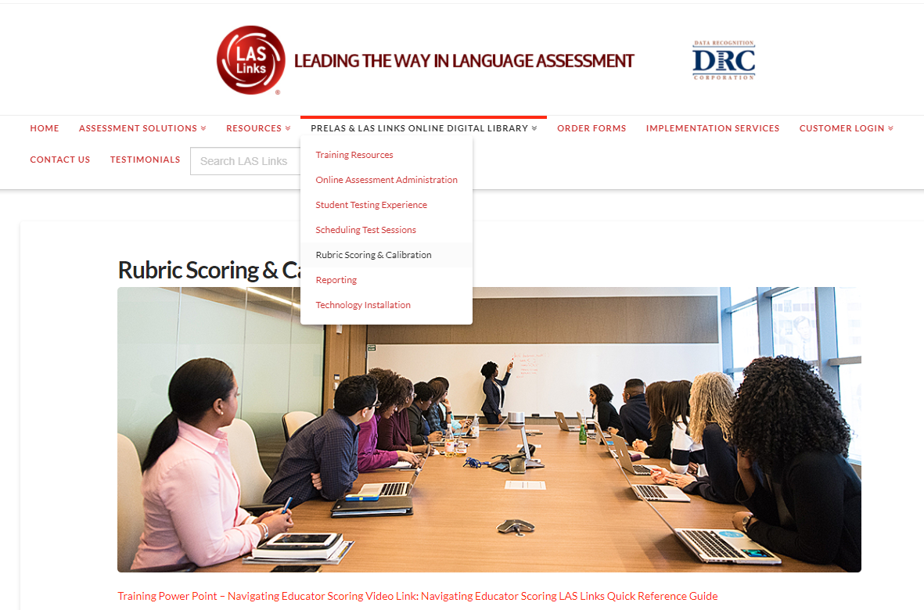
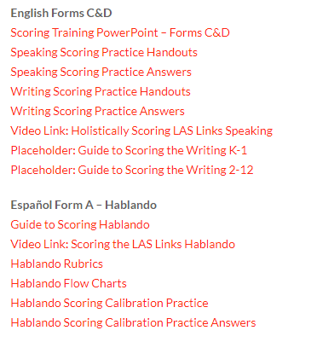
Scoring Calibration Resources
Scoring training PowerPoint, practice handouts and answer keys are found in the
LAS Links Online Administration Digital Library located at LASLinks.com
Notes:
For writing calibration resources, please download the LAS Links Writing Scoring Calibration Practice document found in the LAS LINKS Online National Digital Library

Slide 64
Training Part 3: Post Test Activities
Activity 2:
Generating and Interpreting Reports
Notes:
Training Part 3: Post Test Activities- Activity 3: Generating and Interpreting Reports

Slide 65
On-Demand Reports
Click on MY APPLICATIONS >> Report Delivery:
Notes:
Click on My Applications and then on the Report Delivery app.

Slide 66
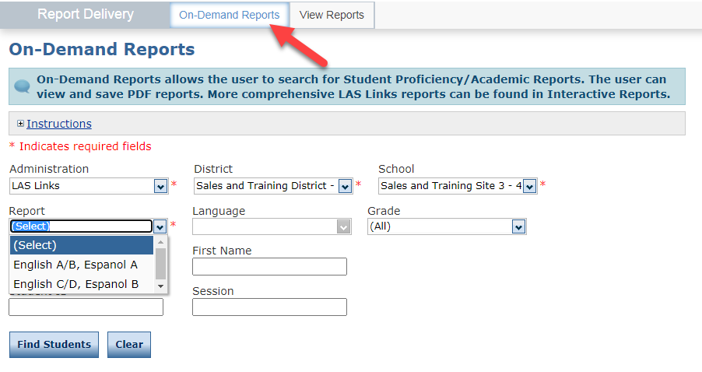
On-Demand Reports
Choose On-Demand Reports;
Apply all filters required (indicated by the asterisk*);
Click Find Students and a roster will populate below.

Slide 67
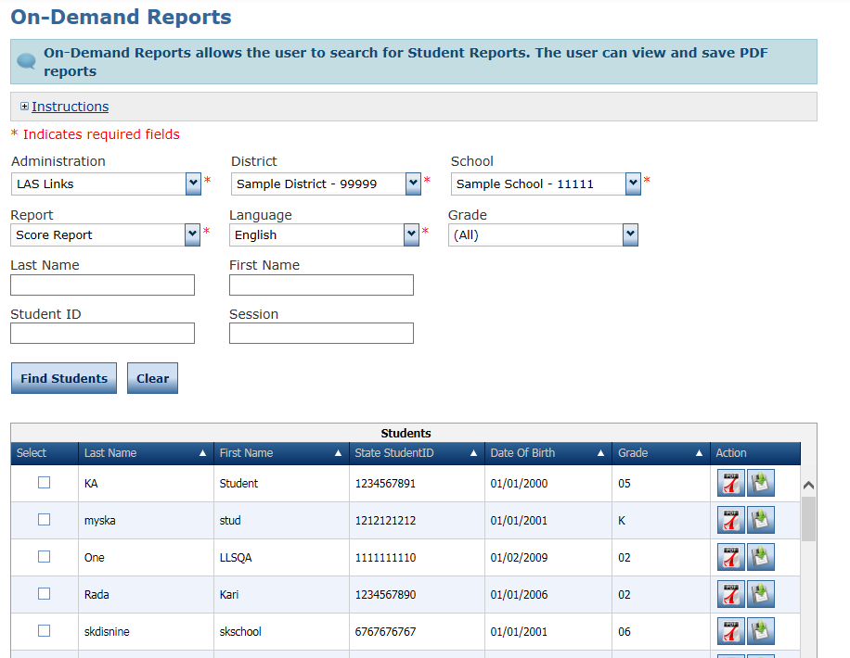
On-Demand Reports
Save PDF
Open PDF
Notes:
Notice there are expandable Instructions.
Then notice the required fields: Administration, District, School and these will most likely be pre-filled based on your sign-in.
Then we have the Search fields.
First, You MUST select a Report type before the search will launch.
You may choose to search by individual student by entering a Last Name and First Name; you may search by Student ID, and you may want to search for all students in a specific Test Session.
Once you have chosen your search criteria, click on Find Students.
If you do not fill in any search criteria, all of the students at your testing site will be returned.
A grid with Student Details will appear below the search fields. Notice that you can see the Last Name, First Name, ID, DOB, and Grade for each student. There are two Action Buttons: Open PDF or Save PDF. There are also Select boxes that you can check to then open or save only your selected students. Once the report PDFs open, you will scroll down through the whole report set if you have chosen multiple students.

Slide 68
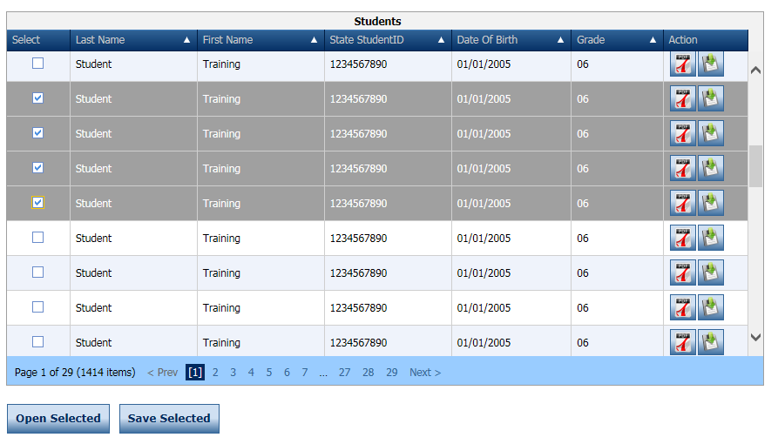
On-Demand Reports
Open or save multiple reports at once
Notes:
You can open and/or save multiple reports at once by clicking the button next to the students’ names then clicking open or save selected.

Slide 69
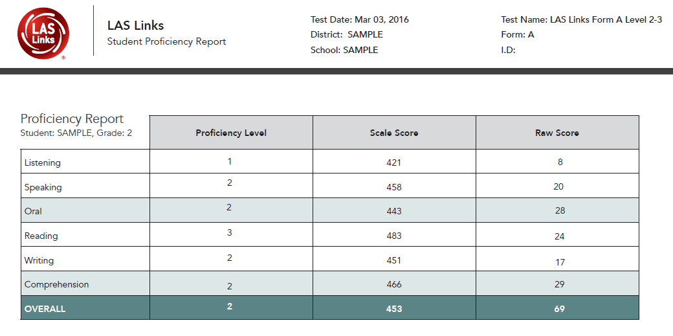
On-Demand Reports
Sample Report:
LAS Links 1st Edition: Forms A, B, Español A
Speaking and Writing scores become available once scoring is complete.
Notes:
This is a Sample Form A/First Edition report.

Slide 70
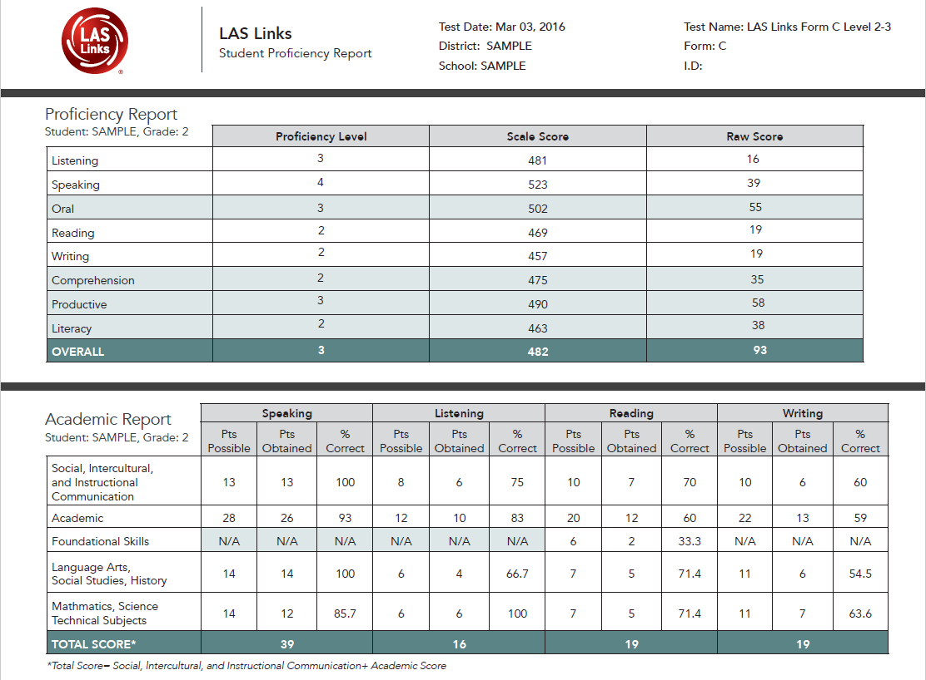
On-Demand Reports
Sample Report:
LAS Links 2nd Edition: Forms C, D, Español B
Speaking, Reading (4-12) and Writing scores become available once scoring is complete.
Notes:
This is a Sample Form C/2nd Edition Report

Slide 71
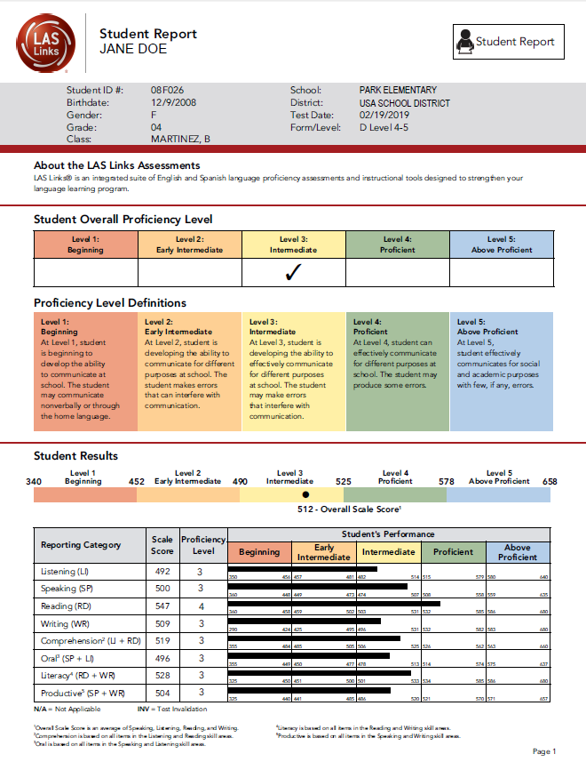
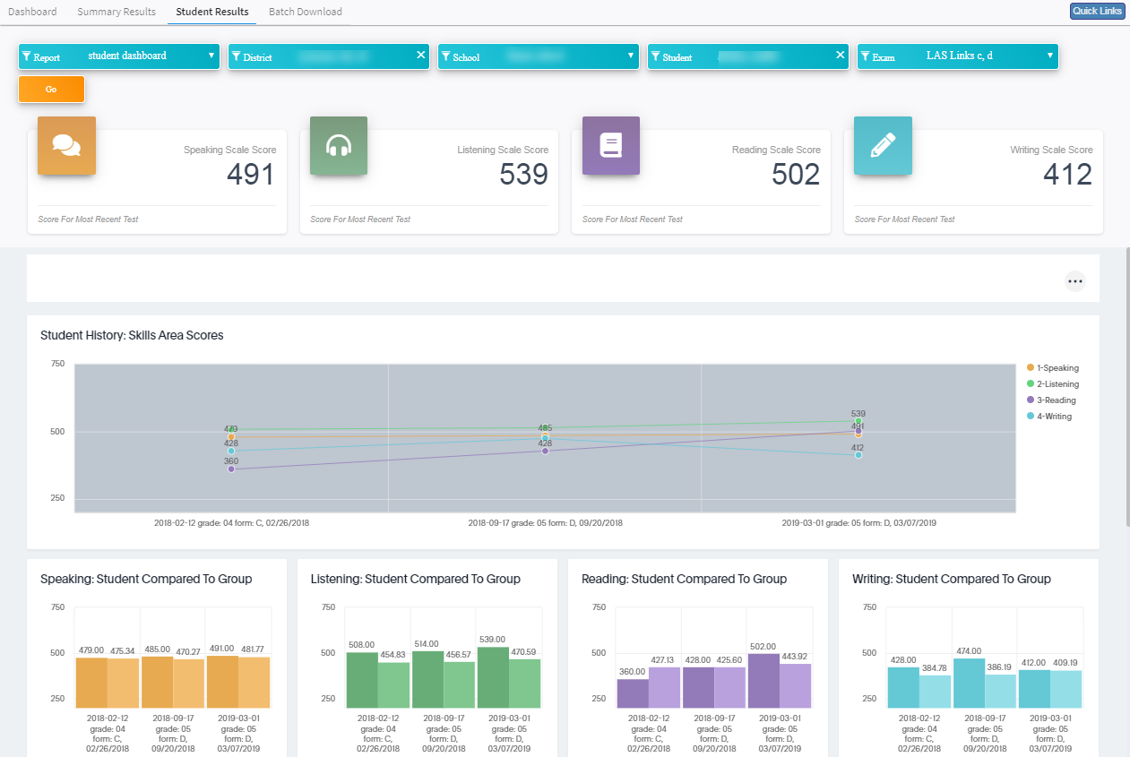
LAS Links Interactive Reports
Once all testing and scoring is complete, data is provided via DRC INSIGHT’s Interactive Reporting application.

Slide 72
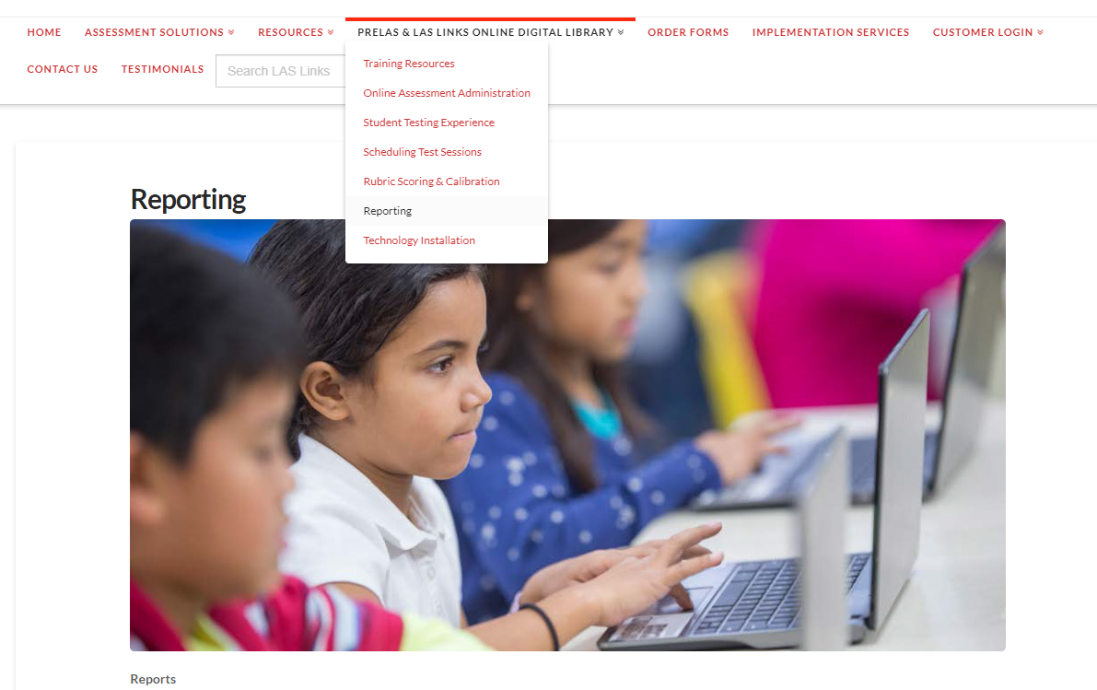
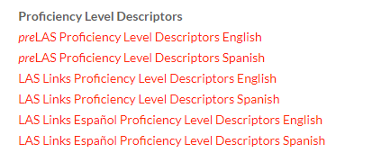
Digital Library: Proficiency Level Descriptors
The Proficiency Level Descriptors are found in the Digital Library

Slide 73
Remote Testing with preLAS and LAS Links Online

Slide 74
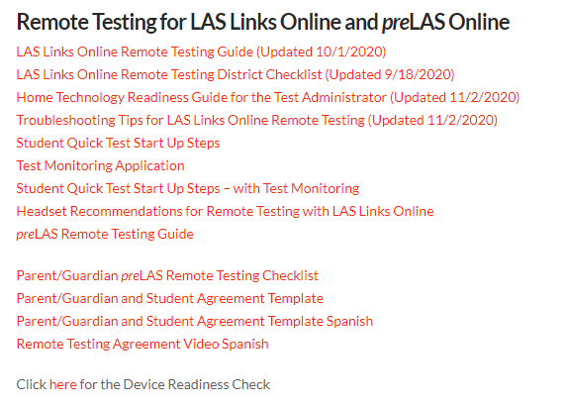
Remote Testing Resources
www.LASLinks.com

Slide 75
LAS Links Online Remote Testing Program Overview
Remote testing is an option for Districts who are unable to test students for in an onsite setting during this time of COVID-19.
From an assessment standpoint, DRC’s remote solution allows the LAS Links Online assessments to retain 3 critical factors: reliability, validity and security.
From a practitioner standpoint, DRC’s remote solution is viable and executable from both the standpoint of the Test Administrator (TA) and from the student who is taking the test remotely.

Slide 76
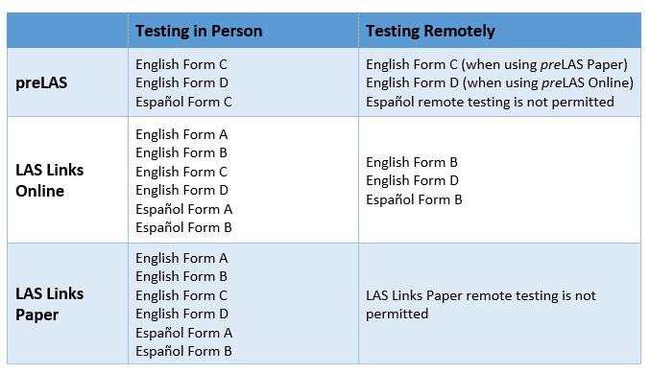
preLAS and LAS Links Online Remote Testing Program Overview
Remote testing is available now
Districts who have purchased LAS Links Online student licenses may begin registering students, scheduling test sessions and testing students remotely.
*Hybrid models are acceptable, as long as the approved form of the test is utilized in the corresponding setting.

Slide 77
Remote Testing with preLAS (preK3, preK4, Kindergarten, 1st Grade)

Slide 78
Remote Testing with preLAS Choosing a Web Conferencing Service
Access to the test by the students will be provided in a one-to-one web meeting scenario – controlled/presented by a Test Administrator (TA).
The TA must use a supported web conferencing platform and be familiar with the use of that platform. Possible options are Zoom, Webex, Google Meet, Microsoft Teams, Skype, GoToMeeting, and Blackboard Collaborate .
Choose a Web Conferencing Service that provides:
Computer-based Audio and Video
Recording Capability
Screen Sharing by Participants
Meeting Login Information Embedded in Link
Ability to allow for private/breakout rooms
Detailed information may be found in the preLAS Remote Testing Guide on the website.

Slide 79
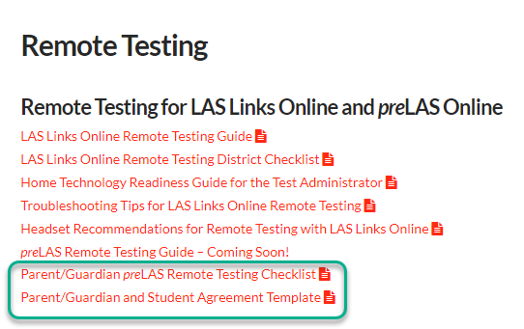
preLAS Remote Testing Home Readiness
Parents/Guardians are required to be present during testing.
Parent/Guardian and Student Agreement (optional) – to be emailed prior to testing day.
It is recommended that the TA and the Parent meet briefly prior to the test session to go over the Parent/Guardian testing checklist.

Slide 80
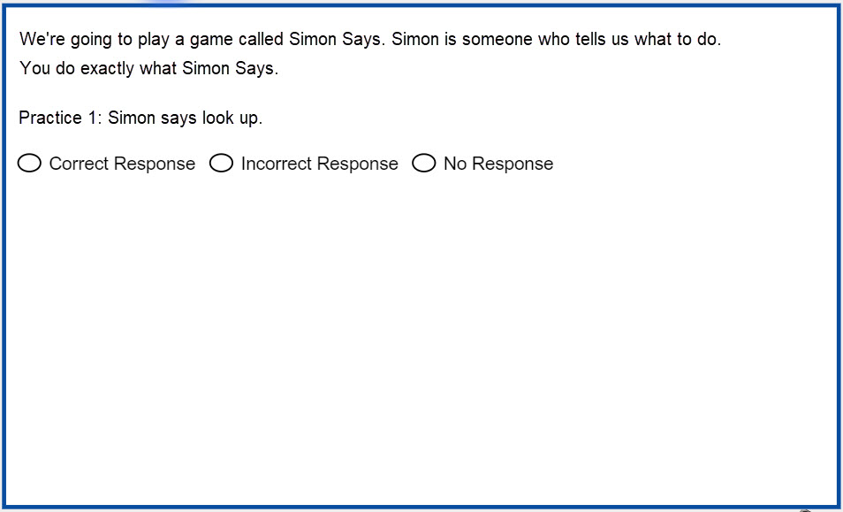
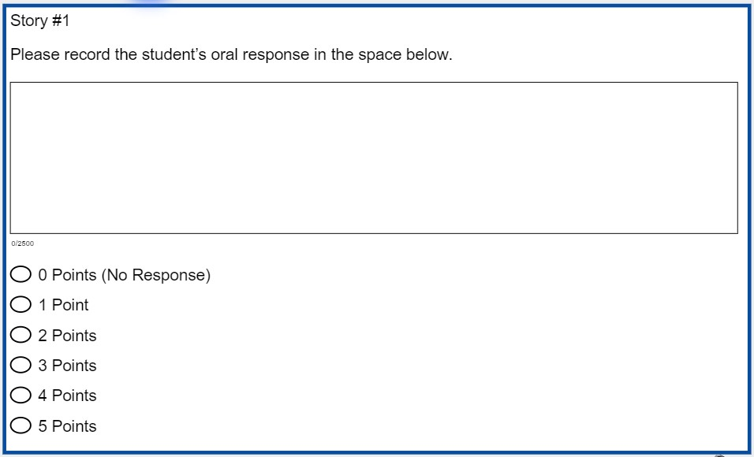
preLAS ONLINE Remote Testing
Form D (online) remote administration
Students at this age (3, 4, 5) do NOT take the test online. The TA enters their answers on a digital platform instead of the paper answer document.

Slide 81
preLAS ONLINE Remote Testing
The following are TA guidelines for the Form D (online) remote administration
Two devices are recommended, one for the web meeting, one to mark student responses.
Or the TA may toggle between tabs on one device if desired
Use the DRC INSIGHT Portal to Register Students, Create Test Sessions and obtain log in credentials which are provided to the student/parent at the time of testing.
From the DRC INSIGHT Portal download the PDF of the cue pictures for parts 2, 4 and 5 of preLAS (Art Show, Human Body, Let’s Tell Stories).
Click on General Information > Documents > Assessment Resources.
Download the preLAS Audio Files from the DRC INSIGHT Portal (Assessment Resources)
Interview the student in the same way they normally would, except the TA will need to “show” the PDF of pictures to the student.
Mark the correct items, holistic scores and final scores directly into the application.

Slide 82
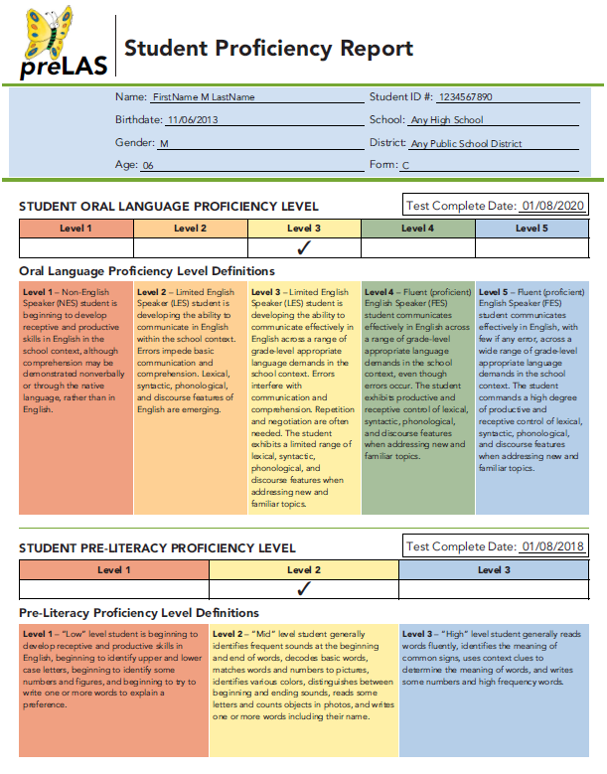
preLAS ONLINE Remote Testing
Student reports will be available 30-60 minutes after the test is submitted as complete.
Reports will be available via On-Demand Reports.
Pricing is $2.20/student license which is comparable to a single student answer sheet.
preLAS Online is an option. Paper documents are still valid and may still be used.
LEAs testing on site are required to use the purchased Cue Book – printing of the copyrighted digital copy of the Cue Book is not allowed.

Slide 83
Remote Testing with LAS Links Online (Grades K -12)

Slide 84
LAS Links Online Remote Testing Device Requirements
Remote testing will be offered to students via two options. Districts can choose which works best for their specific situation:
Option 1: LEA provides a device (Windows, macOS, Chrome OS) to a student with the necessary Google Chrome browser installed;
Option 2: Student using their own device (Windows, macOS, Chrome OS) with the necessary Google Chrome browser installed
DRC has created two following public URLs for remote testing which allows a student to log in to the online test from a device using a Google Chrome browser:
Public URL to use when not utilizing the new Test Monitoring Application
Public URL to use when utilizing the new Test Monitoring Application

Slide 85
DRC Device Check
DRC INSIGHT Readiness URL – www.DRCdevicecheck.com provides one-click device check for students using their own device (Option 2)
Public URL to check readiness for remote DRC INSIGHT testing
Target users are schools and districts conducting remote testing devices using DRC’s Public Browser
Integrated Online Help for easy, quick access to answers
Easy to use device compatibility check for
remote testing on DRC Insight®
www.DRCdevicecheck.com
Notes:
For sites using Option 2 on the previous slide:
DRC Device Check for remote testing, now available online at www.DRCDeviceCheck.com. The Device Check will help you verify that testing devices meet the requirements for remote testing with the DRC INSIGHT Public Browser.
The Device Check allows users to run a quick test to confirm that their testing devices meet the criteria for DRC INSIGHT remote testing. The test is simple and automated.
DRC INSIGHT Readiness URL – www.DRCdevicecheck.com Available Now ◼ Public URL to check readiness for remote DRC INSIGHT testing ◼ Target use is remotetesting devices using DRC’s Public Browser ◼ Integrated Online Help for easy, quick access to answers

Slide 86
DRC Device Check
Notes:
The test results are displayed on screen, indicating whether the criteria were met. If a user has any questions about what is being checked or about their results, they can refer to the integrated Online Help for more information on the specific device requirements.
DRC recommends running the Device Check test to ensure the best user testing experience when using DRC INSIGHT in remote testing settings. The tool is available to use at any time, and can be accessed online through a public URL: www.DRCDeviceCheck.com. We encourage you to use this resource with all of your remote testers.
Important: The new DRC Device Check is intended for remote testing devices only. Sites that administer in-person testing with the DRC INSIGHT Secure Application should NOT use the new DRC Device Check. In-person testing sites should continue to use the System Readiness Check that is part of the DRC INSIGHT Secure Application.

Slide 87
Preparing for Remote Testing
TAs should review and utilize the LAS Links Online Remote Testing Guide and the District Checklist which provides:
Pre-Testing Guidance which includes
Choosing a web conferencing platform
Preparing the test (DRC INSIGHT)
Preparing the remote site/home which includes testing device information
Testing Day Guidance which includes
Web meeting guidance
Proctoring guidance and tips
Post Test Guidance
Scoring
Reporting

Slide 88
Remote Testing with LAS Links Online Choosing a Web Conferencing Service
The TA must use a supported web conferencing platform and be familiar with the use of that platform. Possible options are Zoom, WebEx, Google Meet, Microsoft Teams, Skype, GoToMeeting, and Blackboard Collaborate.
Choosing a Web Conferencing Service that provides:
Computer-based Audio and Video
Recording Capability
Screen Sharing by Participants
Meeting Login Information Embedded in Link
Ability to allow for private/breakout rooms
Web conferencing options may be found posted at www.laslinks.com

Slide 89
LAS Links Online Remote Testing Pre-Testing Activities
Pre-Testing Administrative Tasks:
All LAS Links Online administrative tasks remain the same:
Student Registration occurs in the DRC INSIGHT Portal.
Test Session Creation
Choose either Form B, Form D and/or Español Form B
Students will be provided login credentials at the time of the web meeting with the TA.
Scoring
Contact DRC to convert your sessions to DRC Scoring (if purchased)

Slide 90
LAS Links Online Remote Testing Pre-Testing Activities Continued
Recommended: TAs should meet with the Parent/Guardian and the student being tested to review the home the Home Technology Readiness Checklist which includes:
Technical Specifications
Troubleshooting as needed
Headset guidance
May be done as a meeting with several homes at once if desired.
TAs are to recommended to allow for student LAS Links practice test which allows:
The TA to practice the web meeting (private rooms, chat, etc.)
The student to practice logging in, learning the portal testing tools, try some LAS Links practice items, practice using the chat feature, etc.
To get the meeting started, the TA provides web meeting information via an email that includes the Parent/Guardian and Student agreement (optional) – managed by the District.

Slide 91
LAS Links Online Remote Testing Test Day Activities
Testing
When ready for testing, the TA will invite the student to a web meeting via email.
Via the private chat, TAs provide student with the Student Quick Start Up Steps (with or without TMA) and the student log in credentials from the test ticket.
TMA

Slide 92
LAS Links Online Remote Testing Test Day Activities
Testing
Student either clicks on the DRC INSIGHT application or opens the public URL in the Student Quick Start Up Steps document (preferred) to enter their testing UN and PW.
The public URL allows for easier toggle to chat for the student if they need to communicate with the TA.
Use the Troubleshooting guide at www.laslinks.com to assist as needed
Subtest Administration guidelines:
Speaking will be administered one-to-one testing (large Districts may consider staffing needs).
Listening, Reading and Writing may be administered in a 1:5 setting (no more than 5 students at time).
Student may take subtests all in one day or over the course of several days.
Student must finish the subtest on the same day the subtest was started.
Use professional discretion.

Slide 93
LAS Links Online Remote Testing Post Test Activities
Post Test
Administrative tasks remain the same as on-site testing
Scoring using Educator Scoring (if scoring locally)
Reporting
Contact DRC when all testing is complete to move your data to Interactive Reporting
Technology Support
All technology questions from a student home will need to be directed to the District’s IT department.
DRC will provide technology support to District technology departments only.
If a parent/guardian/student contacts DRC tech support for assistance, DRC will advise the caller to contact their Test Administrator or District tech department for assistance.
DRC has posted home technical requirements (i.e. bandwidth) that may be shared by the District with the home.

Slide 94
Support
LAS Links Help Desk:
866.282.2250
7:00 a.m. - 8:00 p.m. EDT
LASLinksHelpDesk@datarecognitioncorp.com
If you already called in and have a case, provide your case number for expedited service

