Slide 1
Escritura
Scoring Training Packet: Las Links Español Form B

Slide 2
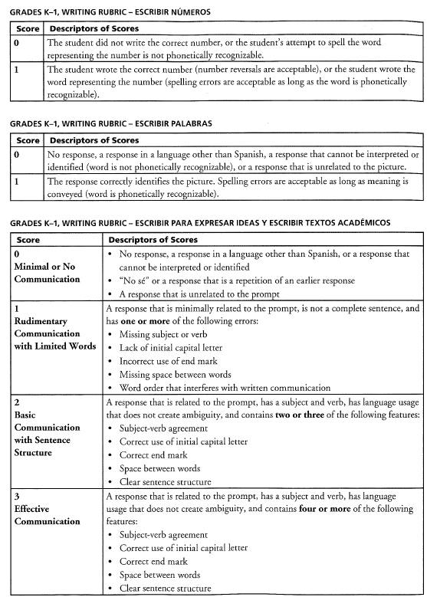
Scoring Escritura – Rubrics Escribir números, Escribir palabras, Escribir para expresar ideas, y Escribir textos académicos (Grades K-1)

Slide 3
Scoring Escritura 0-3 – Process of Score Selection Escribir para expresar ideas (Grades K-1)
Does the response have a subject and verb and relates to the prompt?
Yes = 3 or 2
No = 1 or 0
= 1 Has one or more of the listed ERRORS
= 3 Has four or more listed features
= 0 if response does not relate to the prompt or “no sé”
= 2 Has two or three of the listed features
Process of Score Selection:
Does the response have a subject and verb and relates to the prompt?
If Yes = 3 or 2. No = 1 or 0
If Yes:
3 = Has four or more listed features
2 = Has two or three of the listed features
If No:
1 = Has one or more of the listed ERRORS
0 = if response does not relate to the prompt or “no sé”

Slide 4
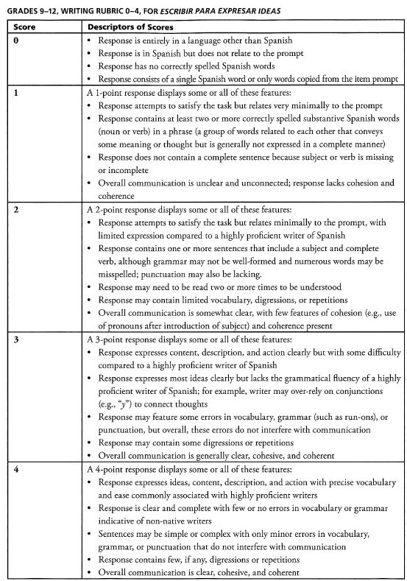
Scoring Escritura 0-4 – Rubrics Escribir para expresar ideas (Grades 2-12)

Slide 5
Scoring Escritura 0-4 – Process of Score Selection Escribir para expresar ideas (Grades 2-12)
Does the response answer all the questions asked (satisfy the task)?
Yes = 4 or 3
No = 2, 1 or 0
= 2 Response contains at least one sentence that relates to the task
= 4 Response is clear, complete, cohesive
= 0 Response does not relate to the prompt
= 3 Response is somewhat clear, minor grammatical errors are okay
= 1 Response contains at least two correctly spelled substantive Spanish words that relate to the prompt
Process of Score Selection:
Did the student response answer all the questions asked (satisfy the task)?
If Yes = 4 or 3. No = 2, 1, 0
If Yes:
4 = clear, complete, cohesive
3 = somewhat clear, minor grammatical errors
If No:
2 = Contains at least one sentence that relates to the task
1 = Contains at least two correctly spelled substantive Spanish words related to the prompt.
0 = Response does not relate to the prompt, no answer, HL answer only

Slide 6
Scoring Escritura 0-3 – Rubrics Escribir textos académicos (Grade 1 only)

Slide 7
Scoring Escritura 0-3 – Process of Score Selection Escribir textos académicos (Grade 1 only)
Does the response have a subject and verb and relates to the prompt?
Yes = 3 or 2
No = 1 or 0
= 0 Response does not relate to the prompt or “no sé”
= 2 Has two or three of the listed features
= 1 Has one or more of the listed ERRORS
= 3 Has four or more listed features
Process of Score Selection:
Does the response have a subject and verb and relates to the prompt?
If Yes = 3 or 2. No = 1 or 0
If Yes:
3 = Has four or more listed features
2 = Has two or three of the listed features
If No:
1 = Has one or more of the listed ERRORS
0 = if response does not relate to the prompt or “no sé”

Slide 8
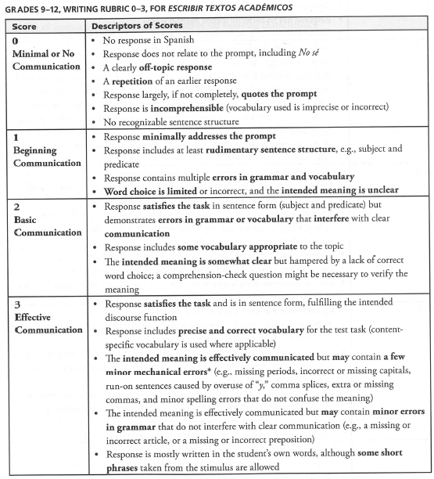
Scoring Escritura 0-3 – Rubrics Escribir textos académicos (grades 2-12 only)

Slide 9
Scoring Escritura 0-3 – Rubrics Escribir textos académicos (grades 2-12 only)
Does the response answer all the questions asked (satisfy the task in sentence format)?
Yes = 3 or 2
No = 1 or 0
= 1 Contains subject and predicate
= 3 Meaning is communicated
= 0 If response does not relate to the prompt, quotes the prompt, or has single Spanish word(s)
= 2 Meaning is somewhat clear, errors in grammar
Process of Score Selection:
Did the student response answer all the questions asked (satisfy the task in sentence format)?
If Yes = 3 or 2. No = 1 or 0
If Yes:
3 = meaning is communicated
Note: It is understood that in grades 4–12, students should capitalize the first word in a sentence and use correct end punctuation to receive a full score of 3.
If the response demonstrates regular errors in these areas, the score will be lowered to a 2. An occasional mistake is permissible.
2 = meaning is somewhat clear, errors in grammar
If No:
1 = Contains at least subject and predicate
0= If response does not relate to the prompt, quotes the prompt, or has single Spanish word(s)

Slide 10
Hablando
Scoring Training Packet: Las Links Español Form B

Slide 11
Scoring Hablando 0-3 – Rubrics Describir y pedir información y Presentar y explicar información
(Grades K-12)

Slide 12
Scoring Hablando 0-3 – Process of Score Selection Describir y pedir información y Presentar y explicar información
(Grades K-12)
Does the response provide an answer to the question with satisfactory sentence structure and include most of the Required Major Information?
Yes = 3 or 2
No = 1 or 0
= 1 if response relates to the prompt
= 3 Response is Understood
= 0 if response does not relate to the prompt
= 2 Response is somewhat clear?
Minor Grammatical errors do not adversely impact meaning or interfere with effective communication (e.g., omissions of prepositions, auxiliary verbs, articles, and errors in their usage).
Serious Grammatical errors affect meaning and could interfere with communication (e.g., omission of a main verb).
Note: May include minor errors that do not interfere with the meaning. Or can be natural speech.
Process of Score Selection:
Does the response provide an answer to the question with satisfactory sentence structure and
include most of the “Required Major Information”?
Yes = 3 or 2; No = 1 or 0
Then, is the meaning somewhat clear ( Yes = 2) or understood (Yes = 3)?
Note: If the response is not completely “understood” as the response contains a serious
grammatical error that interferes with communication. Score = 2 (somewhat clear)
Does the response provide an answer to the question with satisfactory sentence structure and
include most of the “Required Major Information”?
If No = 1 or 0
Then, does the response contain Spanish word(s) that relates to the prompt?
Yes = 1, No = 0
-------------
Minor Grammatical errors include errors that do not adversely impact meaning
and do not interfere with effective communication (e.g., omissions
of prepositions, auxiliary verbs, articles, and errors in their usage).
Serious Grammatical errors include errors that do affect meaning and
could interfere with communication (e.g., omission of a main verb).

Slide 13
Scoring Hablando 0-4 – Rubrics Contar un cuento
(Grades K-12)

Slide 14
Scoring Hablando 0-4 – Process of Score Selection Contar un cuento
(Grades K-12)
Does the response tell a story with coherent & cohesive narrative?
Yes = 4,3 or 2
No = 1 or 0
= 1 if response relates to the prompt
= 4 Response has elaboration & detail
= 0 if response does not relate to the prompt
= 2 Missing a major element in one picture OR serious grammatical errors
= 3 Response does not have elaboration & detail
Process of Score Selection:
Did the student tell a story with coherent & cohesive narrative?
If Yes = 4, 3 or 2. No = 1 or 0
Note: A coherent or cohesive narrative is based on a logical, ordered narrative where the student talks about all the pictures; however, it does not require transitional words such as first, then, next, after that, finally, etc. A coherent and cohesive narrative links the pictures together – not merely describing them as stand-alone scenes.
If Yes, does the story contain elaboration and detail? Yes = 4, No = 3
If Yes, BUT story contains MAJOR GRAMMATICAL ERRORS => 2
If No:
1 = Missing events in one or more of the pictures. Some grammatical errors.
0 = Errors severely interfere with communication.
Response relates to the prompt.

