Slide 1
LAS Links Writing Scoring Training Forms C and D Grades 2-12

Slide 2
Writing Sections
Writing Skill Areas | Scoring
Use Grammar and Conventions | Multiple-Choice
Write Academic Texts | Constructed Response
Write to Express Ideas | Constructed Response

Slide 3
Write Academic Texts 0-3 Rubric
Students are asked to write about a reading passage. First, they write a summary of a paragraph then they are asked to write sentences comparing information provided in a table.
Scoring is based on a 0-3 rubric:
Score
0 | • No response in English • Response does not relate to the prompt, including “I don’t know” • A clearly off-topic response • A repetition of an earlier response • Response largely, if not completely, quotes the prompt • Response is incomprehensible (vocabulary used is imprecise or incorrect) • No recognizable sentence structure
1 | Beginning Communication • Response minimally addresses the prompt • Response includes at least rudimentary sentence structure, e.g., subject and predicate • Response contains multiple errors in grammar and vocabulary • Word choice is limited or incorrect, and the intended meaning is unclear

Slide 4
Write Academic Texts 0-3 Rubric
Score
2 | • Response satisfies the task in sentence form (subject and predicate) but demonstrates errors in grammar or vocabulary that interfere with clear communication • Response includes some vocabulary appropriate to the topic • The intended meaning is somewhat clear but hampered by a lack of correct word choice. A comprehension-check question might be necessary to verify the meaning.
3 | • Response satisfies the task and is in sentence form, fulfilling the intended discourse function • Response includes precise and correct vocabulary for the test task (content-specific vocabulary is used where applicable) • The intended meaning is effectively communicated but may contain a few minor mechanical errors* (e.g., missing periods, incorrect or missing capitals, run-on sentences caused by overuse of “and,” comma splices, extra or missing commas or apostrophes, and minor spelling errors that do not confuse the meaning) • The intended meaning is effectively communicated but may contain minor errors in grammar that do not interfere with clear communication (e.g., a missing or incorrect article, or a missing or incorrect preposition) • Response is mostly written in the student’s own words, although some short phrases taken from the stimulus are allowed

Slide 5
Write Academic Texts Scoring Flow Chart
Does the response answer all the questions asked (satisfy the task in sentence format)?
Yes = 3 or 2
No = 1 or 0
= 1 Contains subject and predicate and meaning is unclear
= 3 Meaning is effectively communicated. May contain minor errors (grammatical and/or mechanical) that do not interfere with communication.
= 0 If response does not relate to the prompt, quotes the prompt, or has single English word(s) – no verb
= 2 Meaning is somewhat clear, errors in grammar that interfere with communication

Slide 6
Write Academic Texts Scoring Practice (0-3 Rubric)
Student Response | Score
Wind
People used winds mills because it pumped the water. Also because the sail boats have to have wind to push the sails.
It is about wind and wind mills
The wind helps it move for the water can pump up. So the water can move.
0
3
1
2

Slide 7
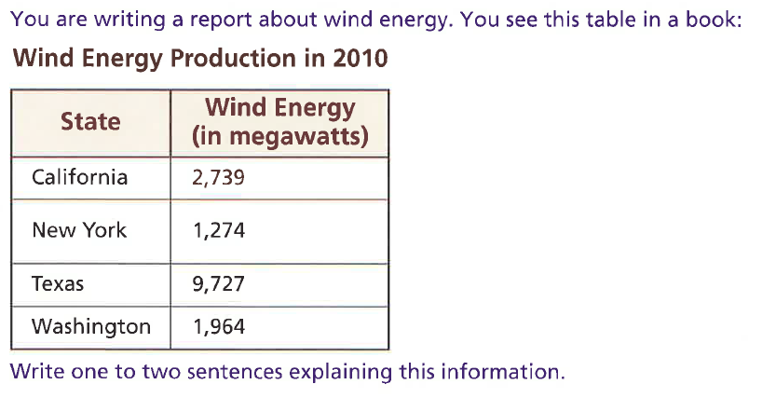
Write Academic Texts Scoring Practice (0-3 Rubric)
Note: Any response indicating that Texas has the highest amount of wind energy or that New York has the least amount of wind energy receives full credit because it fully demonstrates the student’s understanding of the information in the table.
Student Response | Score
Texas has a lot of wind energy it is 9,727
The bigger wind energy is 9,727. And the smallr wind energy is 1,274.
Texas produce more wind energy than all the other states.
Very windy.
1
2
3
0

Slide 8
Write to Express Ideas 0-4 Rubric
Students are asked to read a message and write their response to the message.
Score
0 | Response displays some or all of these features: • Student does not respond orally • Response is in a language other than English or is unintelligible
1 | A 1-point response displays some or all of these features: • Response attempts to satisfy the task but relates very minimally to the prompt • Response contains at least two or more correctly spelled substantive English words (noun or verb) in a phrase (a group of words related to each other that convey some meaning or thought but are generally not expressed in a complete manner) • Response does not contain a complete sentence because subject or verb is missing or incomplete • Overall communication is unclear and unconnected; response lacks cohesion and coherence
2 | A 2-point response displays some or all of these features: • Response attempts to satisfy the task but relates minimally to the prompt, with limited expression compared to a highly proficient writer of English • Response contains one or more sentences that include a subject and complete verb, although grammar may not be well-formed and numerous words may be misspelled. Punctuation may also be lacking. • Response may need to be read two or more times to be understood • Response may contain limited vocabulary, digressions, or repetitions • Overall communication is somewhat clear, with few features of cohesion (e.g., use of pronouns after introduction of subject) and coherence present

Slide 9
Write to Express Ideas 0-4 Rubric
Score
3 | A 3-point response displays some or all of these features: • Response expresses content, description, and action clearly but with some difficulty compared to a highly proficient writer of English • Response expresses most ideas clearly but lacks the grammatical fluency of a highly proficient writer of English; for example, writer may over-rely on conjunctions (e.g., “and”) to connect thoughts • Response may feature some errors in vocabulary, grammar (such as run-ons), or punctuation, but overall, these errors do not interfere with communication • Response may contain some digressions or repetitions • Overall communication is generally clear, cohesive, and coherent
4 | A 4-point response displays some or all of these features: • Response expresses ideas, content, description, and action with precise vocabulary and ease commonly associated with highly proficient writers • Response is clear and complete with few or no errors in vocabulary or grammar indicative of non-native writers • Sentences may be simple or complex with only minor errors in vocabulary, grammar, or punctuation that do not interfere with communication • Response contains few, if any, digressions or repetitions • Overall communication is clear, cohesive, and coherent

Slide 10
Write to Express Ideas Scoring Flow Chart
Does the response answer all the questions asked (satisfy the task)?
Yes = 4 or 3
No = 2, 1 or 0
= 2 Response contains at least one sentence that relates to the task with errors that cause you to read the response more than once for understanding
= 4 Response is clear, complete, cohesive
= 0 Response does not relate to the prompt or is unintelligible
= 3 Response is somewhat clear, minor grammatical errors are acceptable
= 1 Response contains at least two correctly spelled English words that make up at least a phrase that relates to the prompt

Slide 11
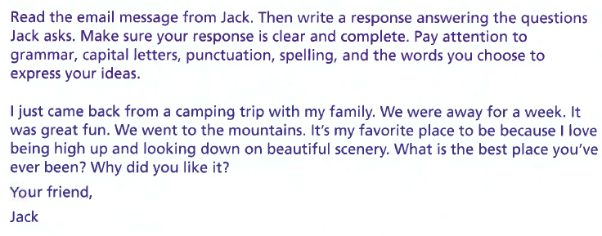
Write to Express Ideas Scoring Practice (0-4 Rubric)
Student Response | Score
He came back from camping trip whit his family. They were away for a week and went to the mountains it his favorite place to be. He looked down on beautiful scenery. This was his faverit camping trip with his family. He had a great time.
1
Response attempts to satisfy the task but relates very minimally to the prompt. Response contains some spelling errors and grammatical errors.
NOTE: although response contains a complete sentence, it cannot receive higher than a 1-point score because it only minimally address the prompt. The student recounts the letter from Jack, rather than writing a letter to Jack telling the best place he/she has ever been and why he/she liked it.

Slide 12
Write to Express Ideas Scoring Practice (0-4 Rubric)
Student Response | Score
Hey Jack, My favorite place I ever been is at Six Flags because I get to play fun games and win prizes. Also I like Six Flags because there are fun rides to get on. Also I like to go to Six Flags because you get to spend time with your family. Your friend David
4
Response expresses ideas commonly associated with highly proficient writers of English. Response contains a grammatical error (place I ever been is at). Response contains simple sentences but ideas are expressed clearly. Response answers both parts of the prompt: where and why. Overall communication is clear.

Slide 13
Write to Express Ideas Scoring Practice (0-4 Rubric)
Student Response | Score
My best place is at Mexico. I starded likin it when I was a Baby because I have al my family in Mexico.
2
Response attempts to satisfy the task, with limited expression. Response contains grammatical error (best place is at Mexico; I starded likin it; I have al my family) and spelling errors (starded, likin, al). Response may need to be read two or more time to be understood. Overall, communication is somewhat clear. Response answers both parts of the prompt: where and why.

Slide 14
Write to Express Ideas Scoring Practice (0-4 Rubric)
Student Response | Score
My favorite place was when we went to houston to visit my family last year for Thanksgiving. It was my favorite place was houston because I got to visit my aunts and uncles and cousins. I had fun because I was with my family and we laughed a lot. We had a great time there, and I hope we can come back next year.
3
Response expresses most ideas clearly but lacks the grammatical fluency of a proficient writer of English. Response contains a vocabulary error (lots); grammatical errors (It was my favorite place was Houston); incorrect verb (we can come [go] back). Response contains some repetition (my favorite place….my favorite place…). However, these errors do not interfere with communication. Overall, communication is generally clear. Response answers both parts of the prompt: where and why.

