Slide 1


preLAS Paper Administration Training
Texas

Slide 2
Agenda
  Purpose of preLAS Testing
  Program Overview
  Training Part 1: Pre-test activities (preparing to test)
  Training Part 2: Administering preLAS Paper, includes holistic scoring training
  Training Part 3: Post-test activities (Generating and Interpreting Scores)

Slide 3

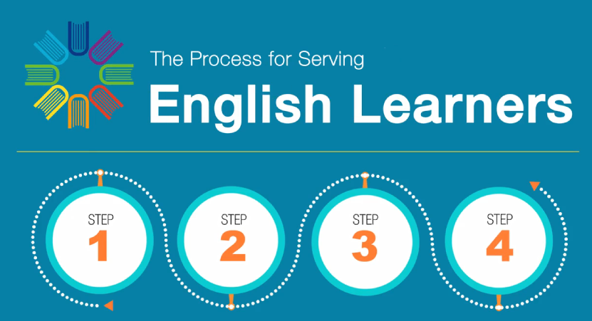
TEA Video: Process for Serving English Learners
https://www.txel.org/media/odafmp2j/english-learners-video.mp4

Slide 4
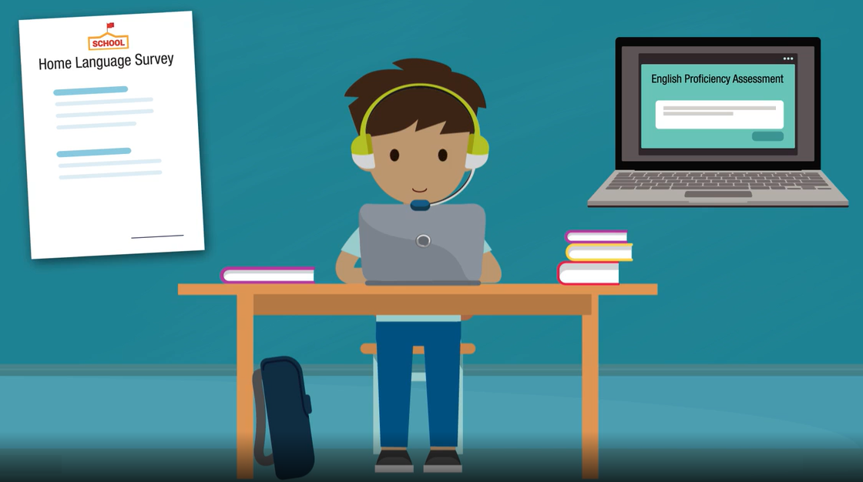
What is the LAS Battery of Assessments?
Meets the first step requirement for serving English learners (Emergent Bilinguals):
Assessing with a Proficiency Assessment

Slide 5
Texas Emergent Bilingual Identification Program Overview
Grade Level | Approved Assessment(s) for Identification:
preK3, preK4, Kindergarten | preLAS English Form C preLAS Español Form C Available in Online or Paper formats
1st Grade | LAS Links Form A Speaking and Listening Only Available in Online or Paper formats
2nd – 12th Grade | LAS Links Form A Speaking, Listening, Reading and Writing Available in Online or Paper formats
1st – 6th Grade* | LAS Links Español Form A Speaking and Listening Available in Online or Paper formats
* Spanish testing is required by the TEA when you have a bilingual program
Notes:
The Texas Education Agency, for the purpose of a Statewide Language Proficiency Test has approved the following assessments:
All preK3, preK4 and Kindergarten students who must be tested for English language proficiency are to be given the preLAS English Form C assessment as well as the preLAS Español Form C assessment when applicable.
All 1st – 12th grade students, who must be tested for English language proficiency, are to be given the LAS Links English Form A assessment
All 1st – 6th grade students, who must be tested in their primary language of Spanish, will be administered the LAS Links Español Form A assessment.

Slide 6
What is the preLAS?
The preLAS is language proficiency assessment consisting of an Oral Language component in English and Spanish for preK3-, preK4-, and Kindergarten students. Test results are used to:
    Identify and place Emergent Bilingual students in appropriate classroom settings
    Measure the developing language of first-language learners of Spanish
    Individually administered assessment
    Takes approximately 15 minutes to administer
Notes:
The preLAS is a language proficiency assessment consisting of an Oral Language component in English and Spanish for three-, four-, and five-year olds. Test results are used to: Identify and place English Language Learners (EL’s) in appropriate classroom settings and to measure the developing language of first-language learners of Spanish. The preLAS assessment is individually administered and takes approximately 15 minutes to administer.

Slide 7
  Training Part 1:
  Pre-Test Activities
  Activity 1:
  Accessing the INSIGHT portal and DRC’s Professional Learning courses

Slide 8
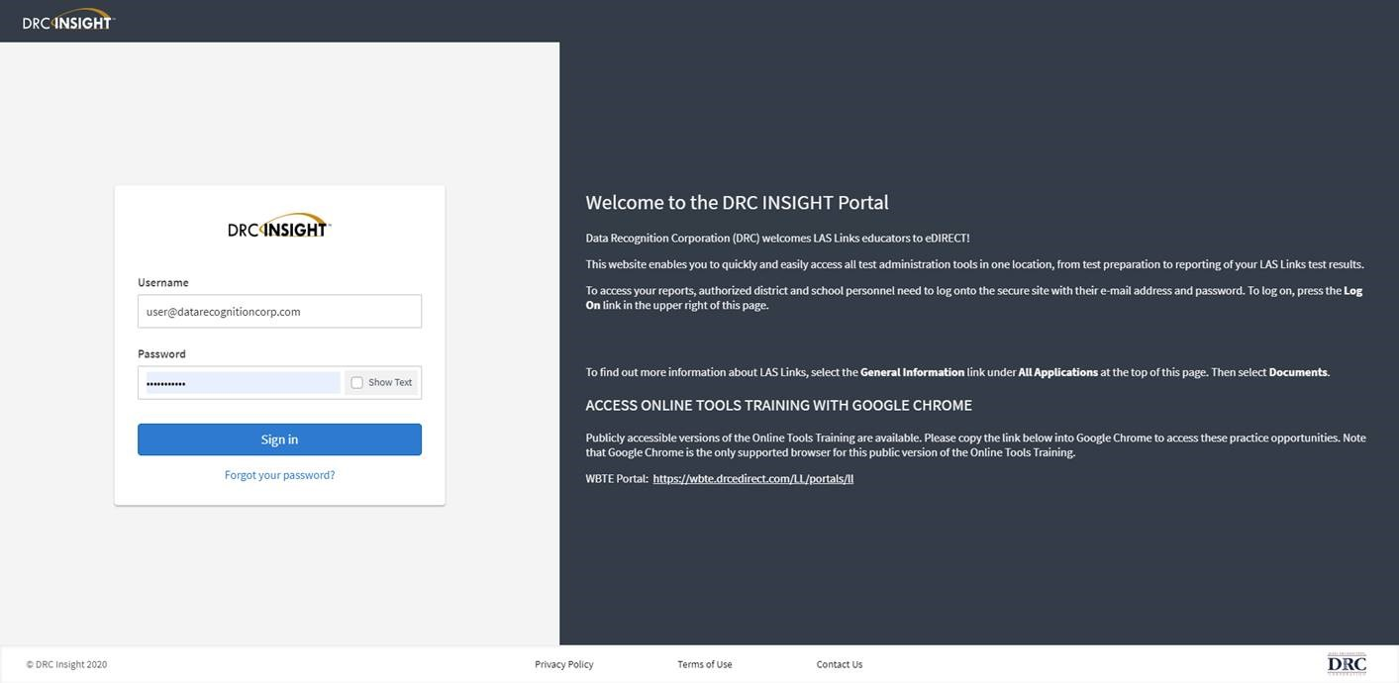
Accessing the DRC INSIGHT Portal
www.drcedirect.com
Use the INSIGHT portal for Test Administrative functions such as professional learning and accessing the preLAS audio files.
Notes:
Use the INSIGHT portal for Test Administrative functions such as professional learning and accessing the preLAS audio files.

Slide 9
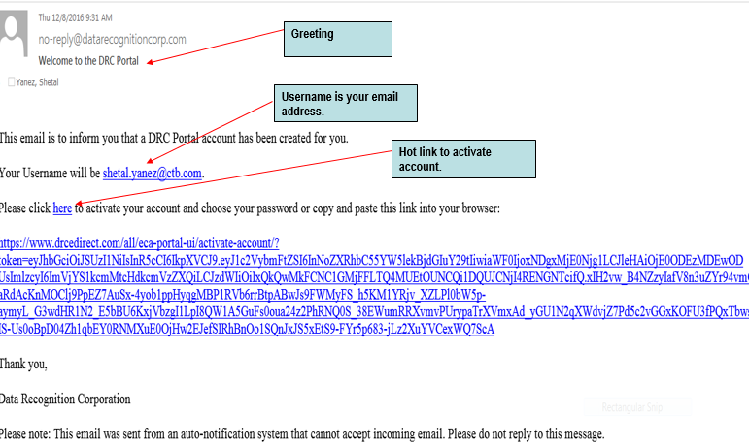
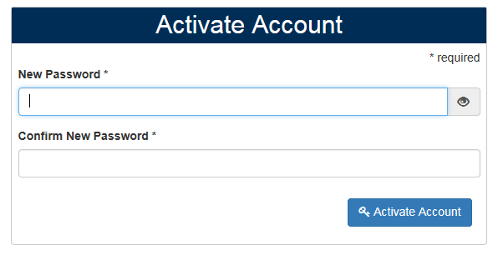
Portal Activation Email
Sent from: no-reply@datarecognitioncorp.com
Check your clutter/spam if you do not find the email in your inbox
Notes:
Your Point of Contact for your testing site should provide you access to the DRC INSIGHT Portal. Once this occurs, you will receive an Activation Email that looks like this from no-reply@datarecognitioncorp.com which provides your access. Notice that the greeting says “Welcome to the DRC Portal, “ and you are informed that your user name is your email address. Then you click on the link provided and follow the steps to activate your account.

Slide 10
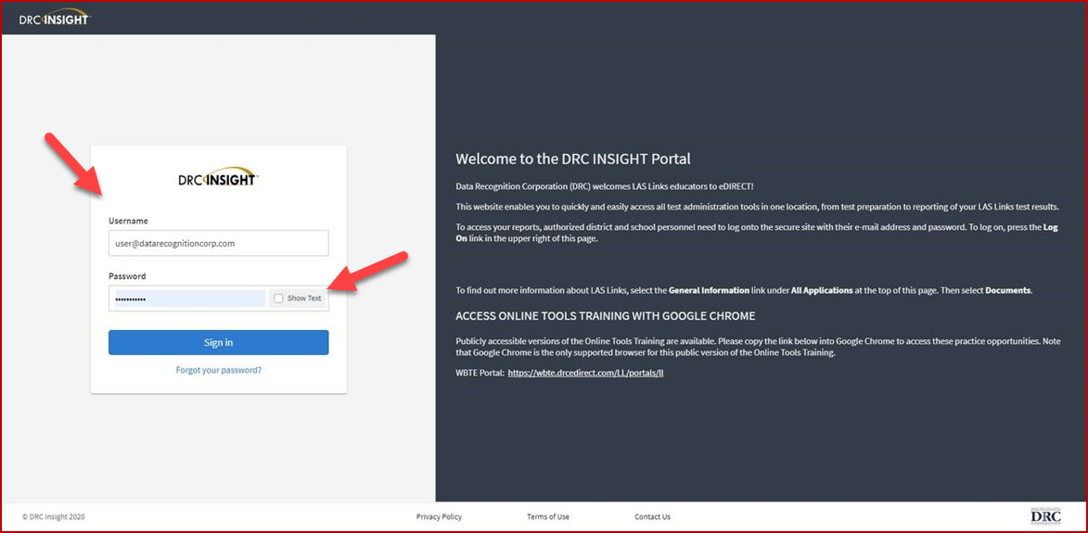
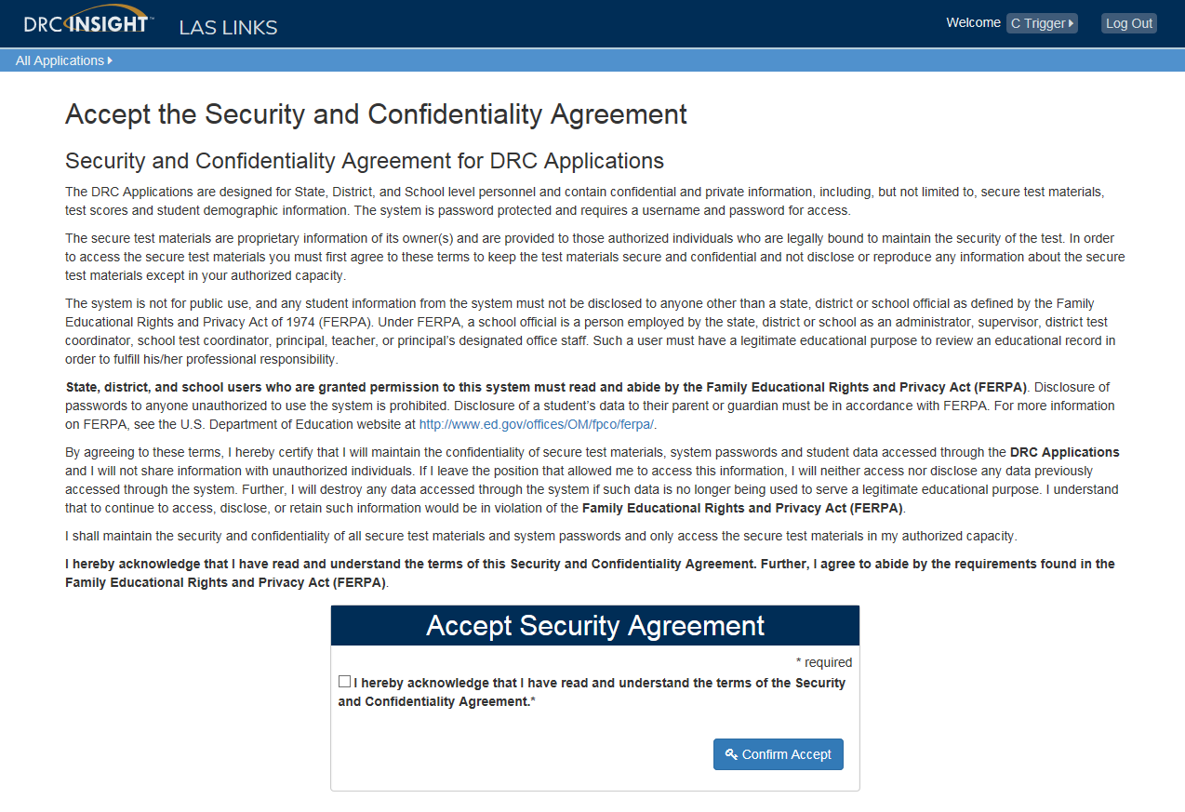
Logging into the Portal
Click on “Forgot your password?” if unable to locate your welcome email
Your Username is your email address
If the system does not recognize you as a User, please check with your LEA director who will need to add you as a User to the portal.
Notes:
If you forgot your password or didn’t activate your account within 24 hours of receiving the activation email, go to www.drcedirect.com and click on forgot your password. Your username is your email address. If the system recognizes you, you will be prompted to update your password. If the system does not recognize you as a User, please check with your LEA director who will need to add you as a User to the portal.

Slide 11
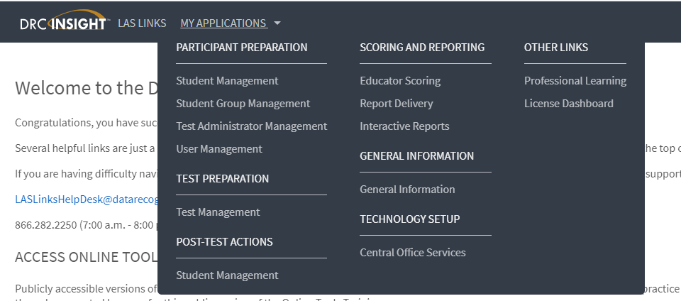
Accessing the Professional Learning Courses
Click on MY APPLICATIONS >> Professional Learning:
Notes:
Once in the portal, go to My Applications then Professional Learning

Slide 12
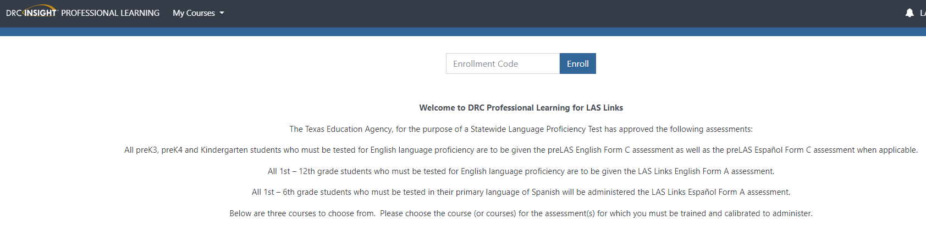
Professional Learning Courses
DRC’s Professional Learning is a system designed to provide LEAs with a single robust, integrated platform of preLAS and LAS Links training courses. This virtual training platform, available 24/7, provides 6 courses.
No enrollment code is needed. Simply scroll down the page to see all available courses.
Notes:
Once in Professional Learning, you are already enrolled so you will not need to input an enrollment code.

Slide 13
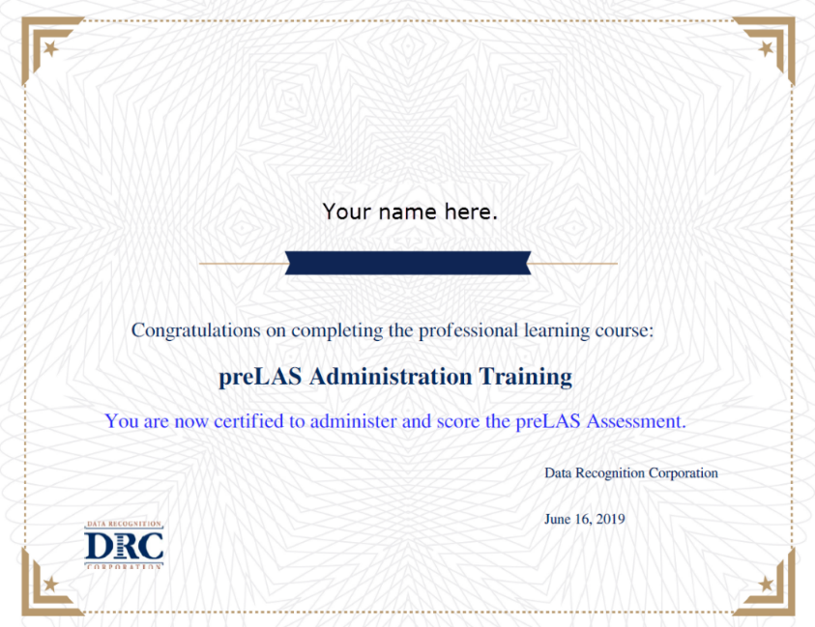
Professional Learning Courses
Each course is its own individual course so test administrators may take any or all of the courses based on their assessment assignment(s);
Test administrators will receive a certificate of calibration once they receive a 90% or better on the “check your knowledge” and “scoring calibration” quizzes associated with each course.
Notes:
Each course is its own individual course so test administrators may take any or all of the courses based on their assessment assignment(s);
Test administrators will receive a certificate of calibration once they receive a 90% or better on the “check your knowledge” and “scoring calibration” quizzes associated with each course.
After this onsite training, if you would like a certificate, please log in to Professional Learning and take the quizzes. You may skip the training videos as you will have already been trained through today’s activities, however, the videos and other resources available in the courses will help you as you navigate the quizzes.

Slide 14
  Training Part 2:
  Administering the preLAS

Slide 15
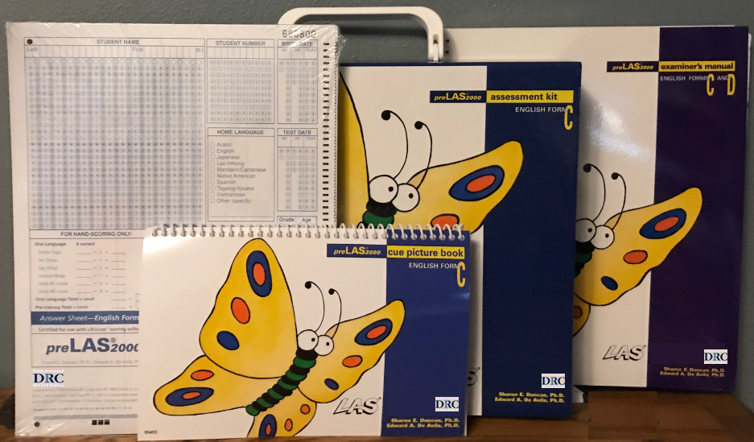
preLAS Test Materials Needed for Testing
Test Administration Kit: at a rate of one kit for every 50 students or less
50 Answer Sheets are provided in each kit
Audio CD and/or Audio Files found in INSIGHT
Examiner’s Manual: provides in-depth test directions, rubrics and scoring
Cue Picture Book: provides picture prompts to use while testing
Notes:
To administer the preLAS you will need: Test Administration Kits at a rate of one kit for every 50 students or less.
Each kit includes a cue picture book, examiner’s manual and a quick reference guide. The preLAS kit also includes a package of 50 Student Answer Sheets, an Audio CD, and a pre-literacy Game board. PreLAS answer sheets can be ordered a la carte in quantities of 10 or 50.
DRC also provides the audio files in an MP3 format. These are accessible via the INSIGHT portal.

Slide 16
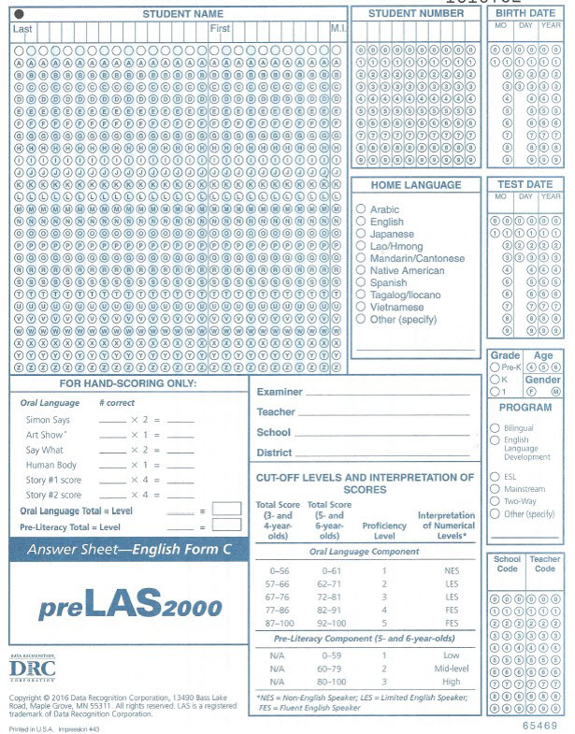
preLAS Test Materials Needed for Testing
Tabulation occurs on the front of the student answer sheet
Reports in:
  Total Score
  Proficiency Level
Notes:
The preLAS allows for easy tabulation on the front of the student answer sheet as illustrated here. There is no separate profile sheet for the preLAS. The preLAS reports in terms of total score and proficiency level.
To fill out the Student Answer Booklet, first you will need to:
Enter the student name, student ID number (if available), birthdate, test date, grade if applicable, age and gender.
There is no need to bubble under the written information as this document will not be scanned since you will be scoring onsite.
Please also provide the examiner’s name and/or teacher name (if known), School (if known) and District.
Please ask your district administration as to whether they need you to bubble in the Home Language, program, school code and/or teacher code

Slide 17
preLAS Test Components
Simon Says | Students play a game called Simon Says. The student does what Simon tells him or her to do.
Art Show | Using the Cue Picture Book, students are asked to identify the object and answer questions related to the object. What is it? What is it used for?
Say What You Hear | The student repeats what he or she hears.
The Human Body | Using the Cue Picture Book, students are asked to look at the picture and identify the body part.
Let’s Tell Stories | A student listens to a story and looks at corresponding pictures in the cue picture book. When the story is done, the student tells the examiner what happened in the story.
Notes:
The preLAS provides 5 test components to be utilized while assessing each student:
- 1st, Simon Says where Students play a game called Simon Says. The student does what Simon tells him or her to do.
- 2nd, Art Show where, using the Cue Picture Book, students are asked to identify the object and answer questions related to the object. What is it? What is it used for?
- 3rd, Say What You Hear where the student repeats what he or she hears.
- 4th, The Human body where, using the Cue Picture Book, students are asked to look at the picture and identify the body part.
- And finally, Let’s Tell Stories where students listen to two short stories while looking at corresponding pictures, and after each story is finished, the student tells the story in their own words.

Slide 18
Test Response Time
Refer to page 14 of the Examiner’s Manual
preLAS is not a timed test.
Test can be administered in several sessions.
Test can be administered in any order.
Allow 3 - 5 seconds for each response. If there is no response, prompt a second time. If there is still no response, continue to the next item.
Prompts may be said no more than twice.
Notes:
For the test response time, please turn to page 14 of your Examiner’s manual if available.
For the preLAS response time, please note the following:
PreLAS is not a timed test
Test can be administered in several sessions
Test can be administered in any order
Two most key things to note……
- Allow 3 - 5 seconds for each response. If there is no response, prompt a second time. If there is still no response, continue to the next item
- Prompts may be said no more than twice

Slide 19
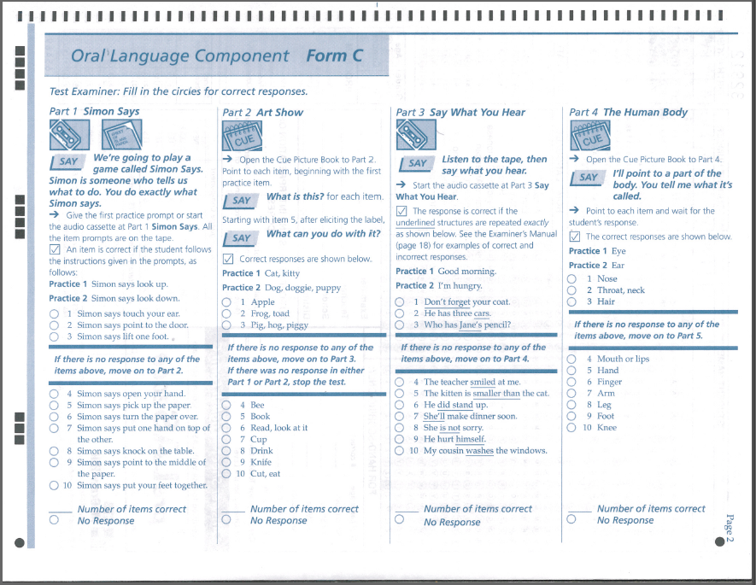
Part 1: Simon Says
For more detailed information, refer to:
  Page 14 of the Examiner’s Manual
Description: | Students play a game called Simon Says. The student does what Simon tells him or her to do.
Examples: | Simon says look up Simon says look down Simon says touch your ear
Scoring: | Using the student answer sheet, examiner fills in the circle for correct responses.
Notes:
For part 1, Simon Says, students play a game called Simon Says. The student does what Simon tells him or her to do. Read the directions exactly as written on the answer sheet “We are going to play a game called Simon Says. Simon is someone who tells us what to do. You do exactly what Simon says.” Then you can add: Now let’s try some for practice. Say to the student “Simon says look up” allow the student 3-5 seconds to respond, and if the student responds correctly by looking up, then you move on to the next practice item by saying “Simon says look down”. If the student responds correctly, say “now lets begin” and move on to number one.
If we can go back to the practice 1 item, when you prompt by saying to the student “Simon says look up” and you wait 3-5 seconds and the student doesn’t answer, you may prompt the student one more time by saying “Simon says look up”. Wait 3-5 seconds and if the student still does not respond, you say “Simon said to look up” and illustrate how to look up . Then, move on to practice 2 and prompt the student following the same protocols you followed with practice 1. Even if the student does not give correct answers to practice 1 and 2 you still move on to test item #1.

Slide 20
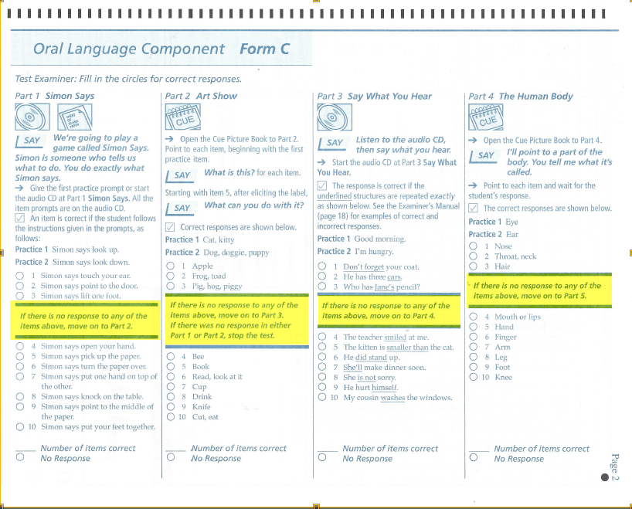
When to Stop Testing
Refer to Page 14 of the Examiner’s Manual for detailed information.
If the student has failed or does not respond to, any five consecutive items, including the practice items, stop testing in that part and move on to the next part of the test.
If the student misses or does not respond to five consecutive items in two consecutive parts, stop the test.
Notes:
Federal and state guidelines state that students to be assessed with a language proficiency test must be given the opportunity to be assessed; therefore, you must administer practice 1, practice 2, items 1-3 before you can make a decision regarding stopping that section of the test and moving on to part 2 of the test. If the student misses, or does not respond to practice 1, practice 2, and items 1-3, you may move on to the next section of Art Show. If the student misses or does not answer practice 1, practice 2, and 1-3 in Art Show, you may stop the test. To stop the test, the student must miss 5 consecutive items in 2 consecutive parts. So, if a student misses 5 consecutive items in Simon Says, but then does not miss 5 consecutive items in the very next part of the test, you may not stop the test.
For more information on When to Stop Testing, please refer to page 14 of the Examiner’s manual

Slide 21

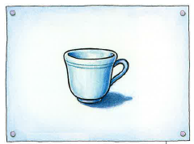
Part 2: Art Show
Refer to Page 16 of the Examiner’s Manual for detailed information.
Description: | Using the Cue Picture Book, students are asked to identify the object and answer questions related to the object. What is it? What is it used for?
Examples:
Scoring: | Using the student answer sheet, fill in the circle for correct responses
Notes:
For Art show use the Cue Picture Book, point to each picture and ask what is it in items 1-4 and both what is it and what is it used for in items 5-10.
If the student answers in a language other than English, you say, “remember, tell me in English, what is this?” – this serves as the second and last time to prompt for this item. Even if the student’s response in another language is correct, it is not counted as correct since it is not in the language of the test being administered.

Slide 22
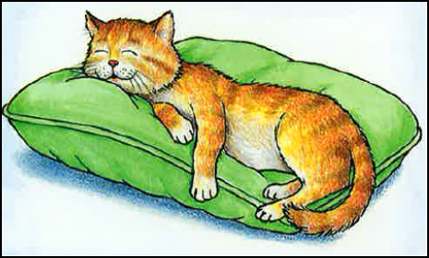
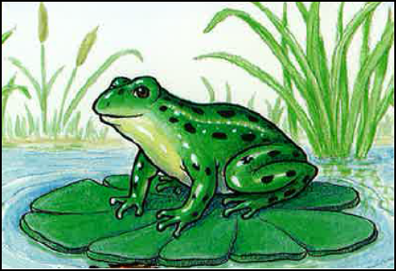
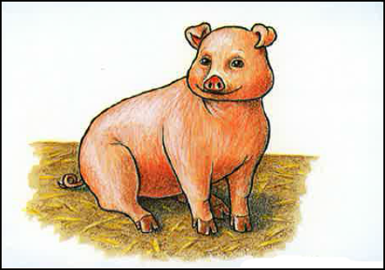



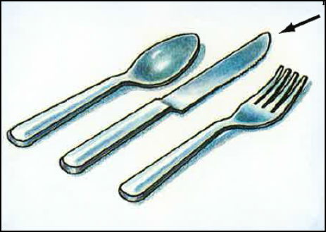
Part 2: Art Show Cue Pictures
Notes:
Here are all of the preLAS cue pictures for Art Show.
ONSITE TRAINER: since the participants may not all have cue picture books to reference, you may utilize these pictures in the TOT workshop.
DISTRICT ONSITE TRAINER: During your District training, please provide your participants with the cue picture books so that they may practice administering this section to each other.

Slide 23
Part 3: Say What You Hear
Refer to Page 18 of the Examiner’s Manual for detailed information.
Description: | The student repeats what he or she hears.
Examples: | Don’t forget your coat The principal looked at me My cousin washes the windows
Scoring: | The response is correct if the underlined structures are repeated exactly as shown in the examiner’s manual.
Notes:
In Part 3, say what you hear, the student repeats what he or she hears. You may either utilize the audio cd and/or the audio files located in the INSIGHT portal to administer the prompt OR you may prompt the student yourself which is the method most commonly utilized.

Slide 24
Say What You Hear Examples
Page 18 of the Examiner’s Manual
Prompt | Structure Tested | Correct Responses | Incorrect Responses
Don’t forget your coat. | negative command | Don’t forget your coat. Don’t forget you coat. | No forget your coat.
The principal looked at me. | past tense | The principal looked at me. The principal looked me. | The principal look me. The principal look at me.
My cousin washes the windows. | Third person singular, present tense | My cousin washes the windows. My cousin washes the floor. | My cousin wash the windows.
Notes:
On page 18 of the examiner’s manual, you will find correct and incorrect responses for the underlined portion of the sentence. This is not a pronunciation component but rather did they use the correct word?, correct tense?, etc.
For Don’t forget your coat, they can say, don’t forget your hat and it will be considered correct because they got the underlined portion of the sentence correct. If they say, don forget, with out pronouncing the t, it is still correct. Incorrect is if they changed the negative “don’t” to “no” by saying “no forget your coat”. Again, this is not measuring pronunciation. Another example is “My cousin washes the windows” if the student responds with “my cousin watches the windows” it is considered a correct response.

Slide 25
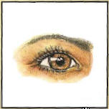
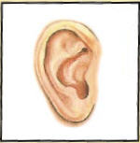
Part 4: The Human Body
Refer to Page 20 of the Examiner’s Manual for detailed information.
Description: | Using the Cue Picture Book, students are asked to look at the picture and identify the body part
Examples:
Scoring: | Using the student answer sheet, fill in the circle for correct responses
Notes:
For Part 4, Human Body, using the cue picture book, point to pictures of body parts and ask “what is this” for each picture. In order to maintain standardization of the assessment, do NOT point to your own eyes, ears, you own finger or hands, etc. Always point to the pictures in the cue picture book only.

Slide 26

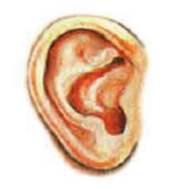
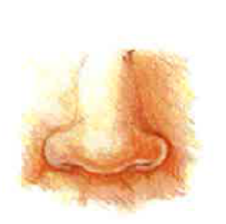
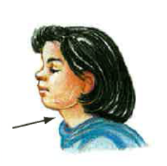
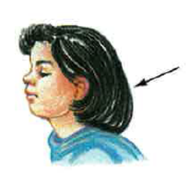
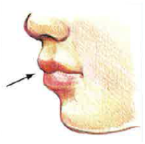
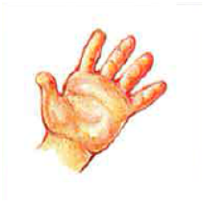
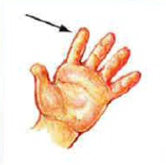
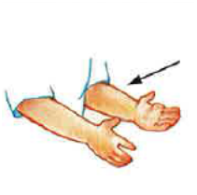
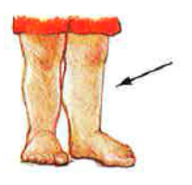
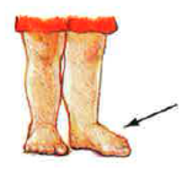
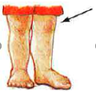
Part 4: The Human Body Prompts
p1
p2
1
2
3
4
5
6
7
8
9
10
Notes:
Here are all of the preLAS cue pictures for The Human Body.
ONSITE TRAINER: since the participants may not all have cue picture books to reference, you may utilize these pictures in the TOT workshop.
DISTRICT ONSITE TRAINER: During your District training, please provide your participants with the cue picture books so that they may practice administering this section to each other.

Slide 27
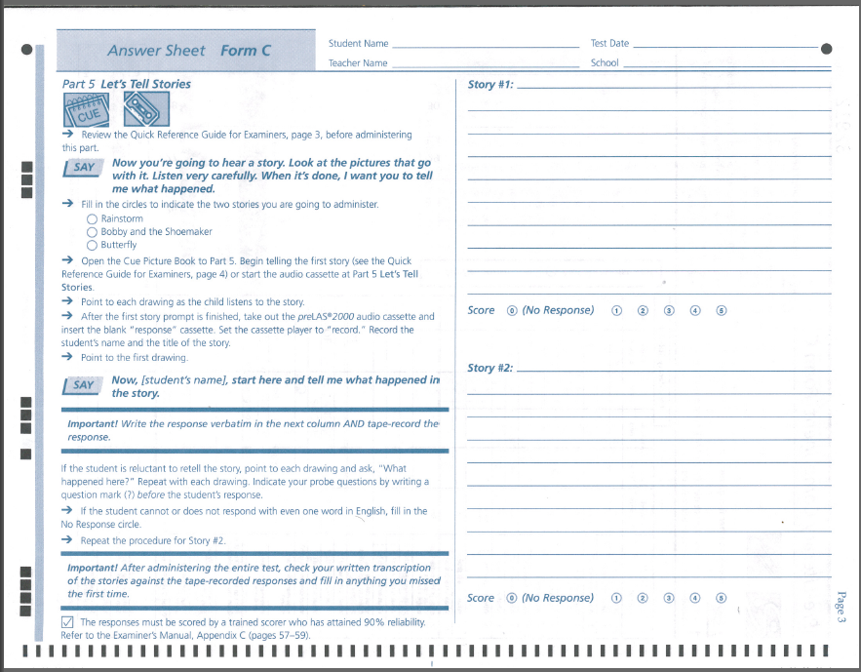
Part 5: Let’s Tell Stories
Refer to Page 21 of the Examiner’s Manual for detailed information.
For documentation purposes, be sure to transcribe the student answers in the appropriate area on the student answer sheet.
Description: | Using the audio cd, audio files or reading the stories from the Quick Reference Guide, students listen to a story and look at corresponding pictures in the cue picture book. When the story is done the student tells the examiner what happened in the story.
Scoring: | The responses are holistically scored based on the rubric found in the Examiner’s Manual
Notes:
On the next page of the student answer sheet is part 5: Let’s Tell Stories. Using the audio cd, audio files, or reading the stories from the Quick Reference Guide, students listen to a story and look at corresponding pictures in the cue picture book. When the story is done, the student tells the examiner what happened in the story. Repeat the process for story number 2. The responses are holistically scored based on the rubric found in the Examiner’s Manual.
Please note, this is purely a language test so students do NOT have to repeat the story exactly as played to them nor do they need to include every detail. When analyzing the student response, you should only consider “how well did the student tell me what he told me, in English?” Students at this age tend to go off on tangents but as long as they start with the story provided to them, you should ask yourself, how well did they tell you, whatever they told you, in English (or Spanish if you are giving the Spanish form of the test)?
For documentation purposes, be sure that you transcribe the student answers in the appropriate area on the student answer sheet.

Slide 28
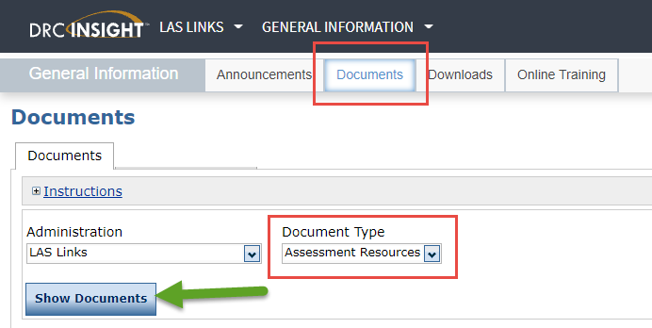
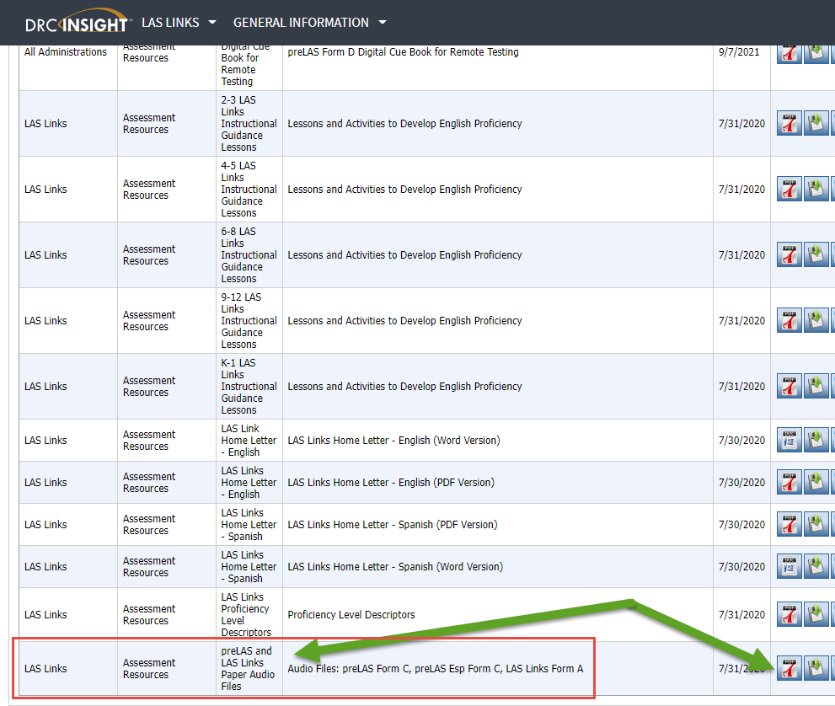
Accessing the Audio Files

Slide 29
  Training Part 2:
  Administering the preLAS
  Holistically Scoring
  Part 5: Let’s Tell Stories

Slide 30
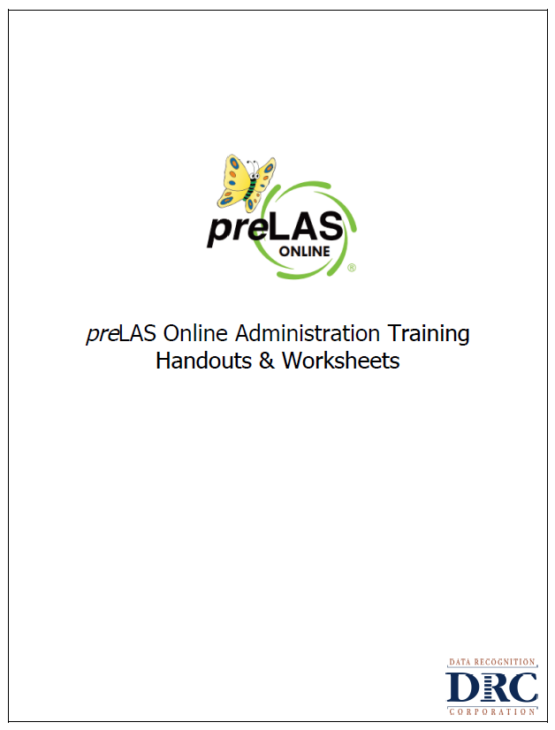
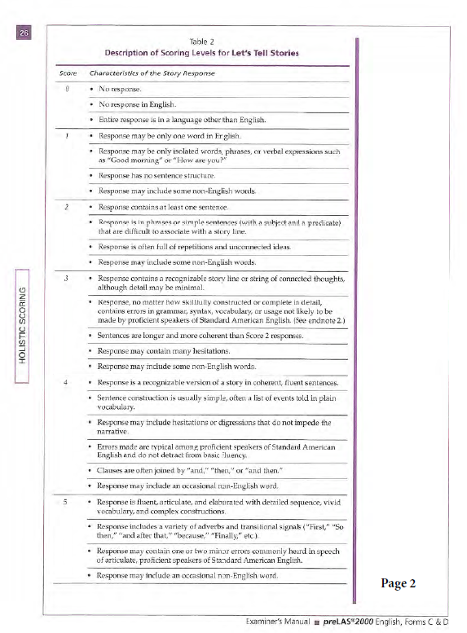
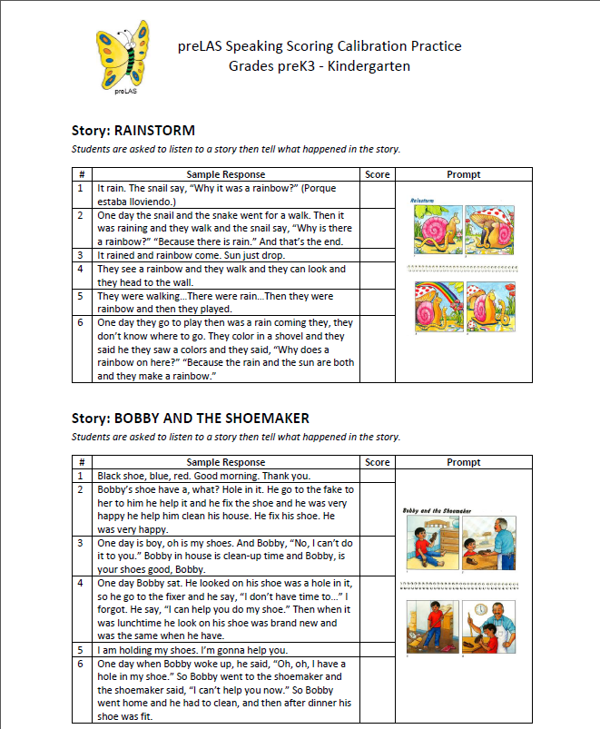
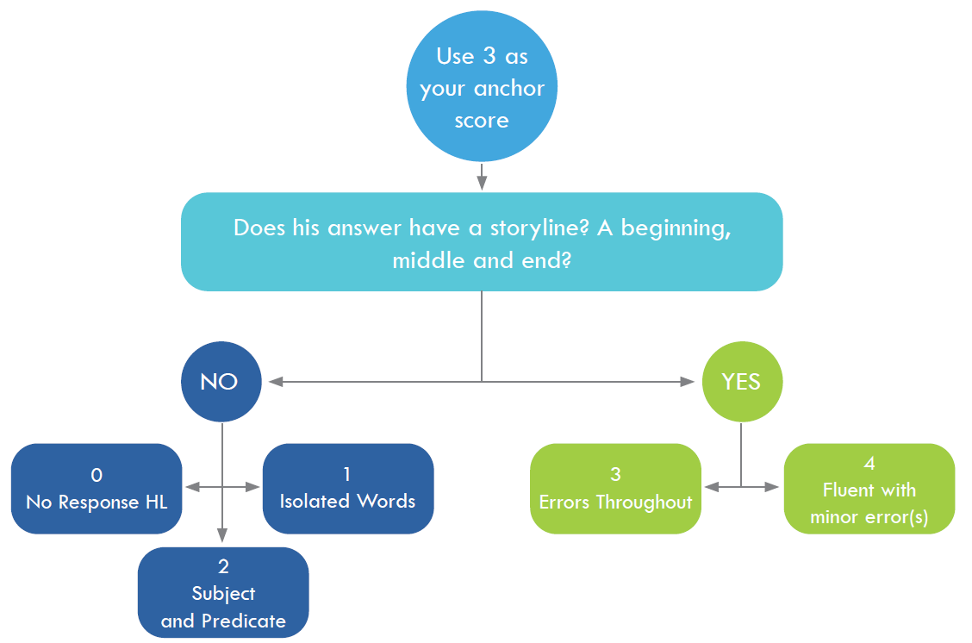
Handouts and Worksheets

Slide 31
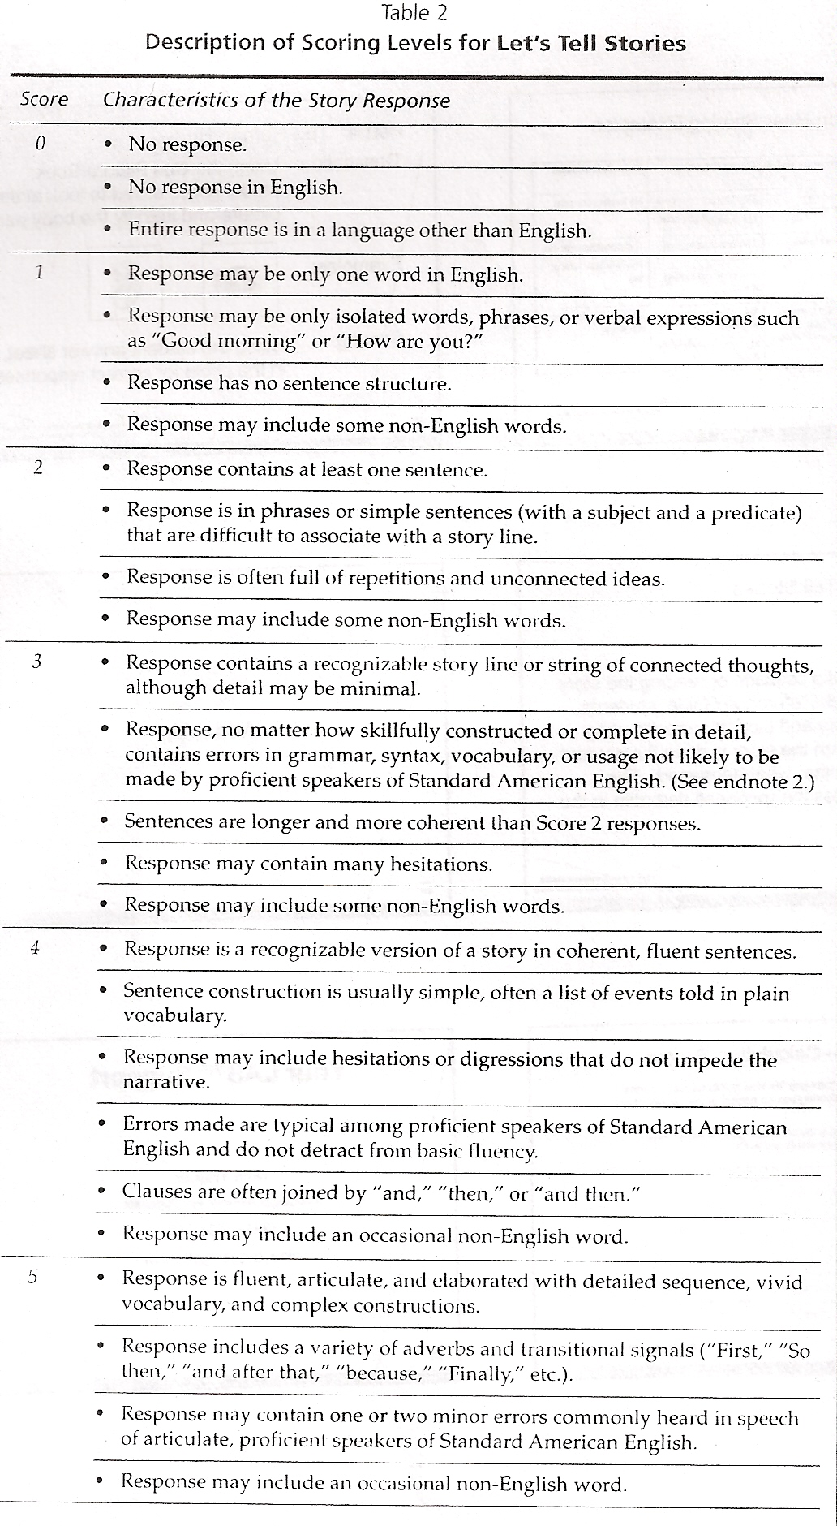
Scoring Rubric
“I don’t know”
Isolated Words
Is there a storyline?
Yes = 3, 4 or 5
No = 2, 1, or 0
Are there errors throughout?
Yes = 3
No = 4 or 5
Fluent

Slide 32
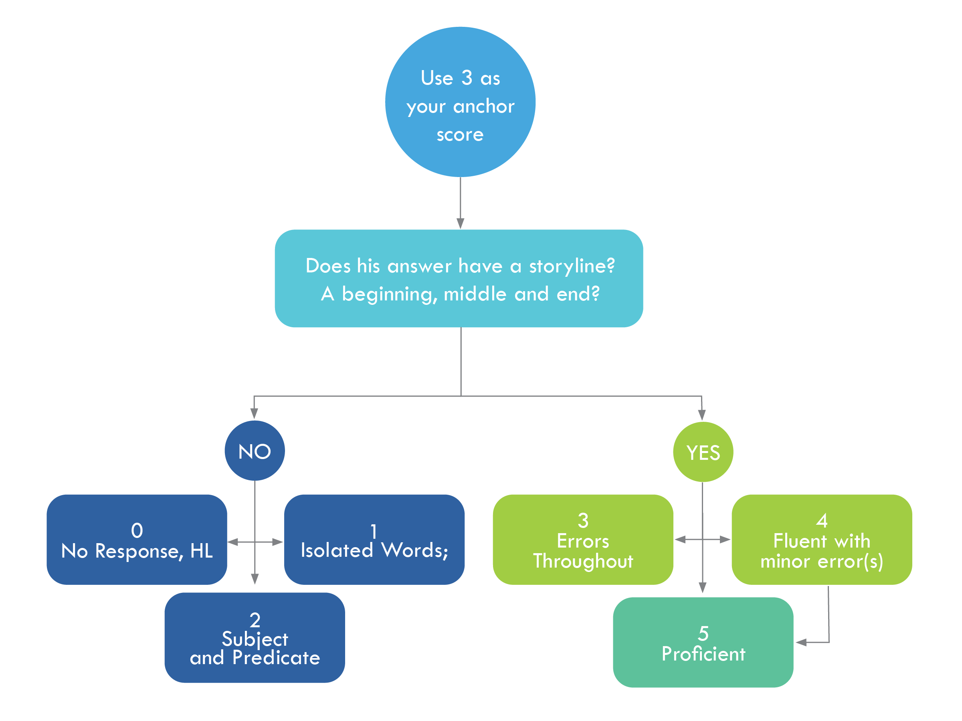
Let’s Tell Stories – Flow Chart

Slide 33
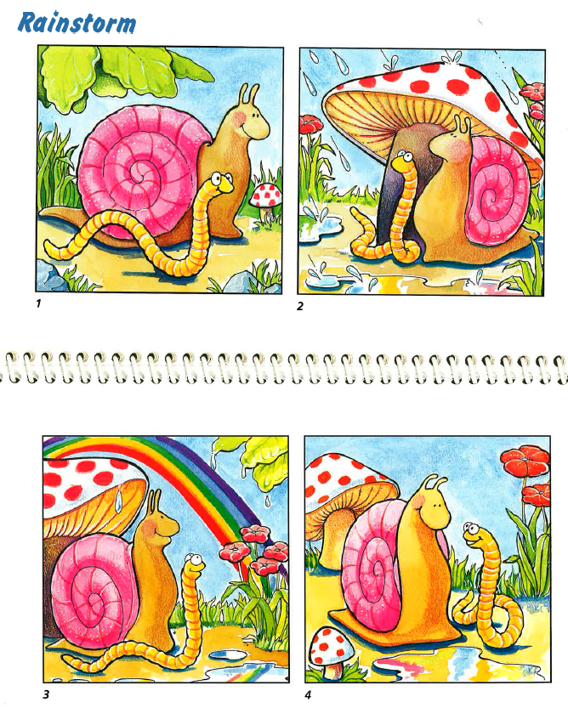
Let’s Tell Stories – Scoring Practice
Story: Rainstorm
Students are asked to listen to a story then tell what happened in the story.
Student | Sample Response | Score
1 | It rain. The snail say, “Why it was a rainbow?” (Porque estaba lloviendo.)
2 | One day the snail and the snake went for a walk. Then it was raining and they walk and the snail say, “Why is there a rainbow?” “Because there is rain.” And that’s the end.
3 | It rained and rainbow come. Sun just drop.
4 | They see a rainbow and they walk and they can look and they head to the wall.
5 | They were walking…There were rain…Then they were rainbow and then they played.
6 | One day they go to play then was a rain coming they, they don’t know where to go. They color in a shovel and they said he they saw a colors and they said, “Why does a rainbow on here?” “Because the rain and the sun are both and they make a rainbow.”
2
4
2
2
3
3

Slide 34
Training Part 3:
Post Test Activities
Tabulating, Reporting and Interpreting the preLAS Scores

Slide 35
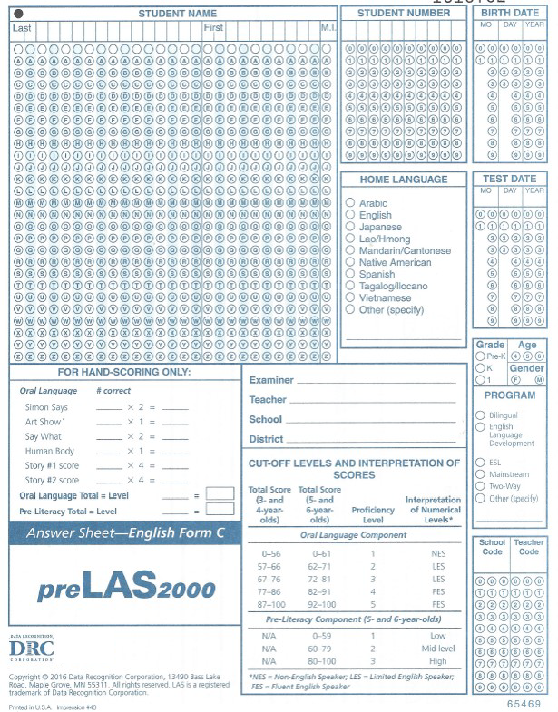
Step 1: transfer the number correct from each section of the test to the front of the answer document. Do the math and calculate the total(s).
Step 2: using the Cut-Off Levels and Interpretation of Scores, the examiner finds the Total Score range.
Step 3: The examiner then finds the corresponding Age Range column: 3- and 4 year olds or 5 year olds.
Step 4: Find the total score in the range of scores, once found, look to the right of the range to find the corresponding proficiency level.
Notes:
The preLAS allows for easy tabulation on the front of the student answer sheet as illustrated here. The preLAS reports in total score and proficiency level.
The first step in tabulating the student proficiency score is to count up the number of items correct from parts 1-5 and transfer those scores from each part to the front of the answer sheet. Do the multiplication across to the right of the number correct, then add up the Oral Language Total and add that to the line.
Step 2: using the Cut-Off Levels and Interpretation of Scores, the examiner finds the Total Score range.
Step 3: The examiner then finds the corresponding Age Range column: 3- and 4 year olds or 5 year olds.
Step 4: Find the total score in the range of scores, once found, look to the right of the range to find the corresponding proficiency level.

Slide 36
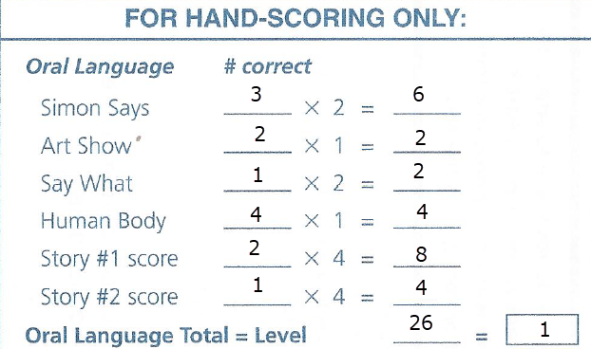
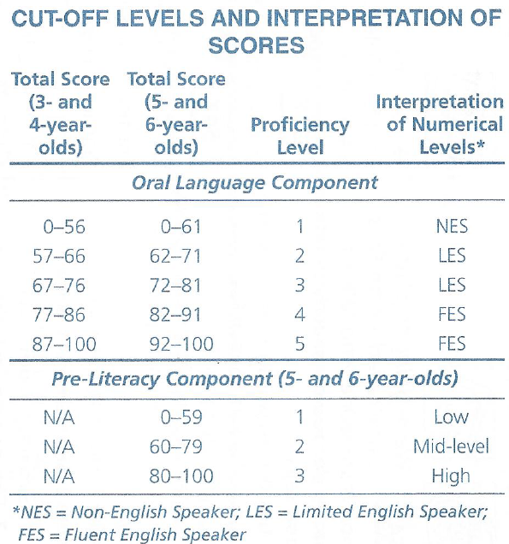
Example, if a 5-year-old received a total score of 26:
find 26 in the range of 0-56,
look to the proficiency level column to the right to find that the range is a Proficiency Level 1,
write “1” in the corresponding Oral Language Level box.
Notes:
For example, if a 5-year-old received a total score of 26, you would find 26 in the range of 0-56, look to the proficiency level column to find that the range is
Proficiency Level 1 then write 1 in the corresponding Oral Language Level box.
This sample student, because they are an Oral Language Proficiency Level of a 1, is considered an English learner.

Slide 37
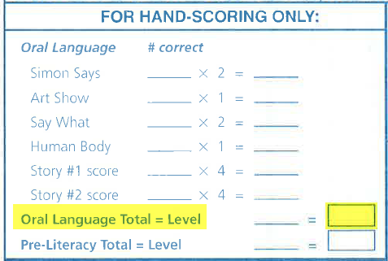
Scores Used to Determine Proficiency
The preLAS reports in 5 proficiency levels.
The chart below provides the scores, that per State and Federal Guidelines, are used to determine proficiency for preK3, preK4 and Kindergarten students:
Per State Guidelines
preK3, preK4, Kindergarten | If a student receives a 1, 2 or 3 Oral Language proficiency level, they are to be classified as an Emergent Bilingual. If a student receives a 4 or 5 Oral Language proficiency level – they are to be considered Fluent - not to be identified as an Emergent Bilingual.
Notes:
To make the determination on English Learner status for preK3, preK4 and Kindergarten students, per the State and Federal Guidelines:
If a student receives a 1, 2 or 3 Oral Language proficiency level, they are to be classified as an English learner (EL).
If a student receives a 4 or 5 Oral Language proficiency level – they are to be considered Fluent - not to be identified as an English learner.
Now I will show you how to tabulate the Oral Language Proficiency Level for preLAS

Slide 38
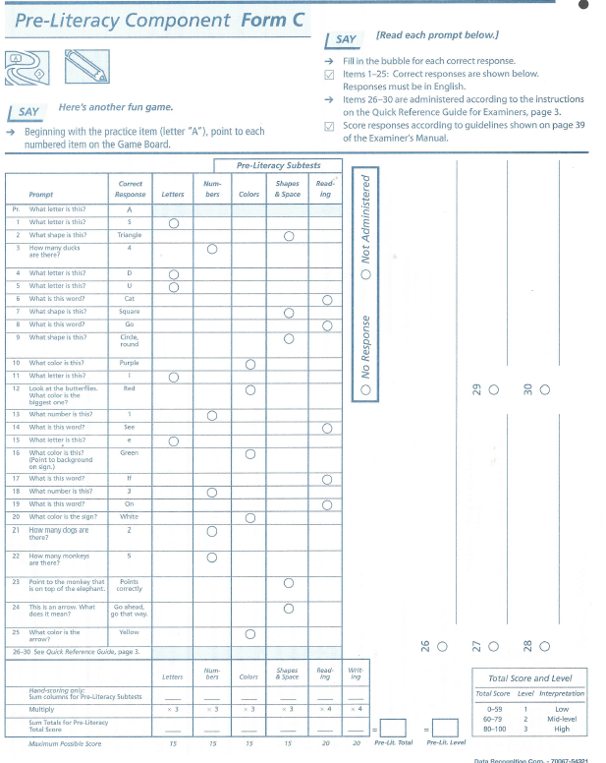
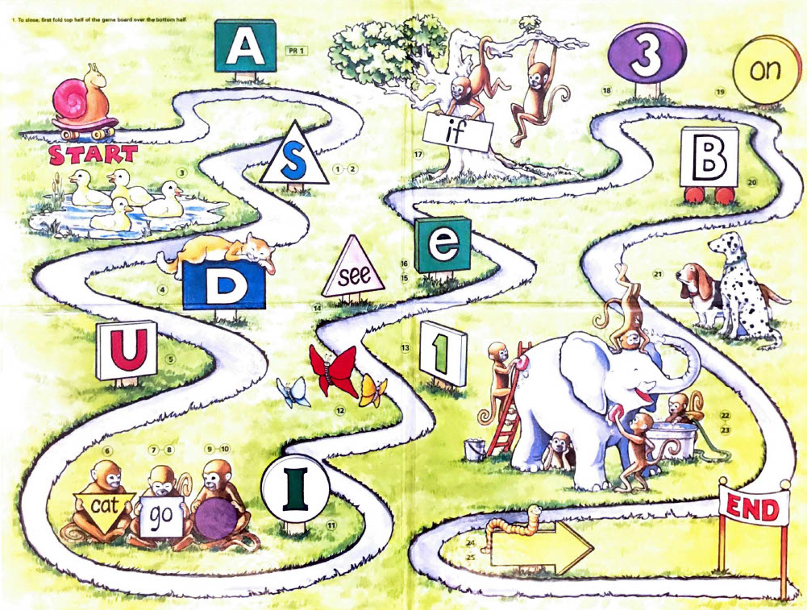
preLAS Pre-Literacy Component
The pre-literacy component is available on the back of the test and is an optional component, but it
DOES NOT FACTOR INTO EMERGENT BILINGUAL IDENTIFICATION
Notes:
Finally, the pre-literacy component, while available on the answer sheet and in the kit, is an optional component for each LEA, BUT IT DOES NOT FACTOR INTO EB IDENTIFICATION.

Slide 39
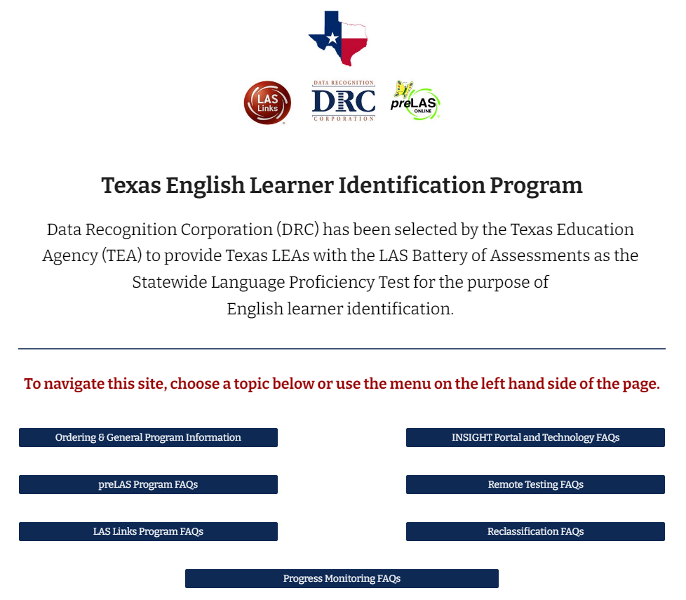
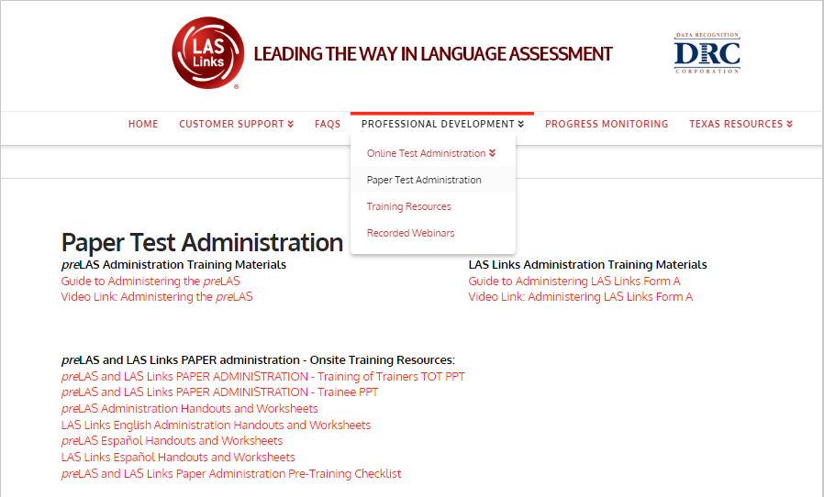

Resources: www.LASLinks.com/Texas
Training PPTs, Guidance Documents and Videos
FAQS
Parent and Teacher Resources
And more….

Slide 40

Support

